Slide 1

Tulip es4/eS2 Fire room test
Test date 2024/1/3 – 2024/1/11

Slide 2
Test Result
Tulip AC and DC model implements 6 smoldering tests in GST and passed all. Prove that the smoke entry design is good and does not block the entry of smoke.
 | Run 01 | Run 02 | Run 03 | Run 04 | Run 05 | Run 06
AC ES4-2 | PASS | PASS | PASS | PASS | PASS | PASS
DC ES2-2 | PASS | PASS | PASS | PASS | PASS | PASS
DC New cover | PASS | PASS | PASS | PASS | PASS | PASS

Slide 3
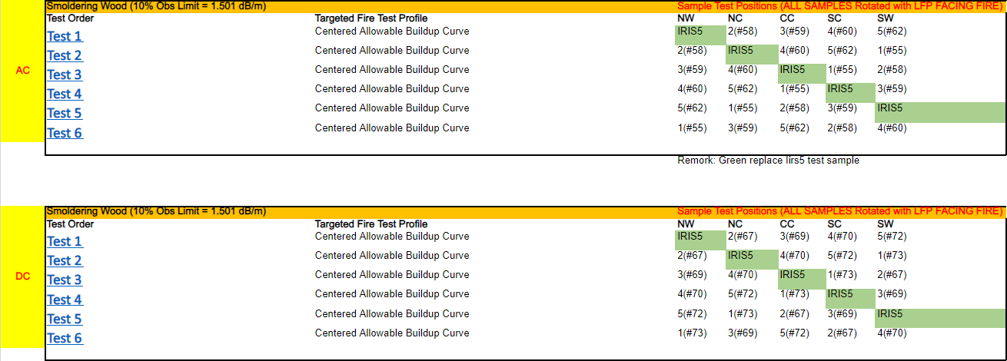
Test Plan

Slide 4
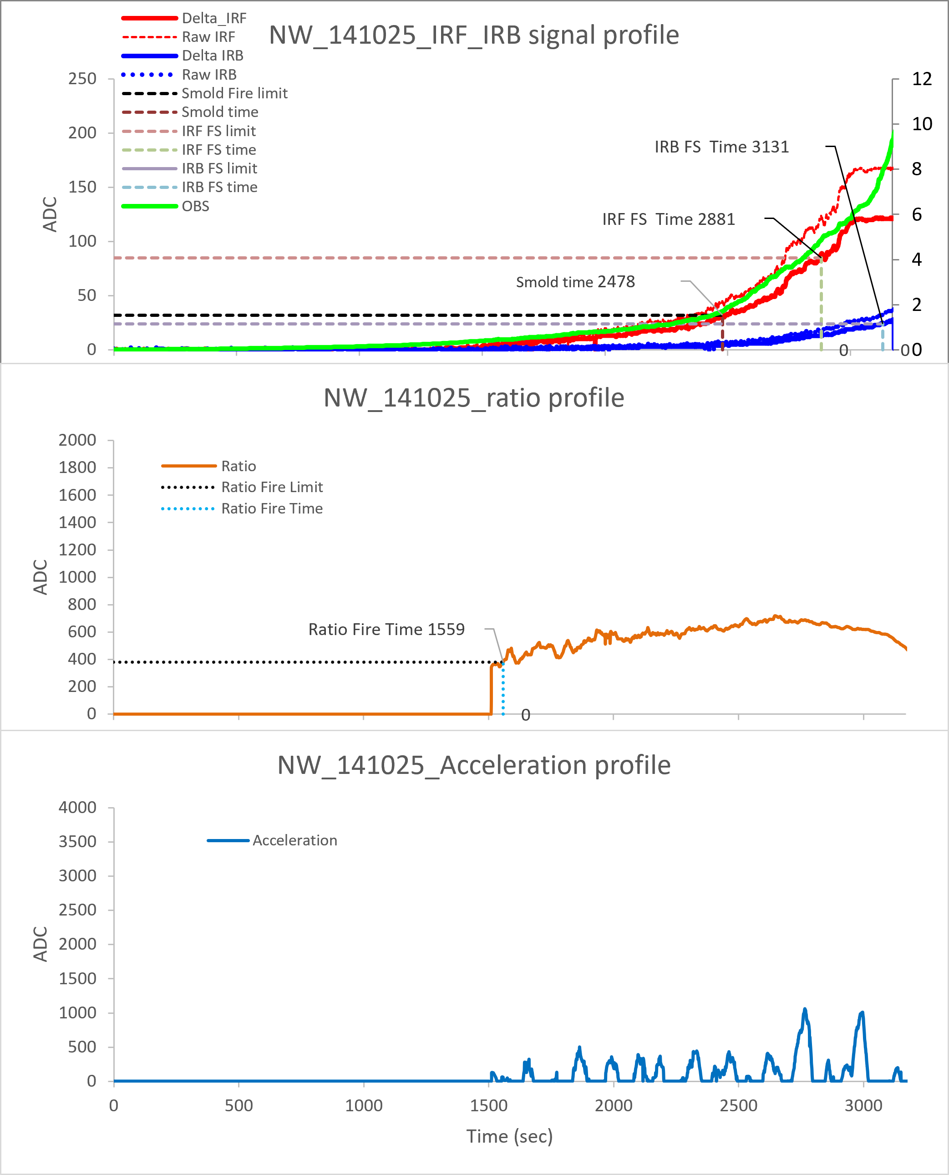
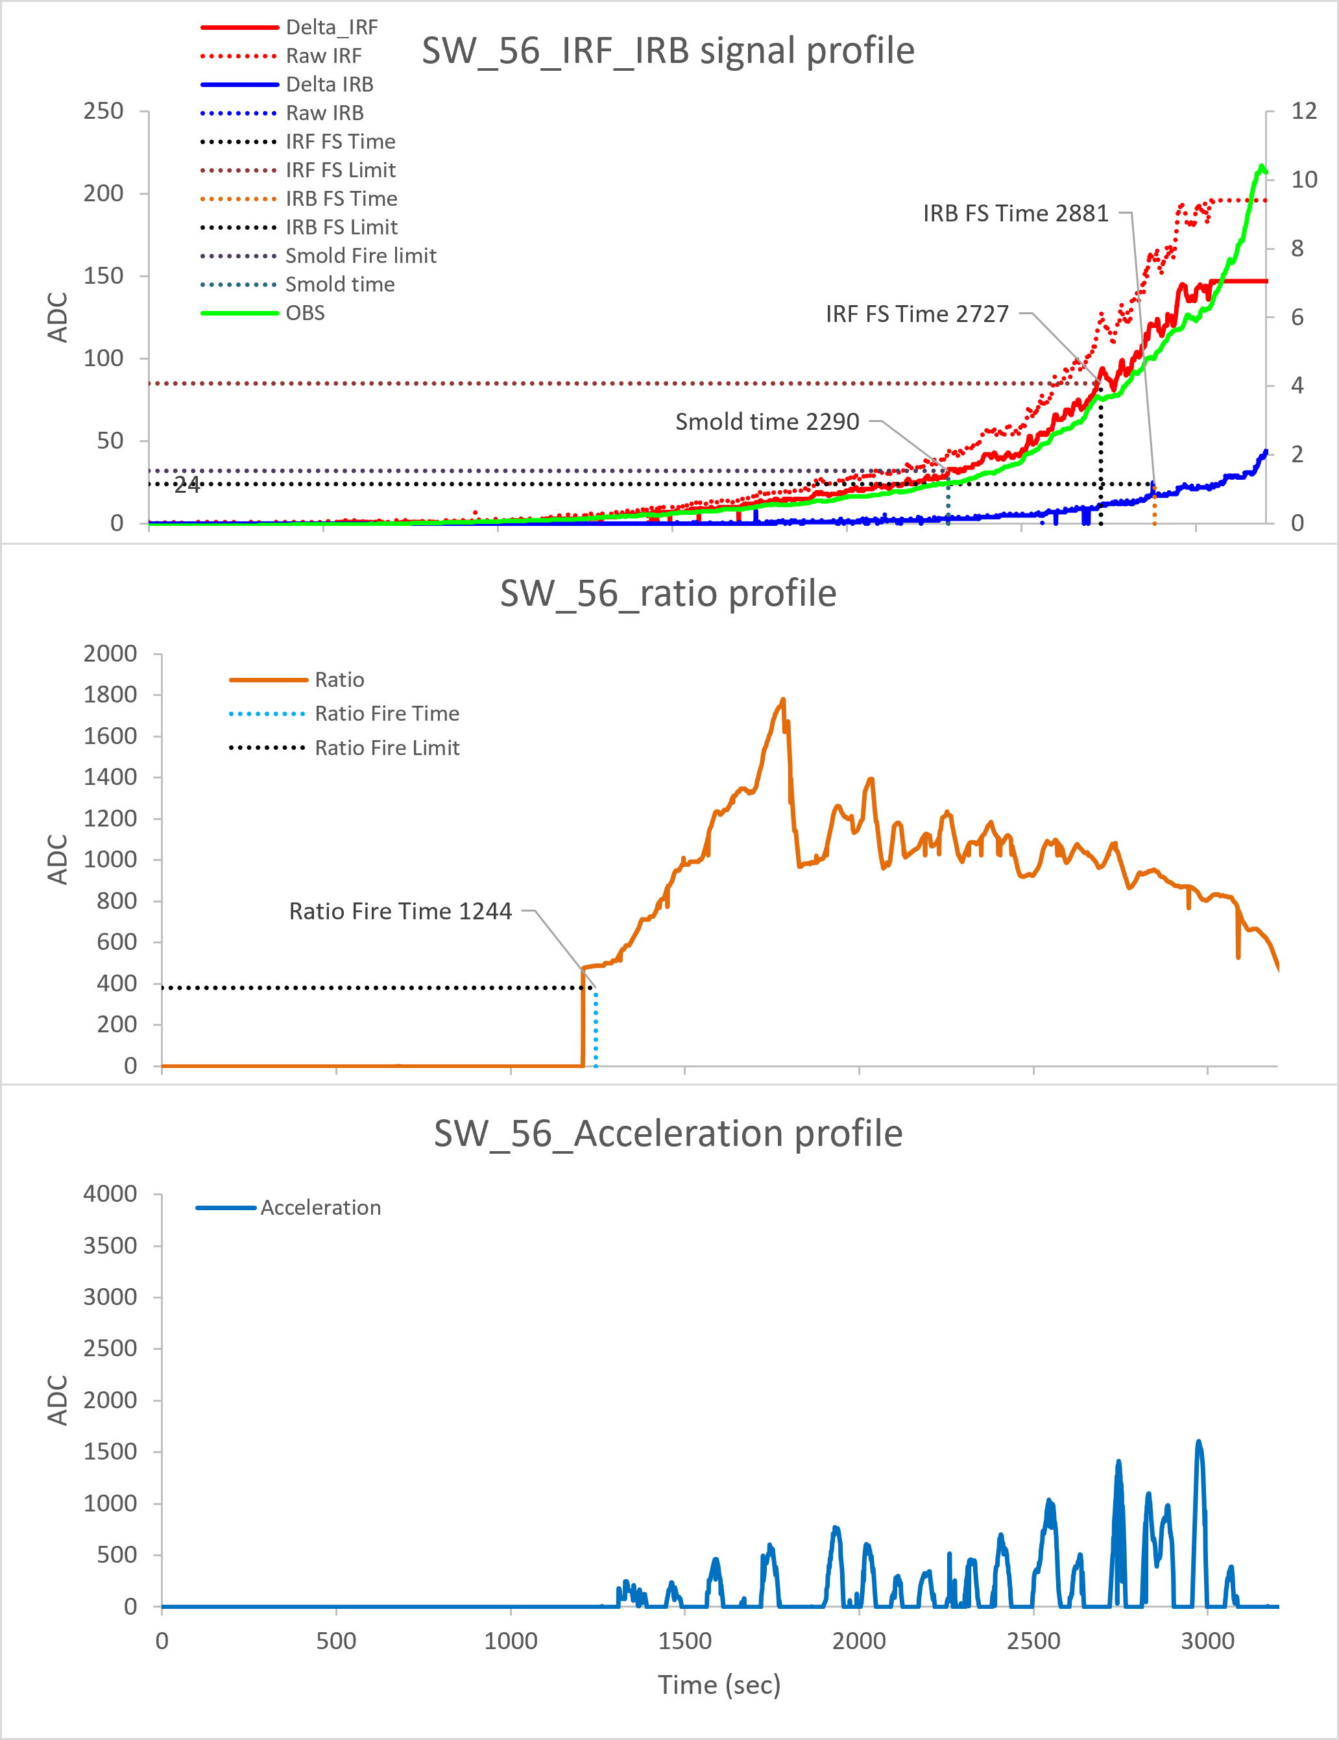
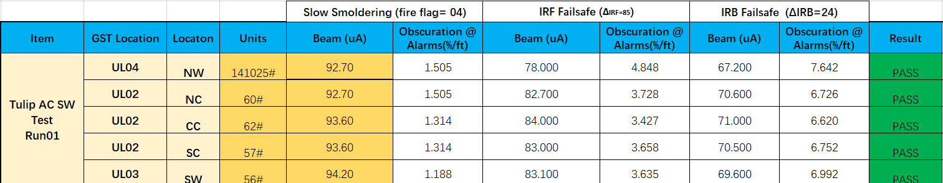
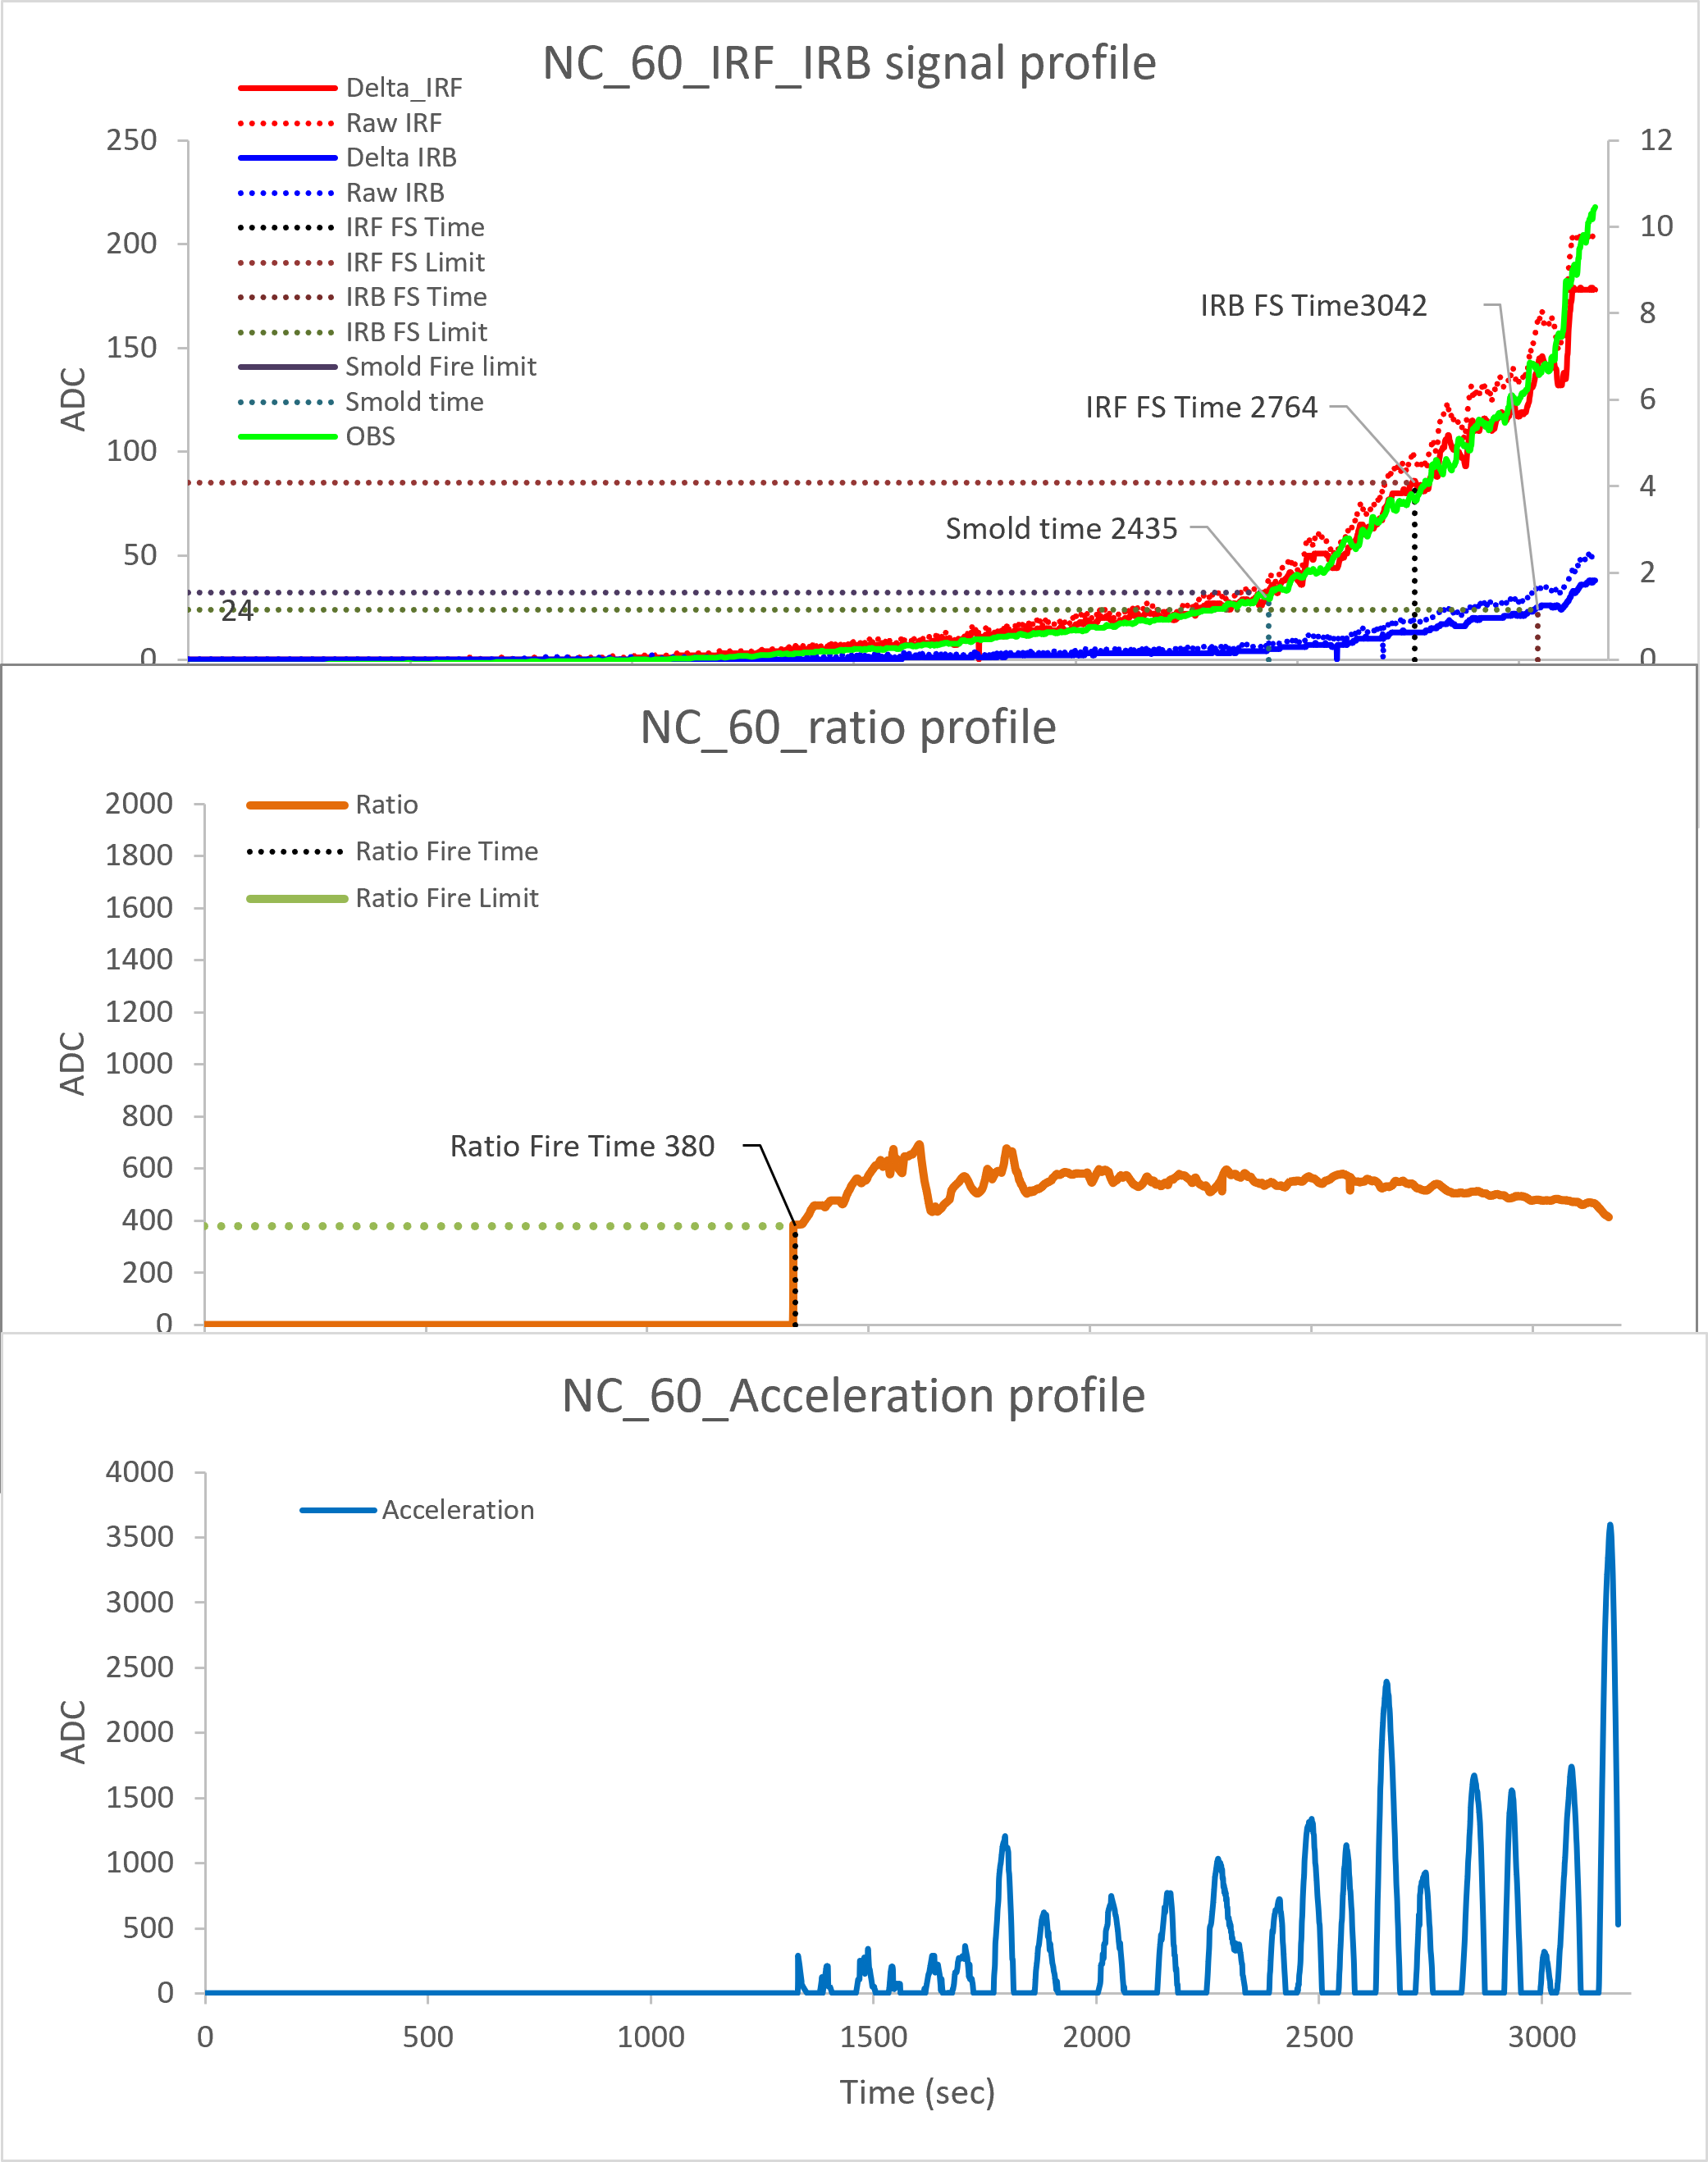
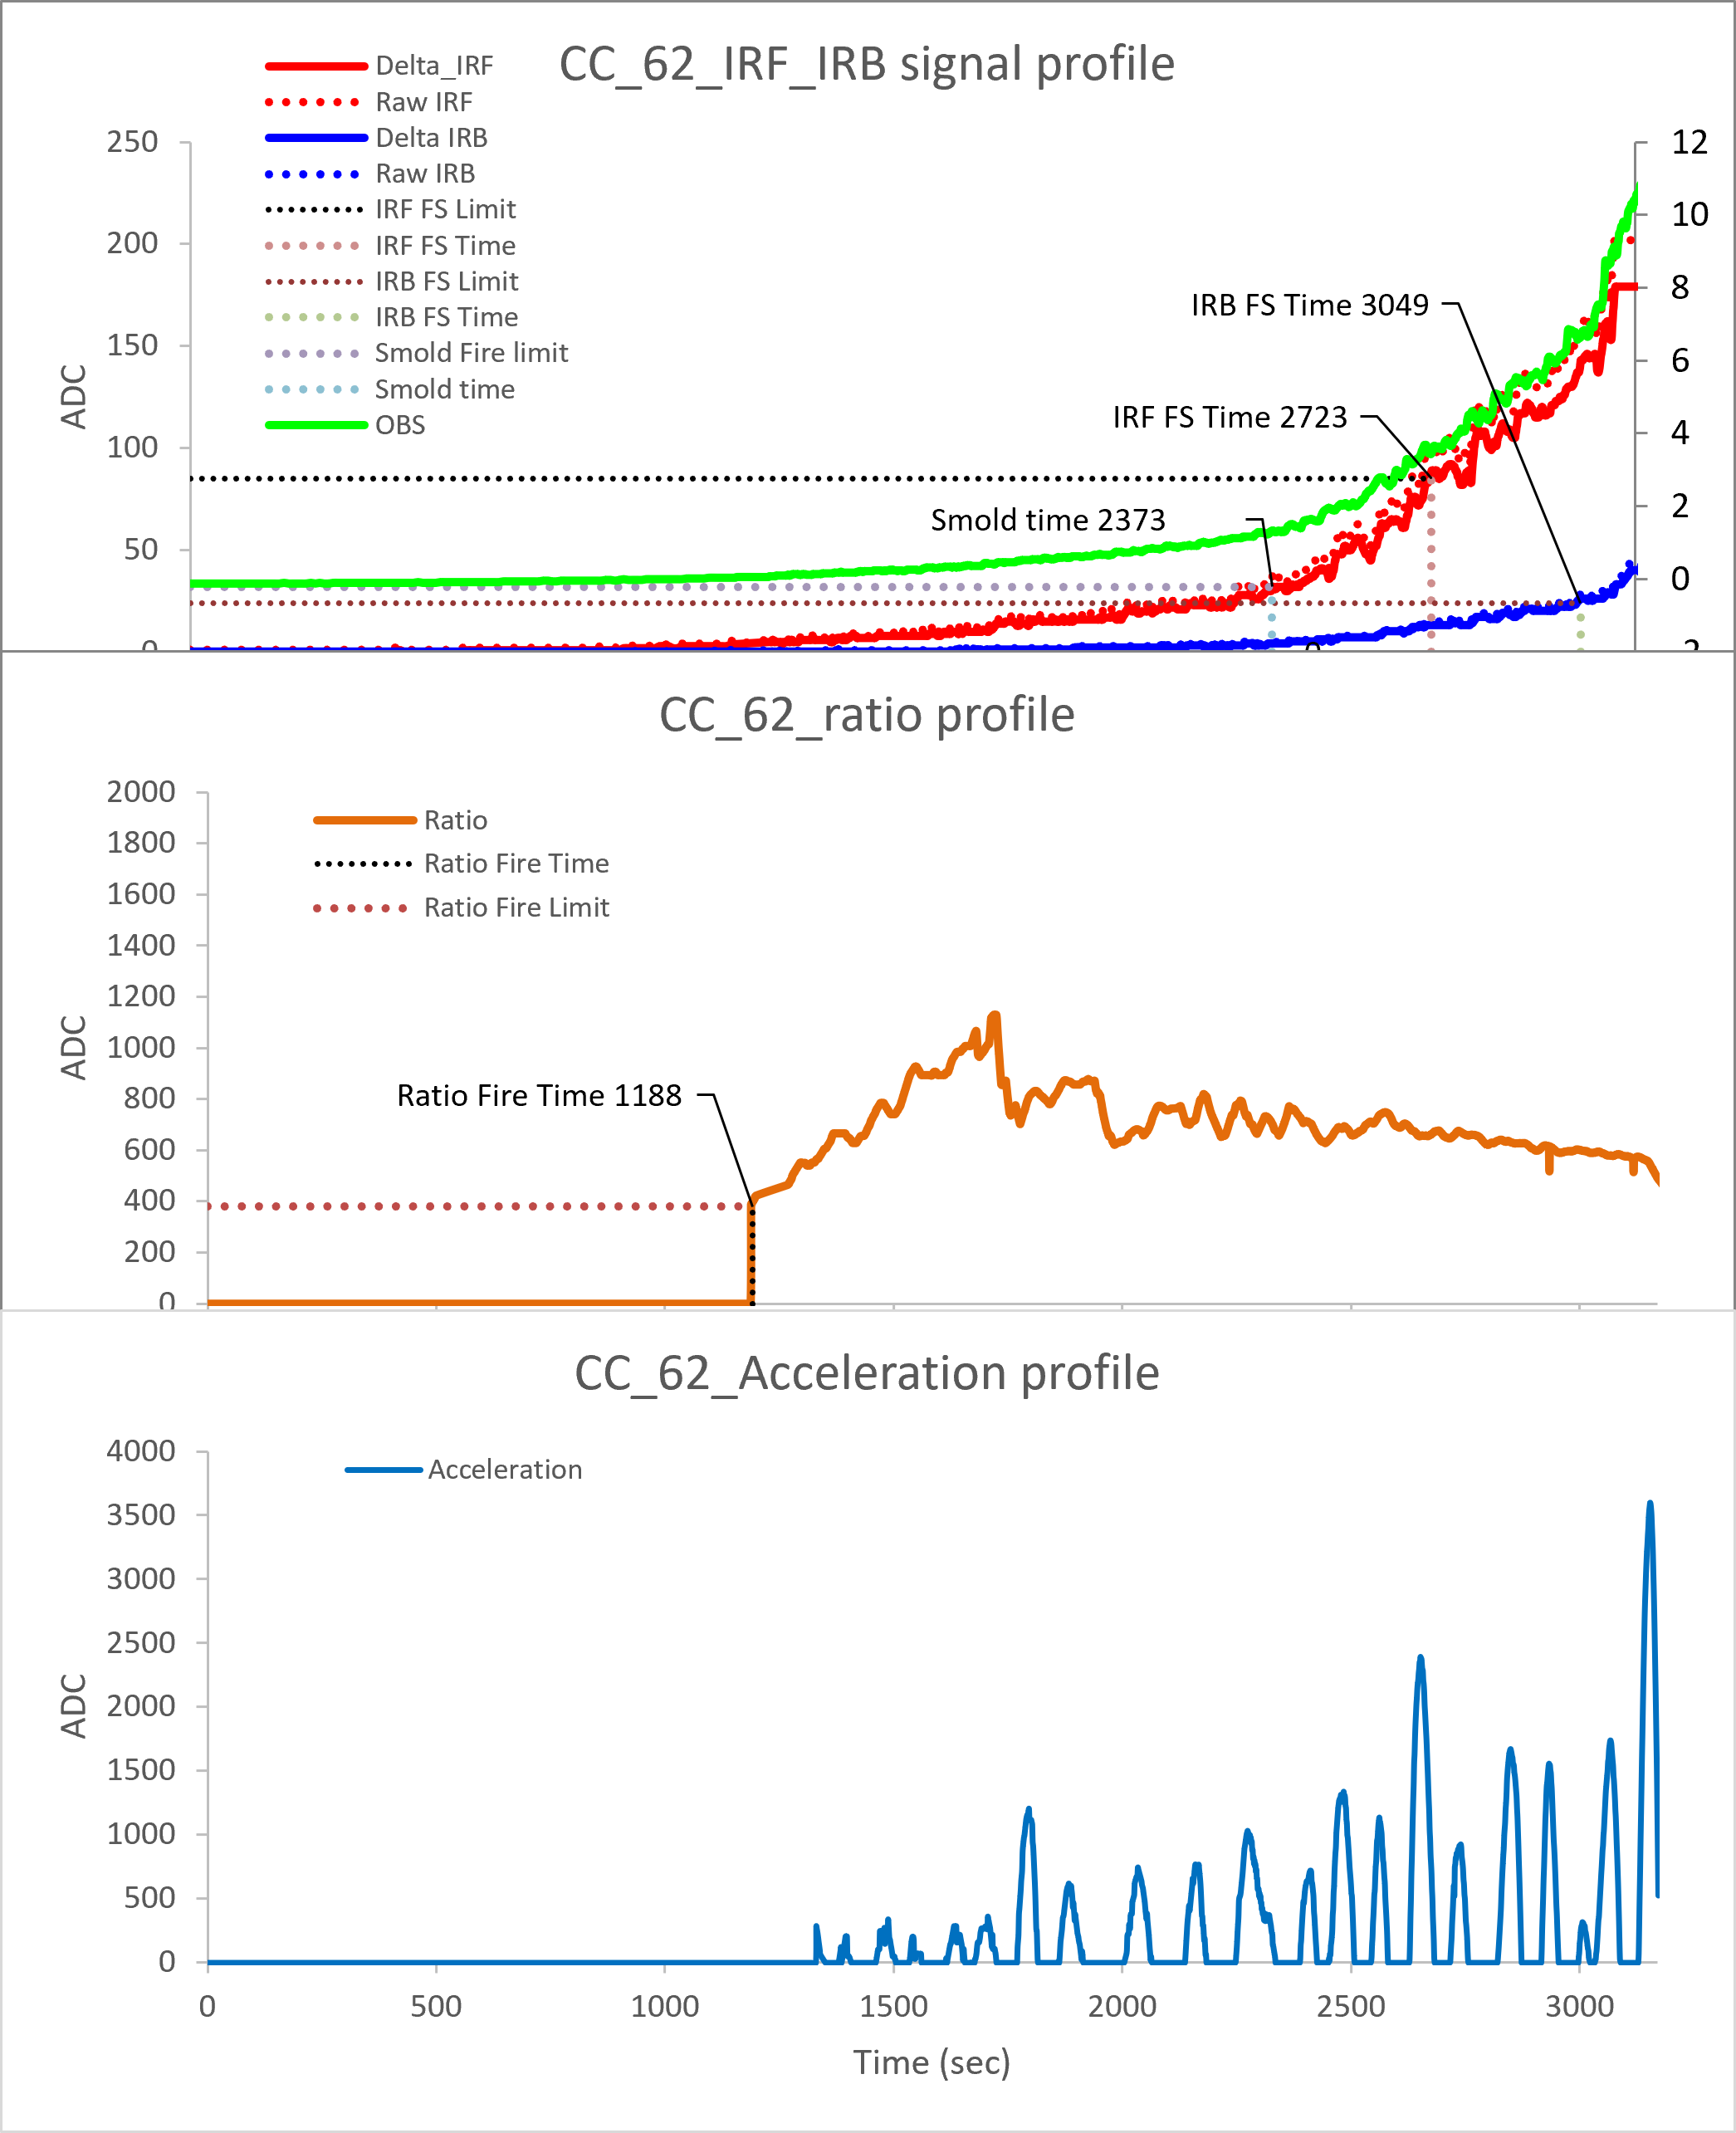
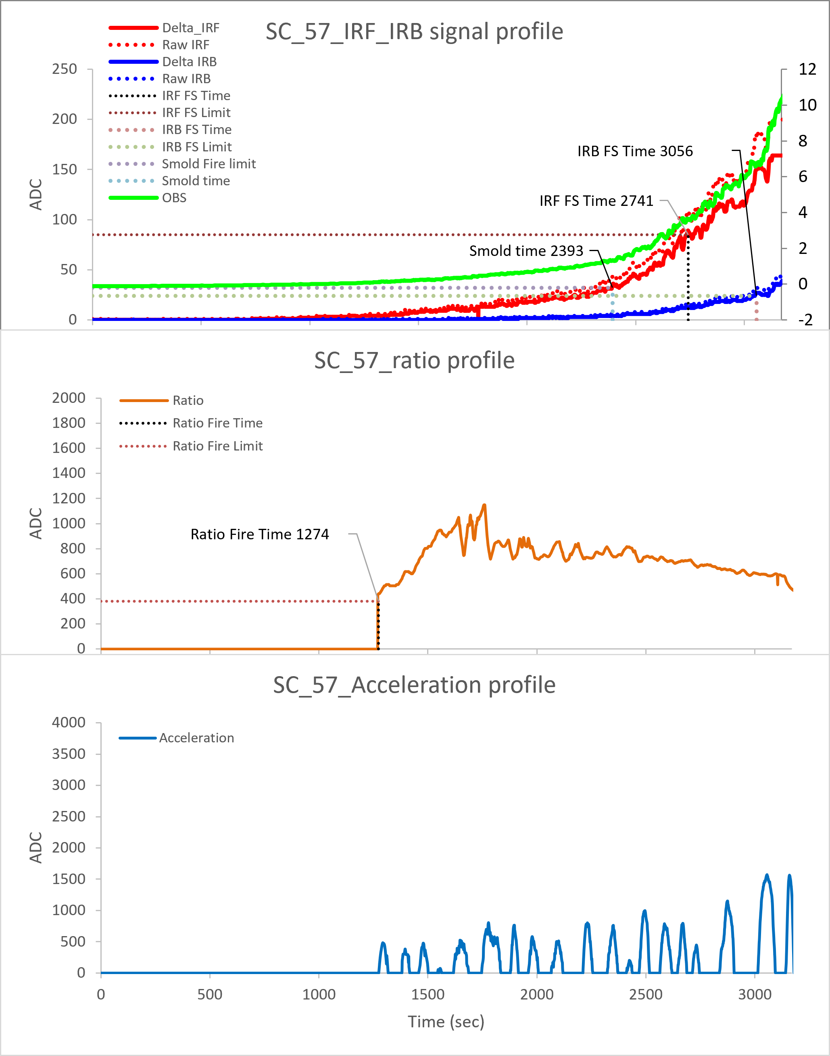
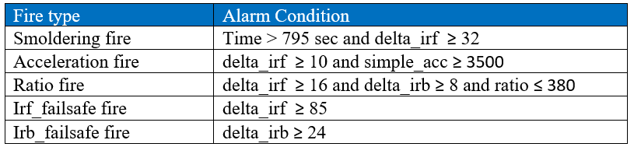
ES4-2 AC
North Wall :141025#-IRIS
South Wall : 56#
North Ceiling : 60#
Center Ceiling : 62#
South Ceiling : 57#
Ver 01.00.04
IRIS
RUN 01
Slow smoldering fire triggered at < 1.5%/ft
IRF failsafe fire triggered at 3.4~4.8%/ft
IRB failsafe fire triggered at 6.6~7.6%/ft
Ratio distribution locates in range of 700~1800

Slide 5
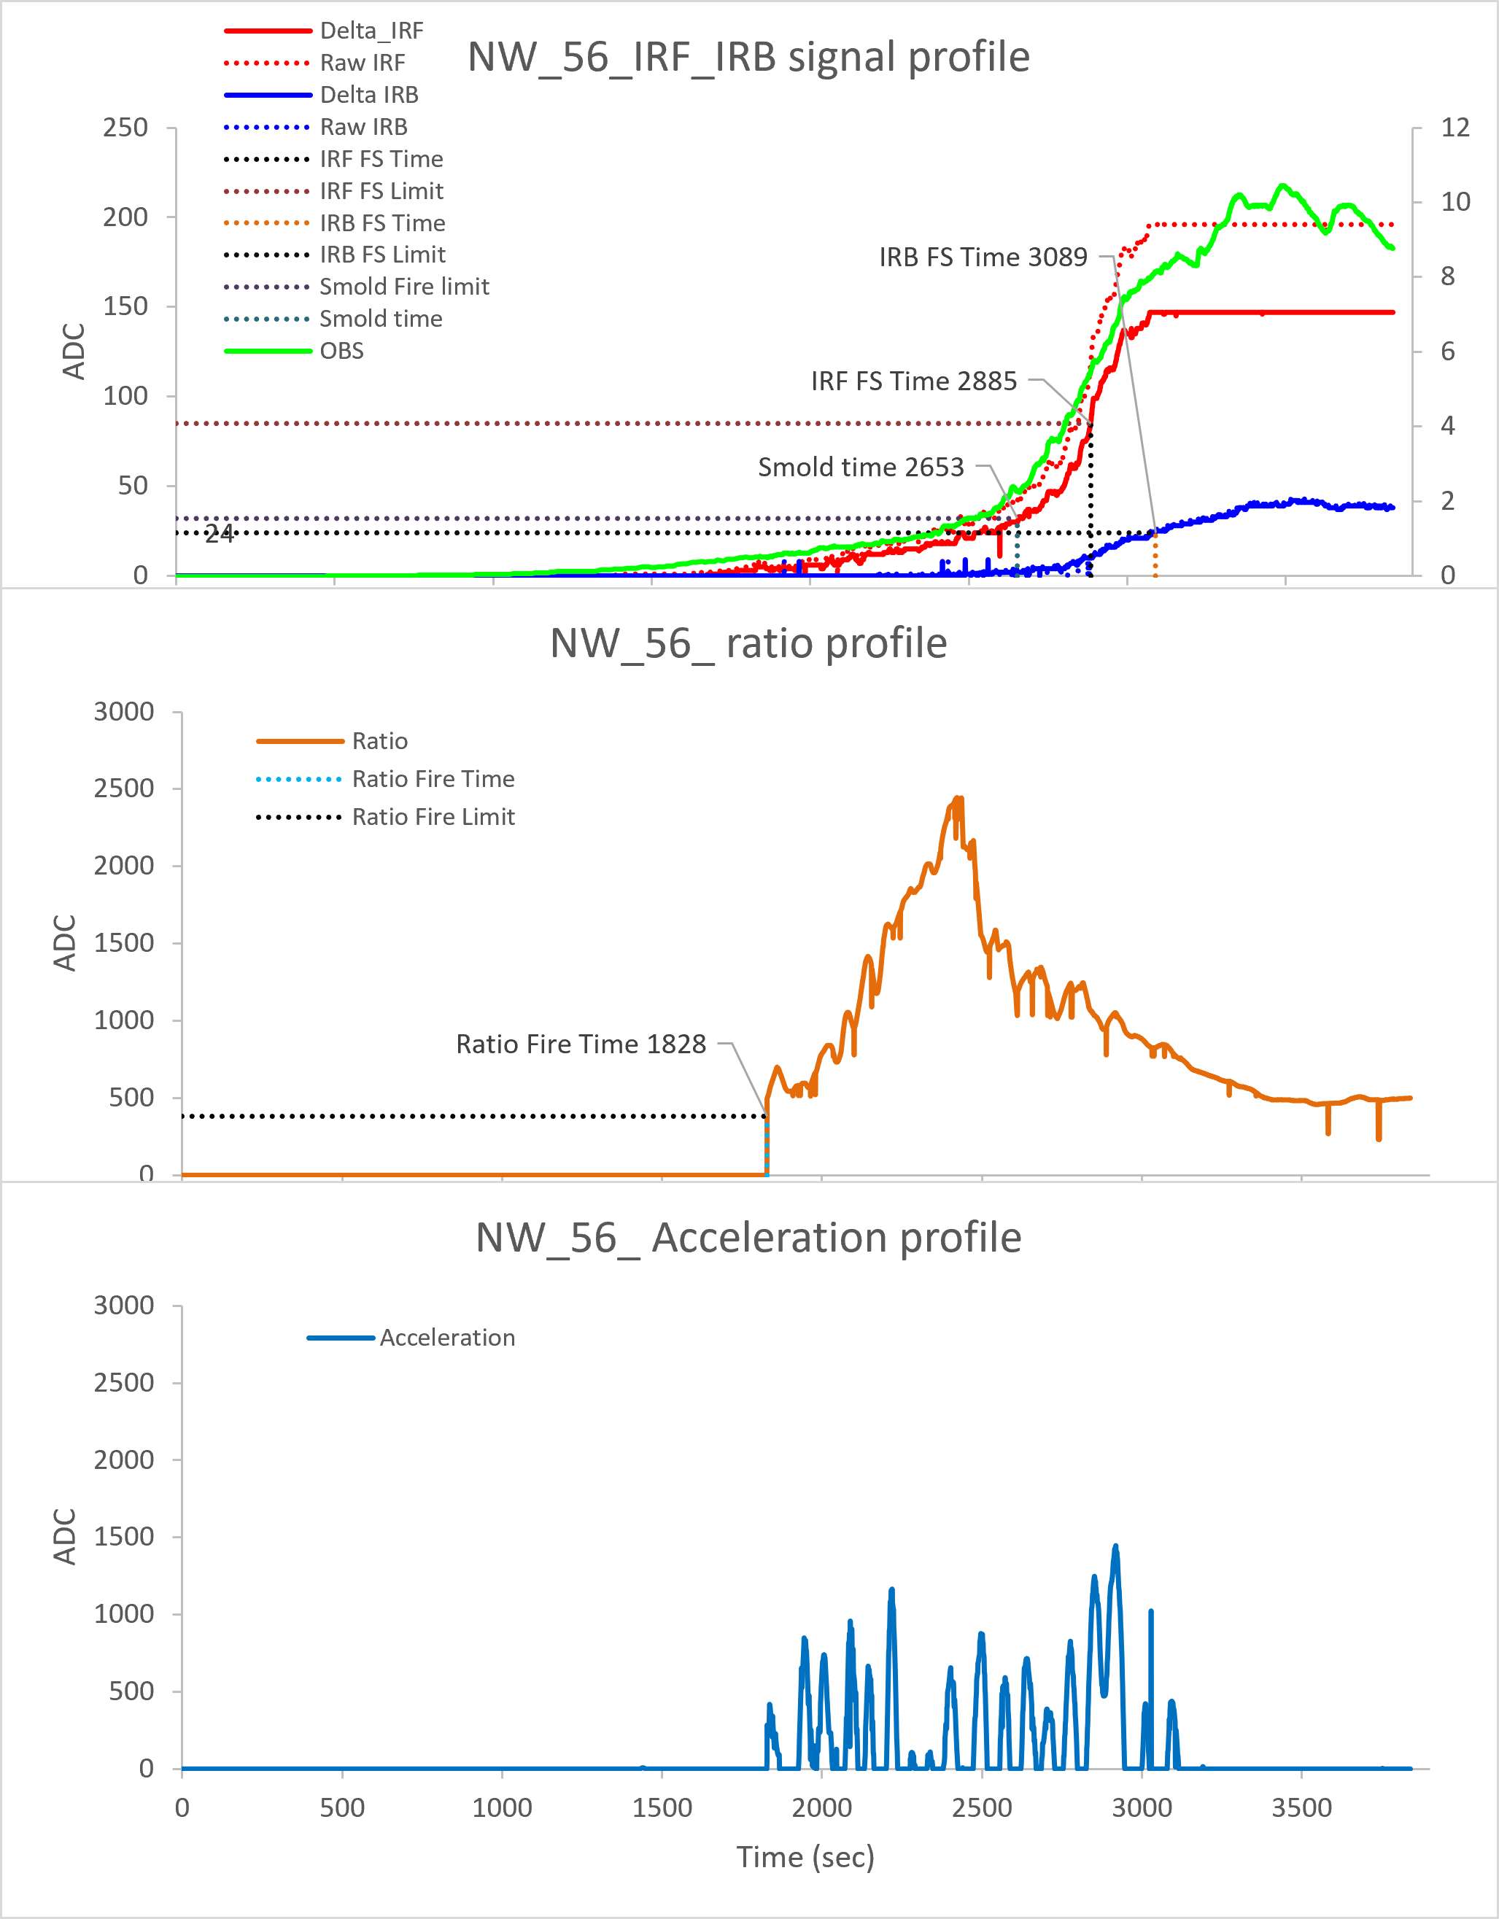
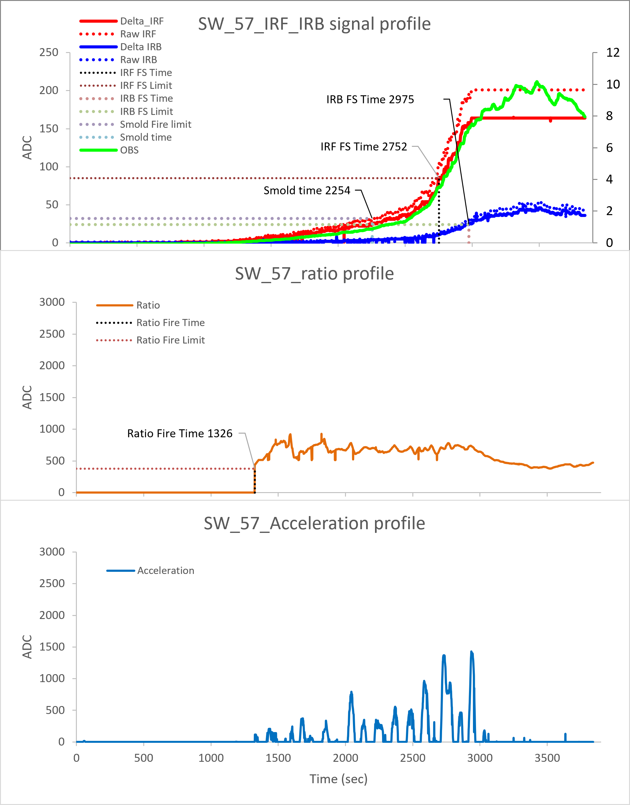
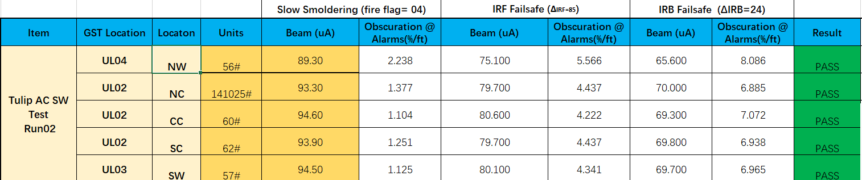
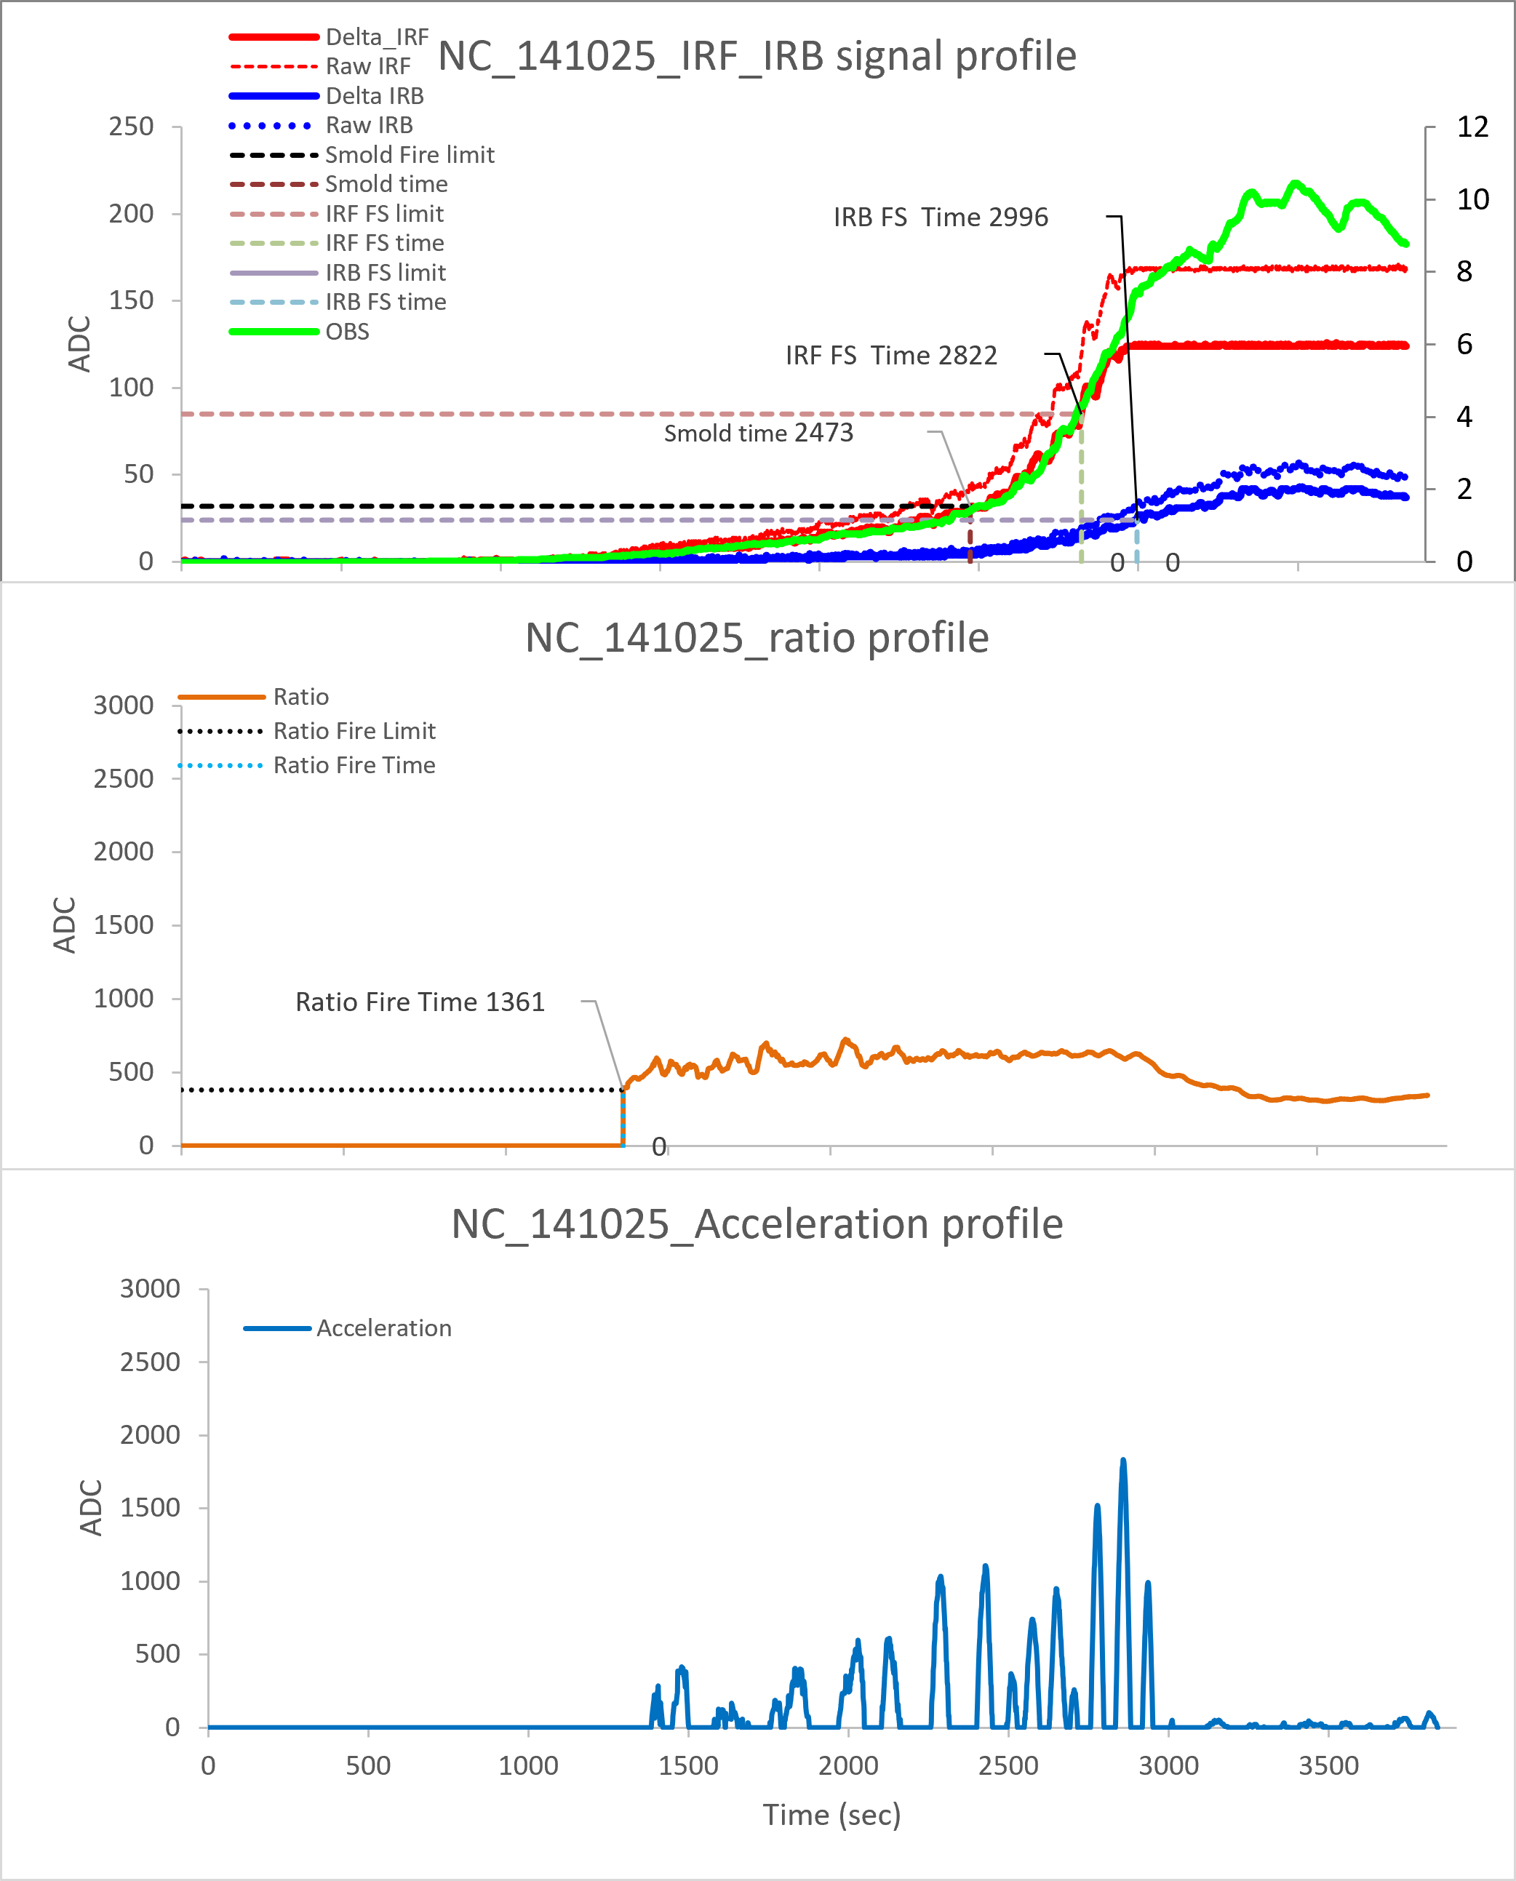
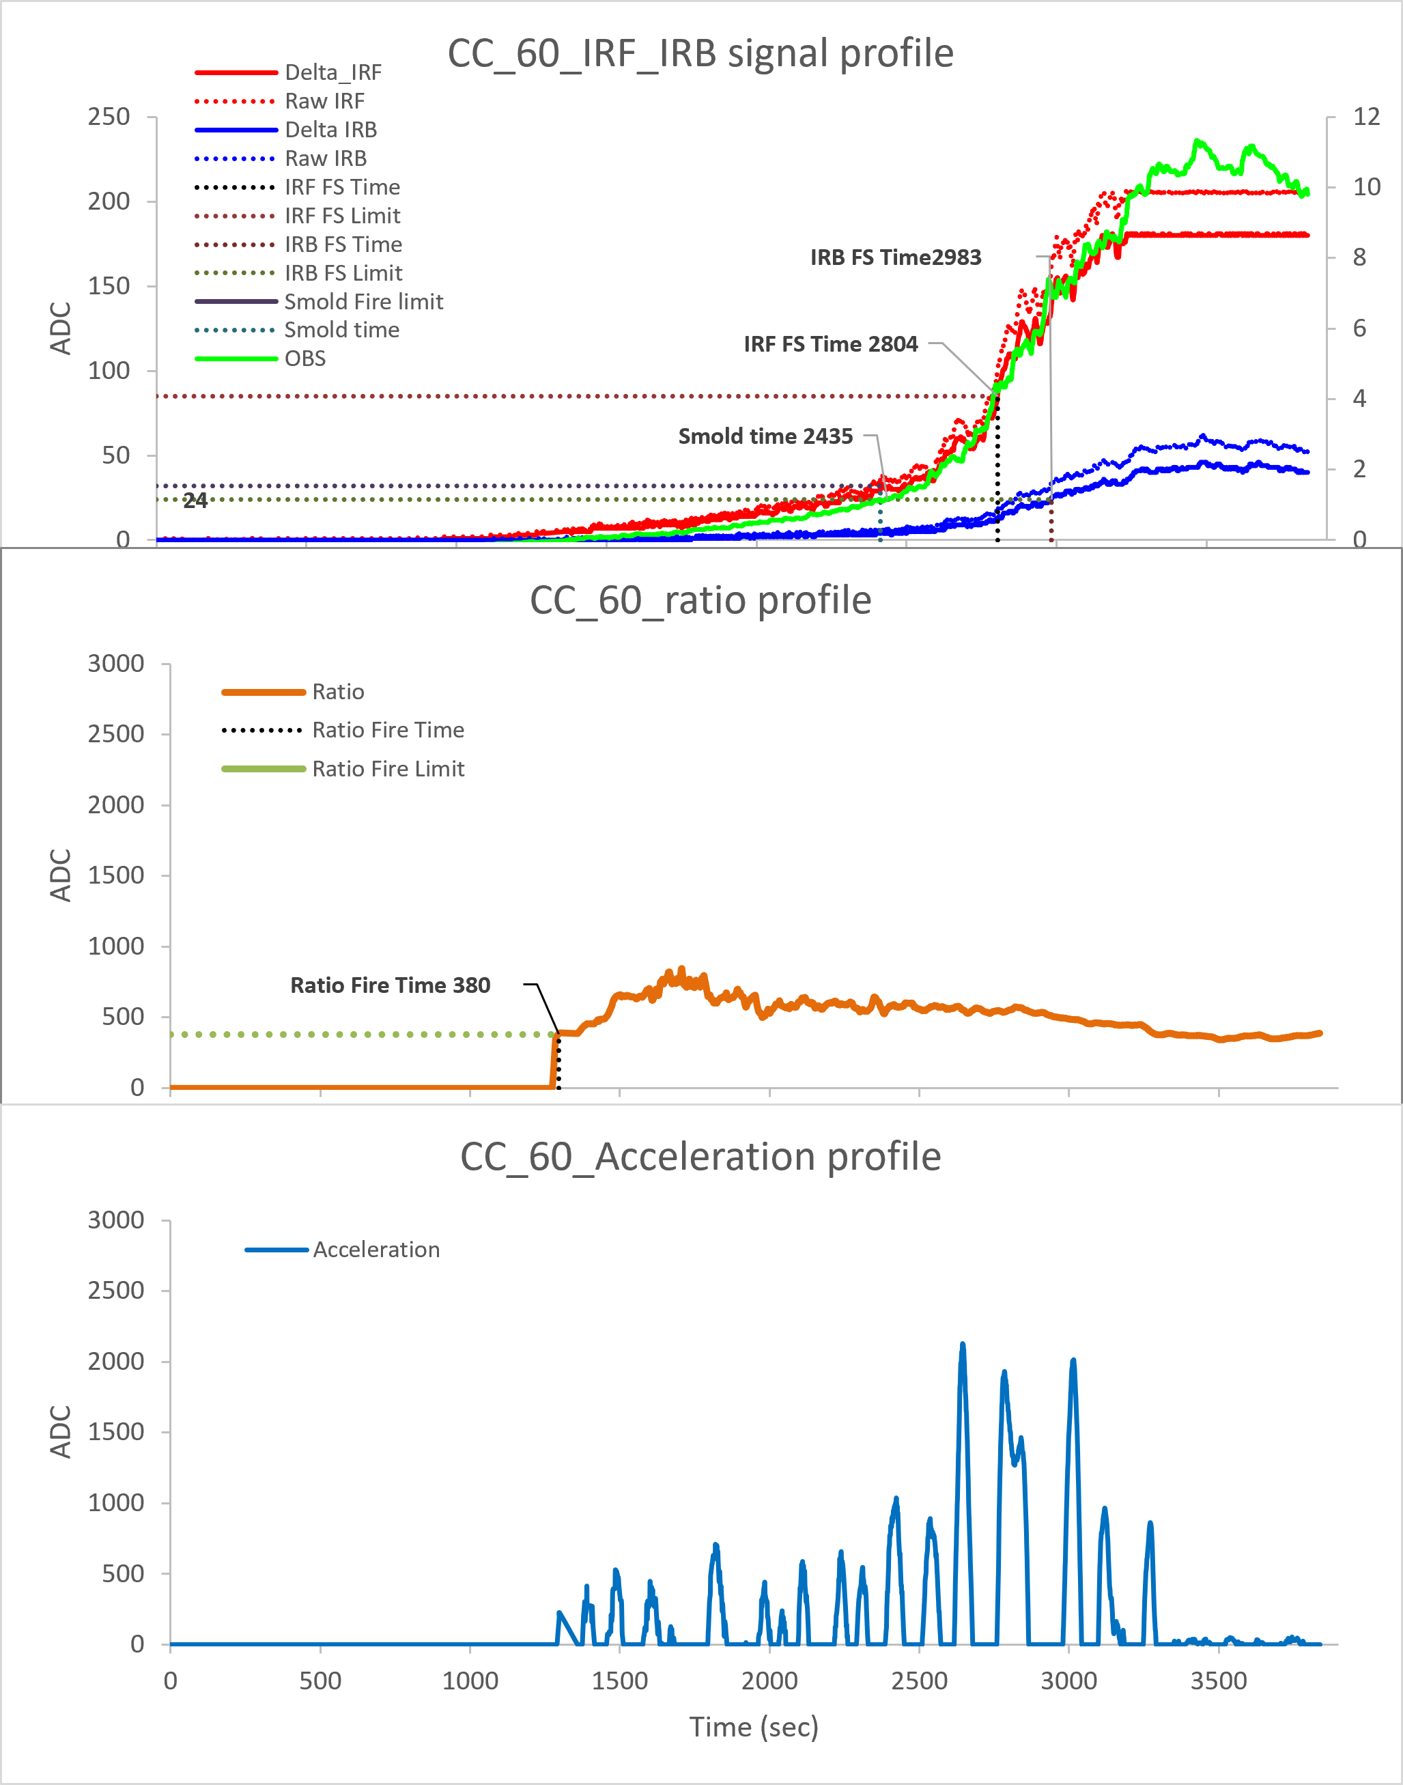
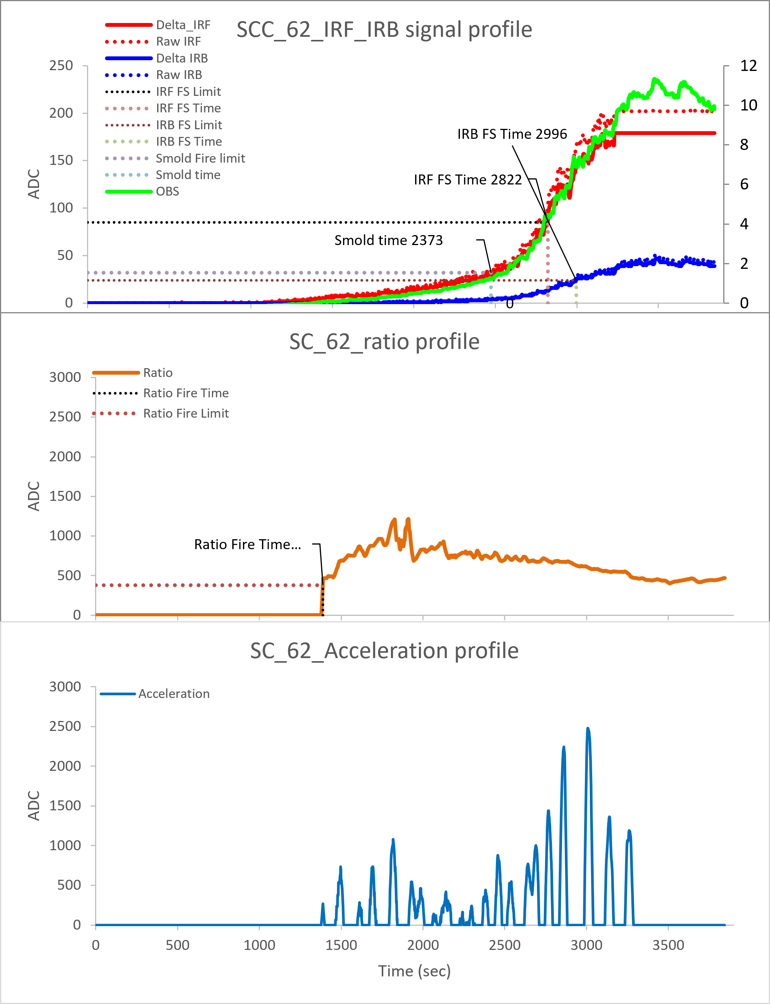
ES4-2 AC
North Wall :56#
South Wall : 57#
North Ceiling : 141025#-IRIS
Center Ceiling : 60#
South Ceiling : 62#
Ver 01.00.04
RUN 02
IRIS
Slow smoldering fire triggered at 1.1~2.3%/ft
IRF failsafe fire triggered at 4.2~5.6%/ft
IRB failsafe fire triggered at 6.9~8.0%/ft
Ratio distribution locates in range of 800~2500

Slide 6
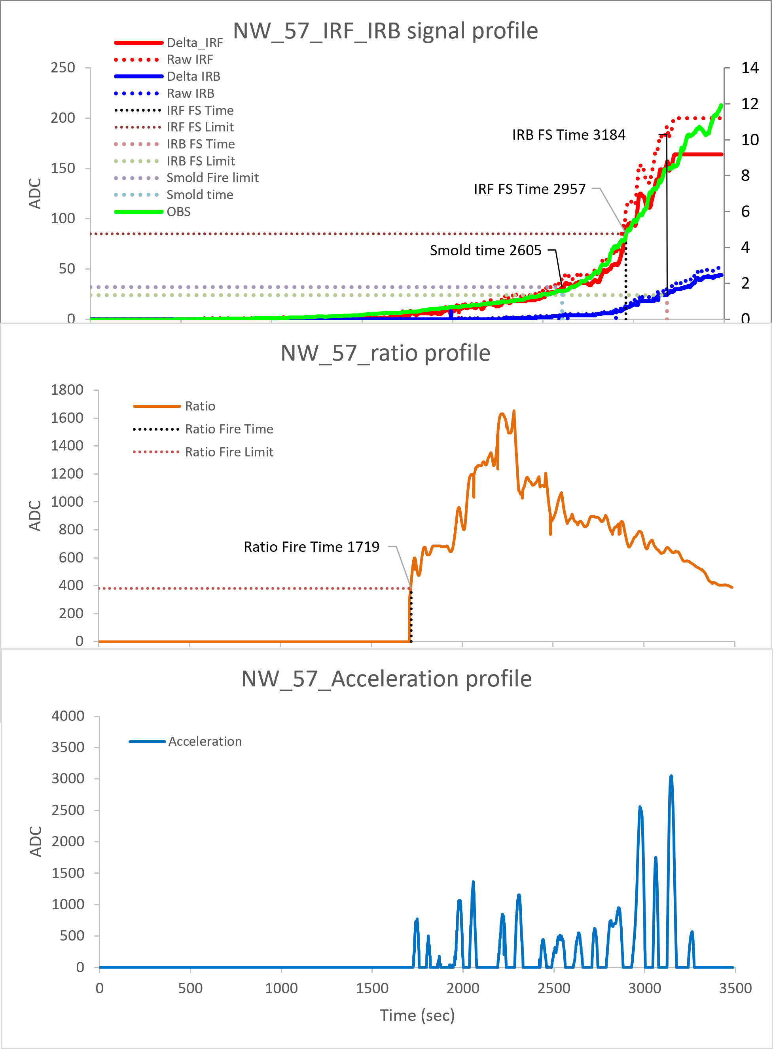
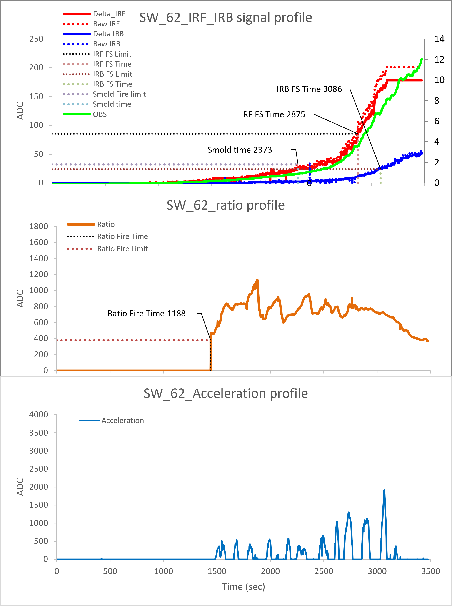
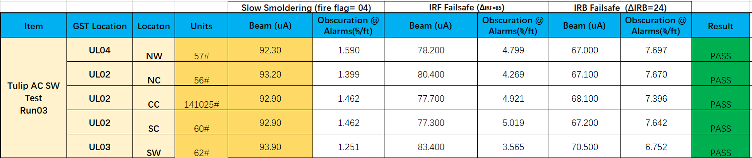
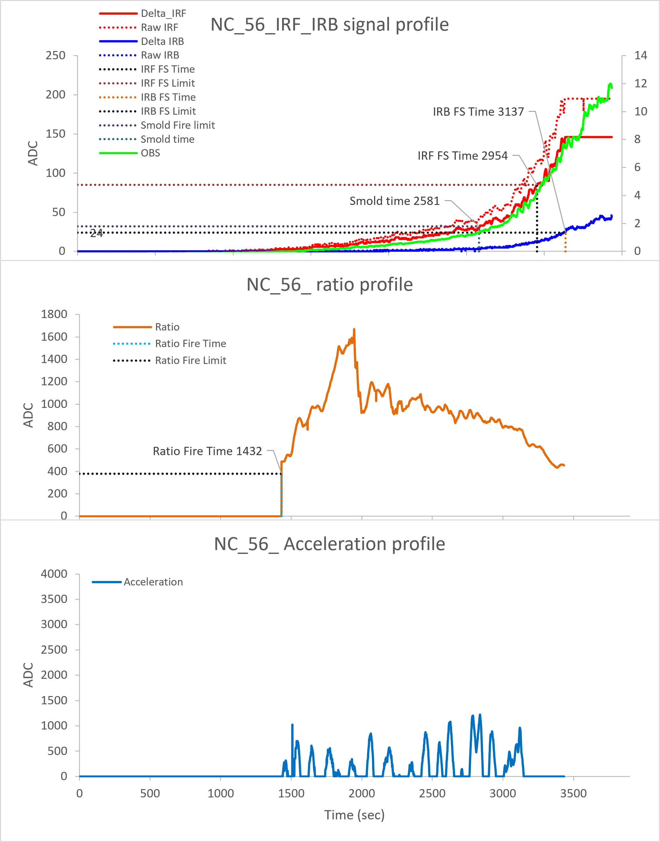
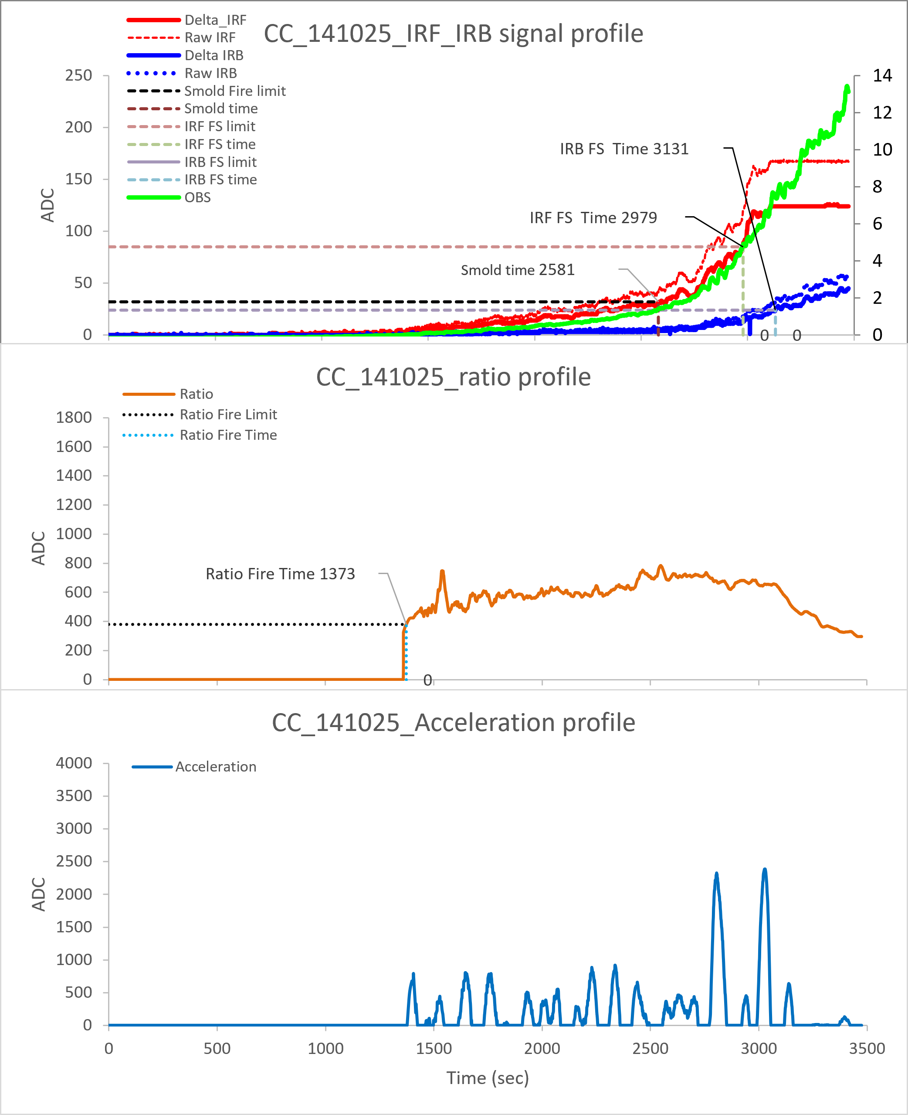
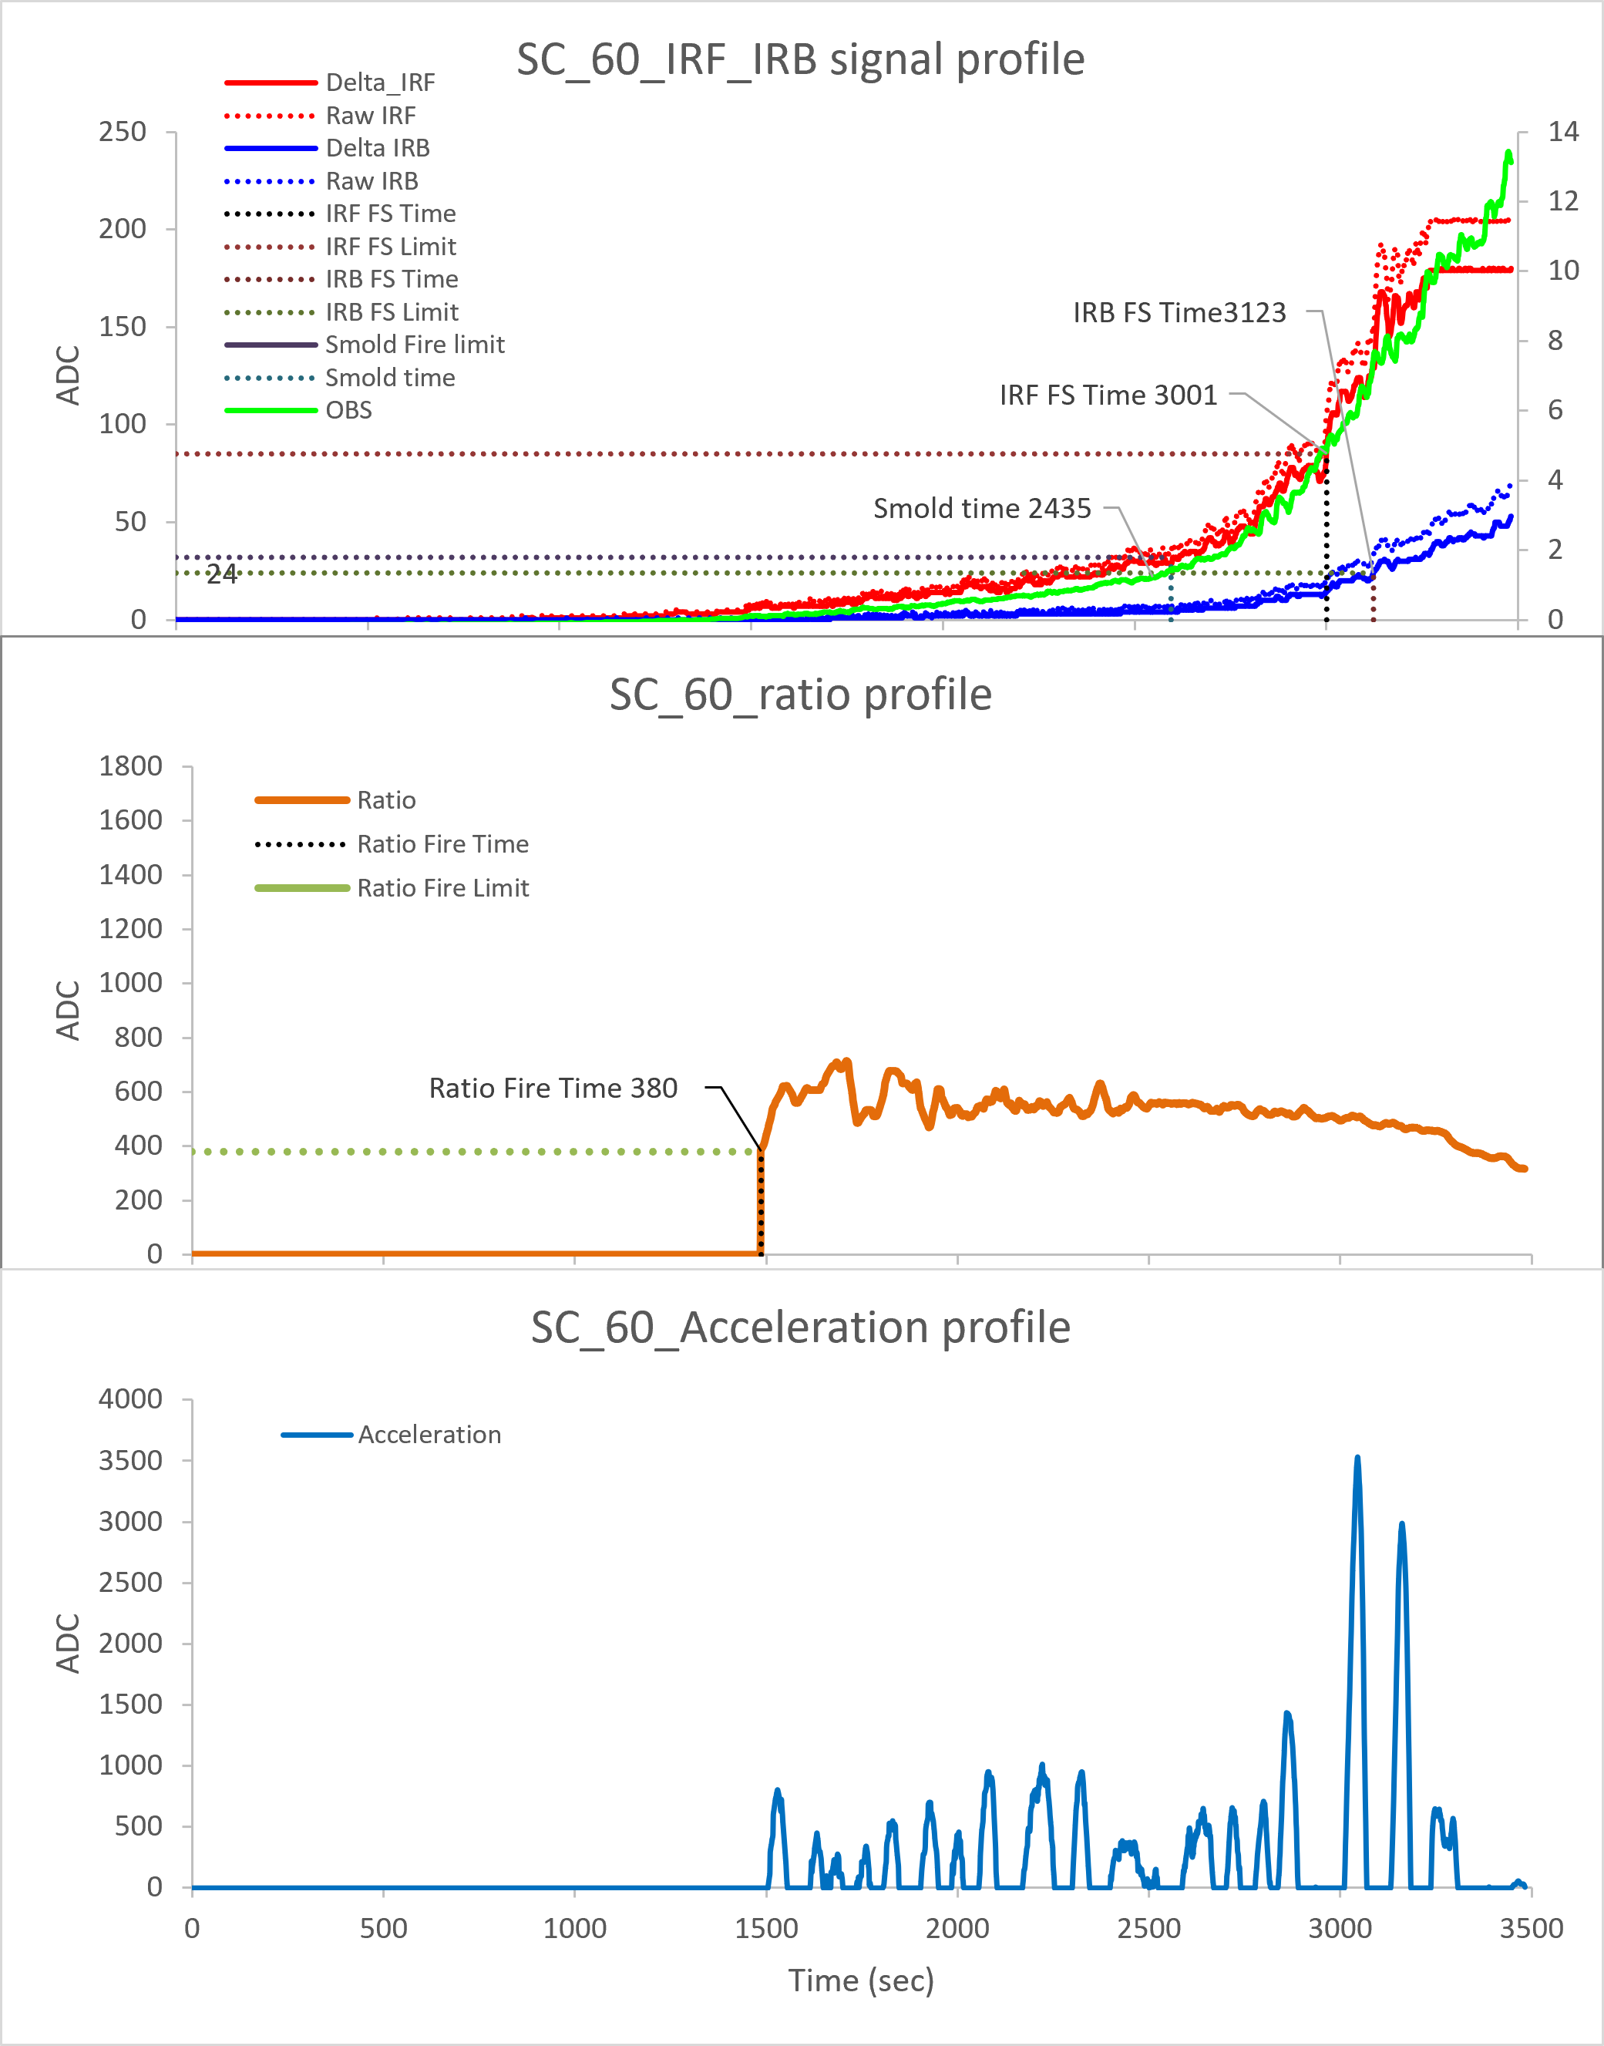
ES4-2 AC
North Wall :57#
South Wall :62#
North Ceiling :56#
Center Ceiling :141025#-IRIS
South Ceiling :60#
Ver 01.00.04
RUN 03
IRIS
Slow smoldering fire triggered at 1.2~1.6%/ft
IRF failsafe fire triggered at 3.5~5.0%/ft
IRB failsafe fire triggered at 6.7~7.7%/ft
Ratio distribution locates in range of 800~1800

Slide 7
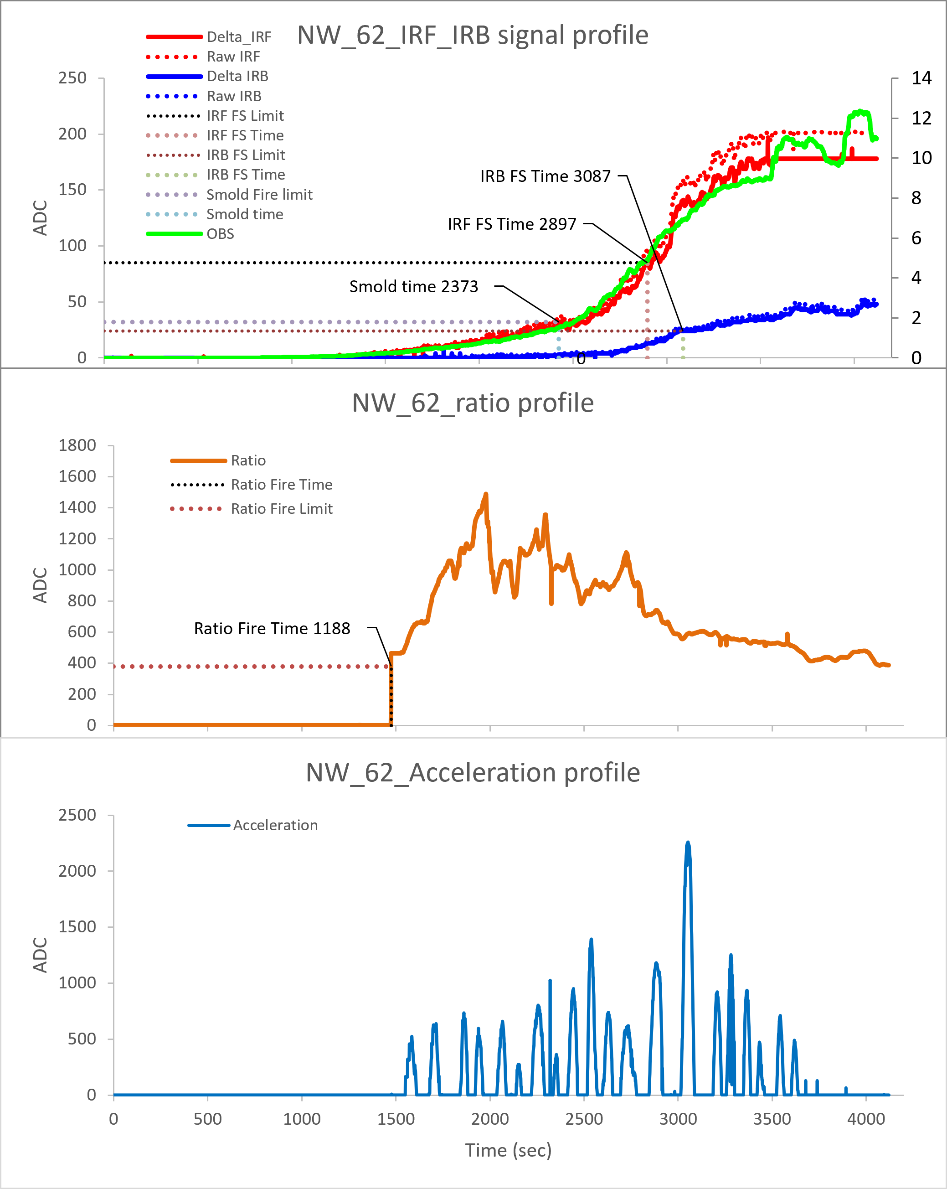
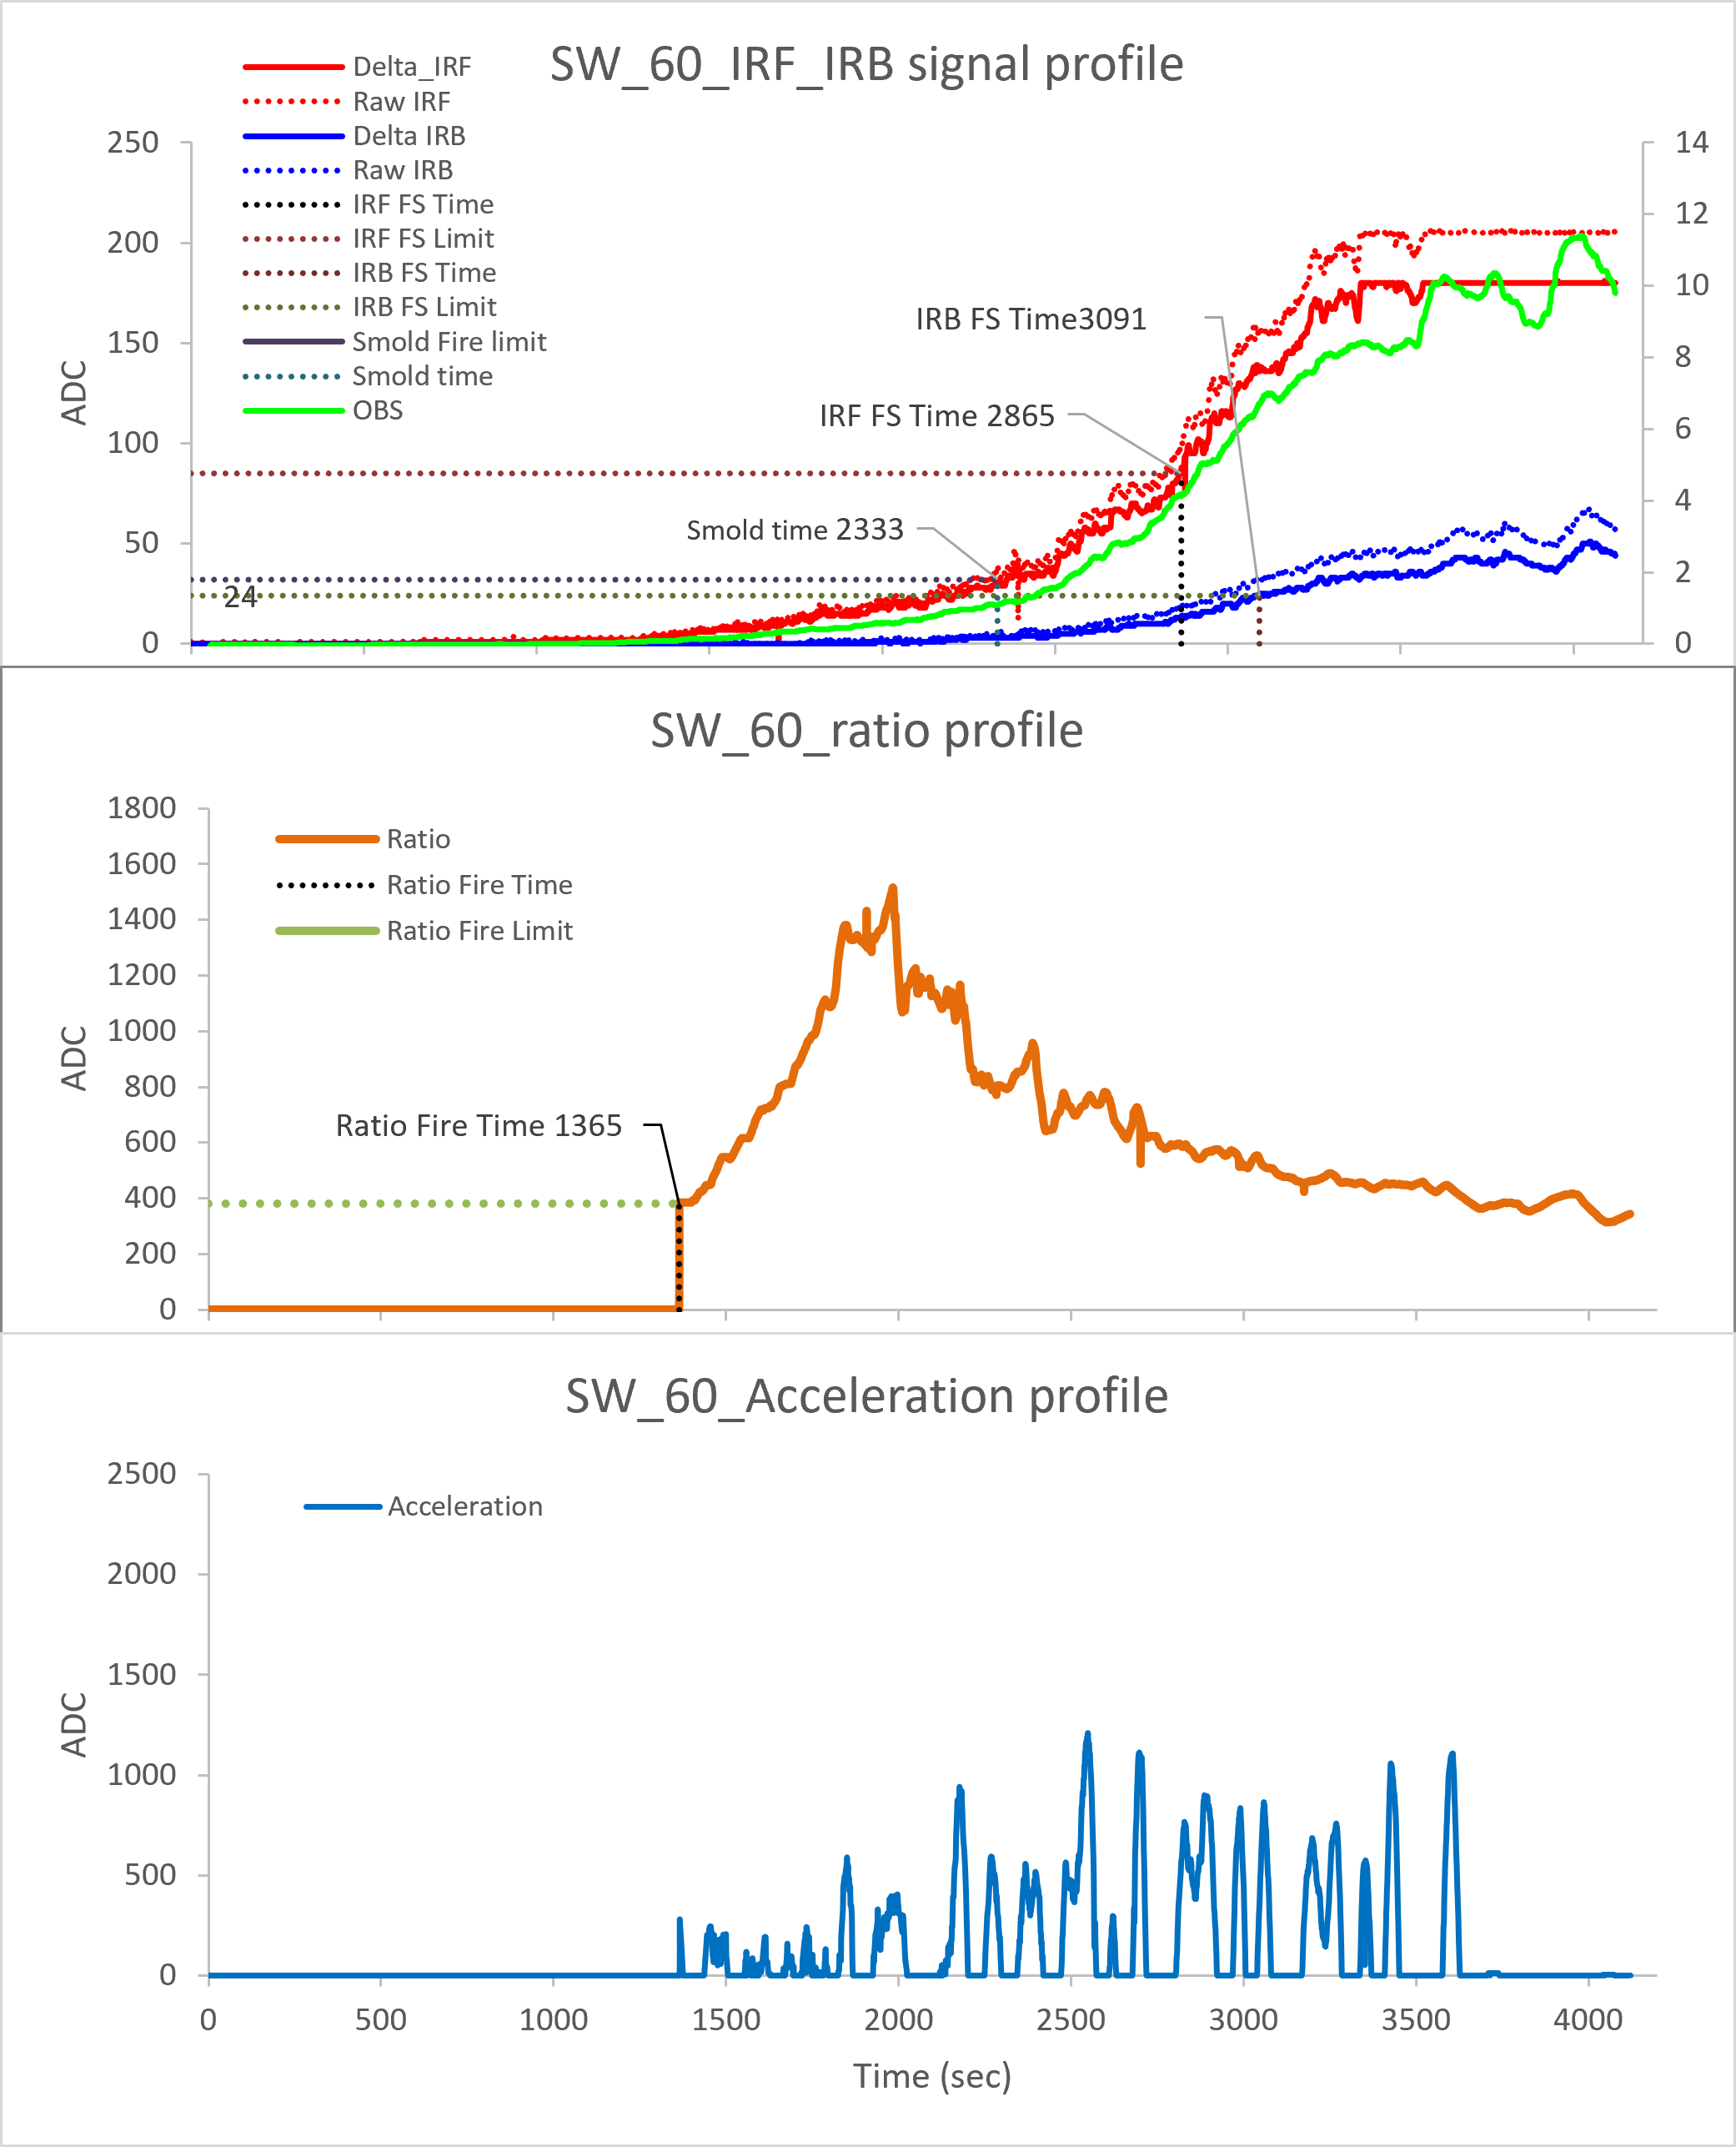
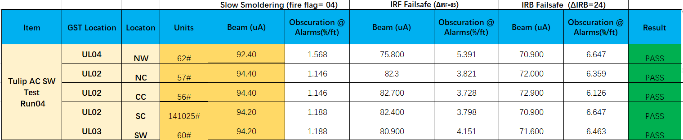
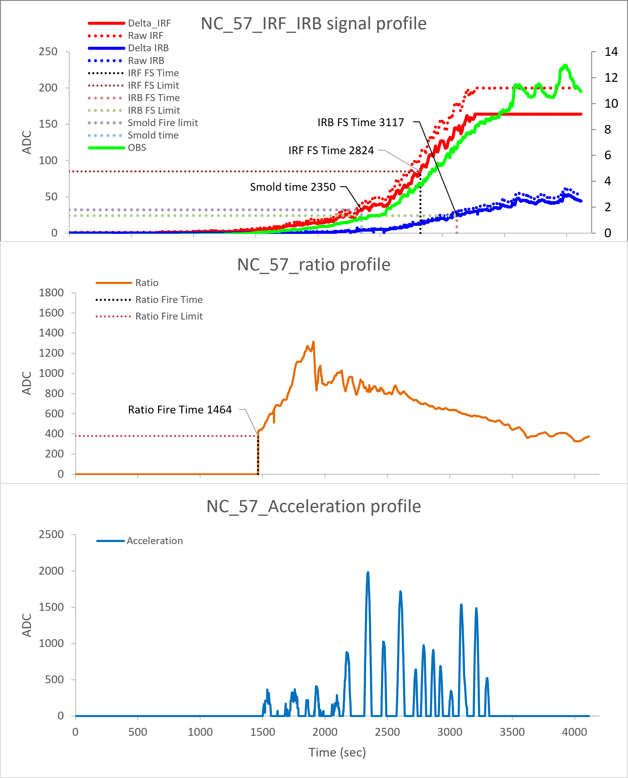
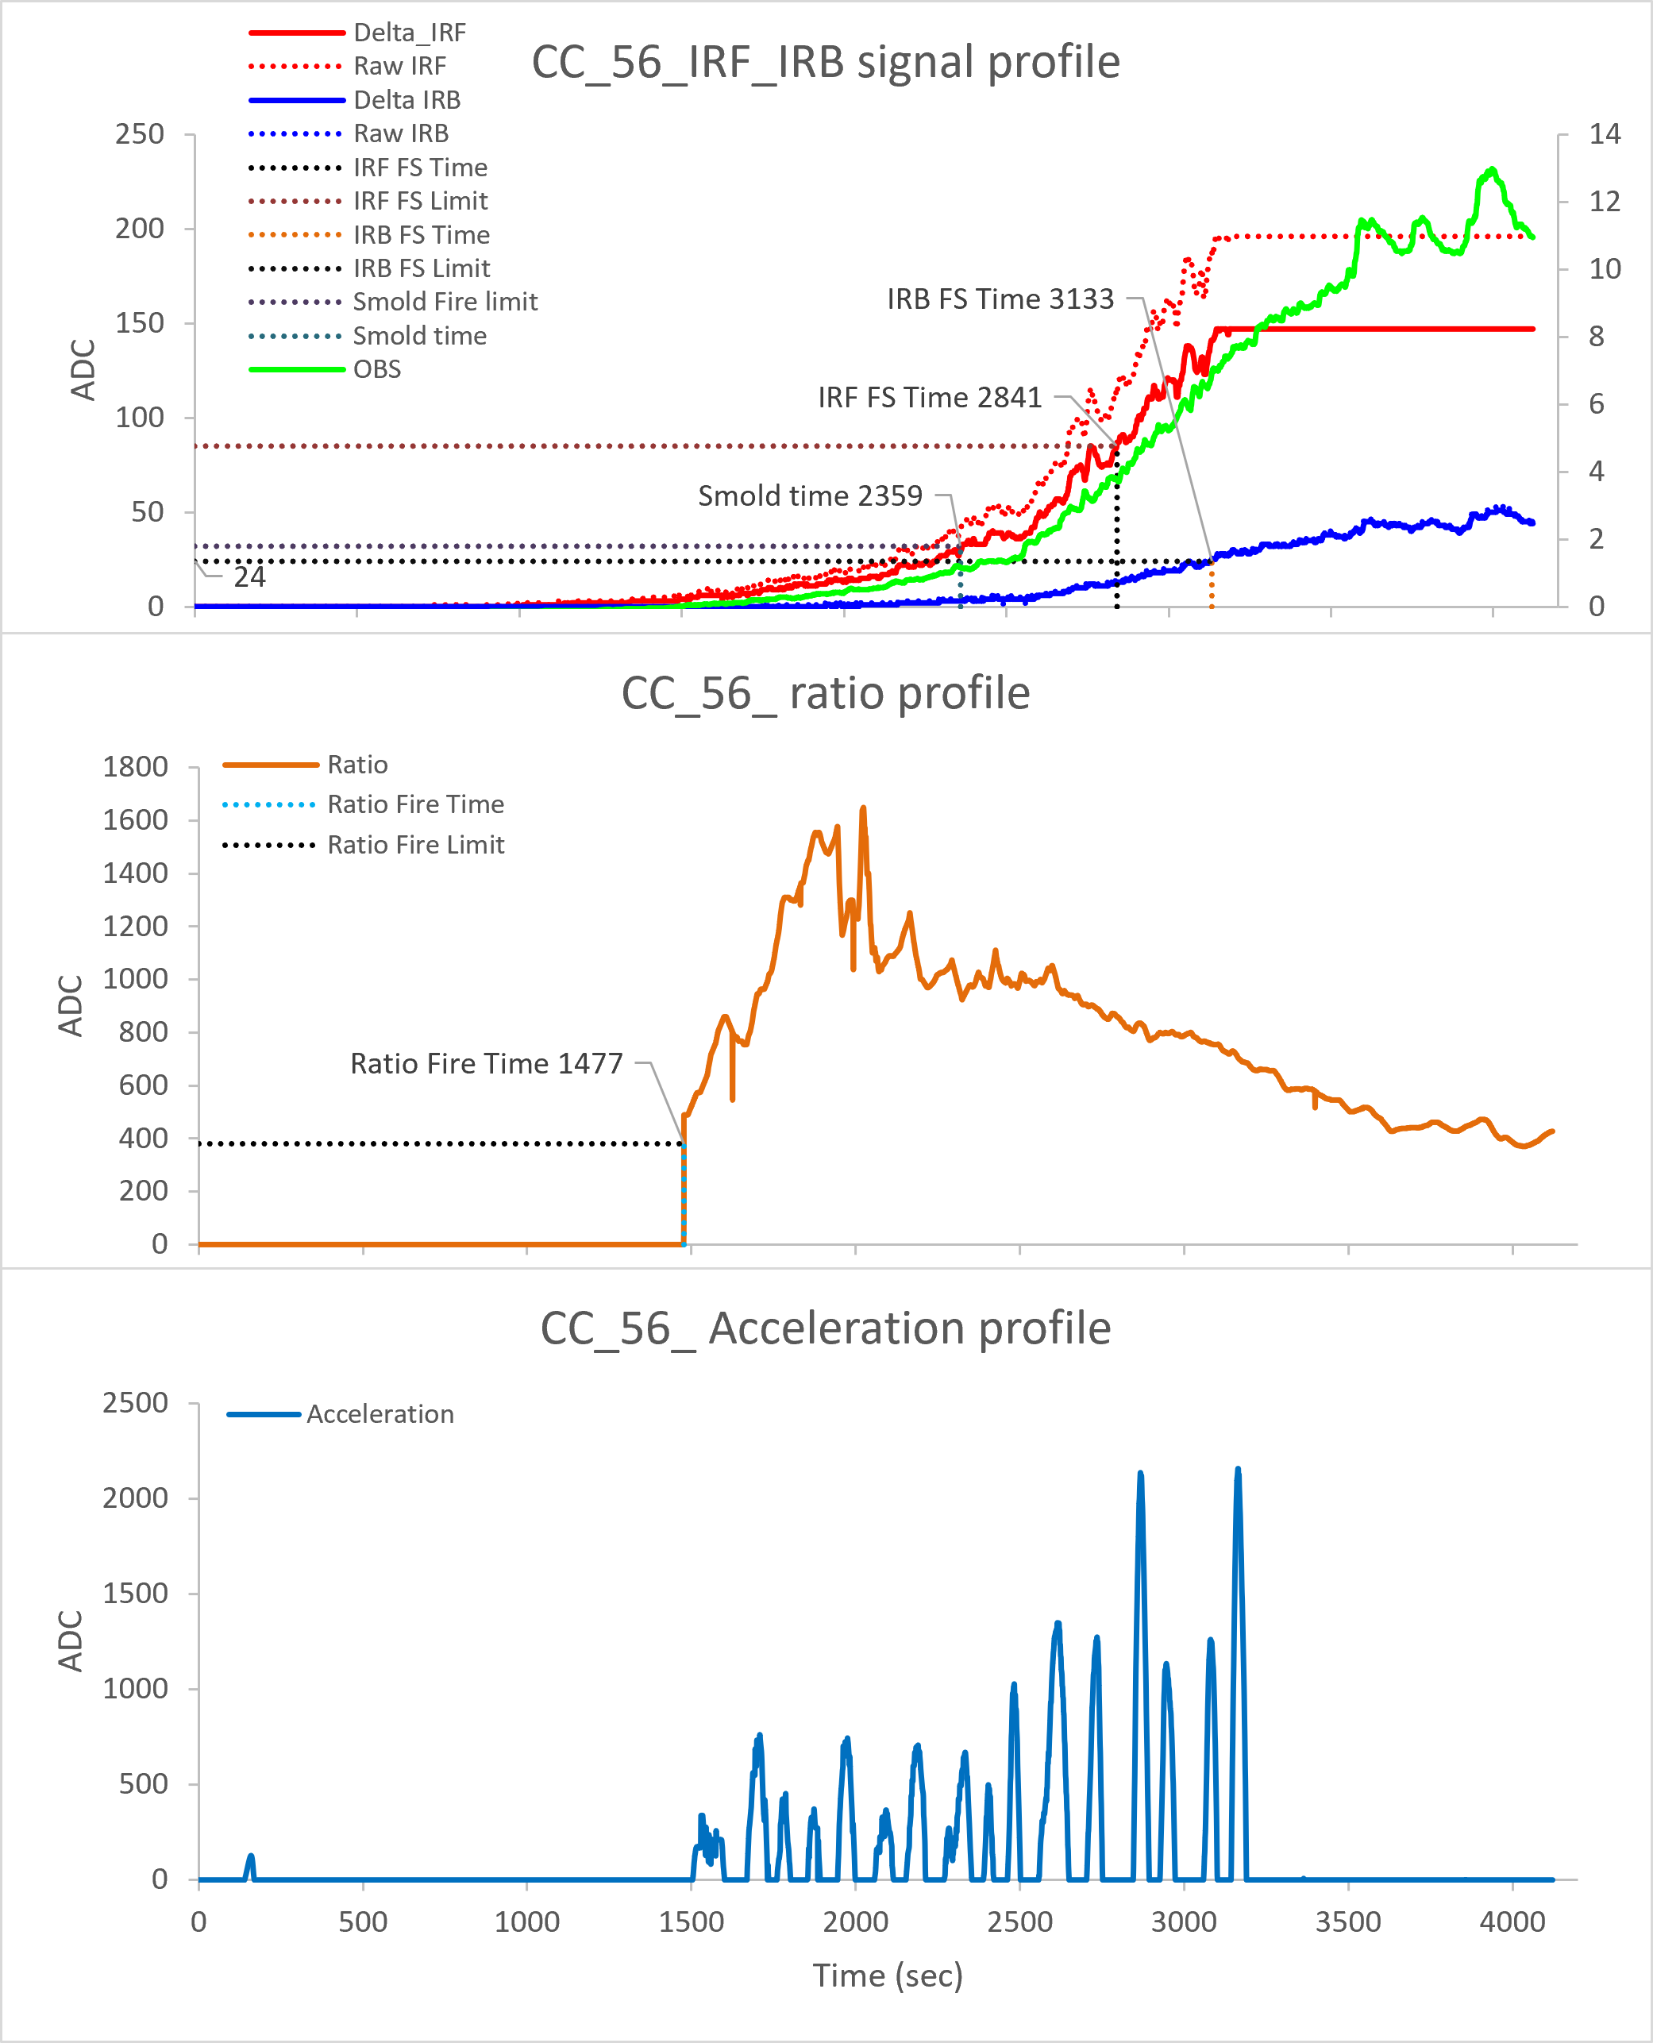
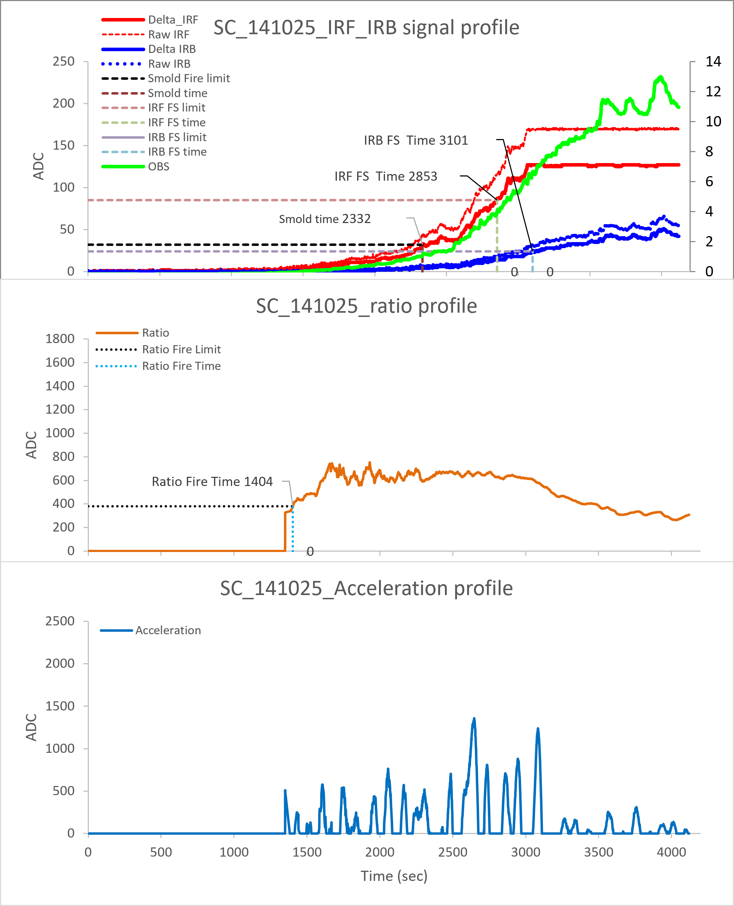
ES4-2 AC
North Wall :62#
South Wall :60#
North Ceiling :57#
Center Ceiling :56#
South Ceiling :141025#-IRIS
Ver 01.00.04
RUN 04
IRIS
Slow smoldering fire triggered at 1.1~1.6%/ft
IRF failsafe fire triggered at 3.7~5.3%/ft
IRB failsafe fire triggered at 6.1~6.6%/ft
Ratio distribution locates in range of 800~1800

Slide 8
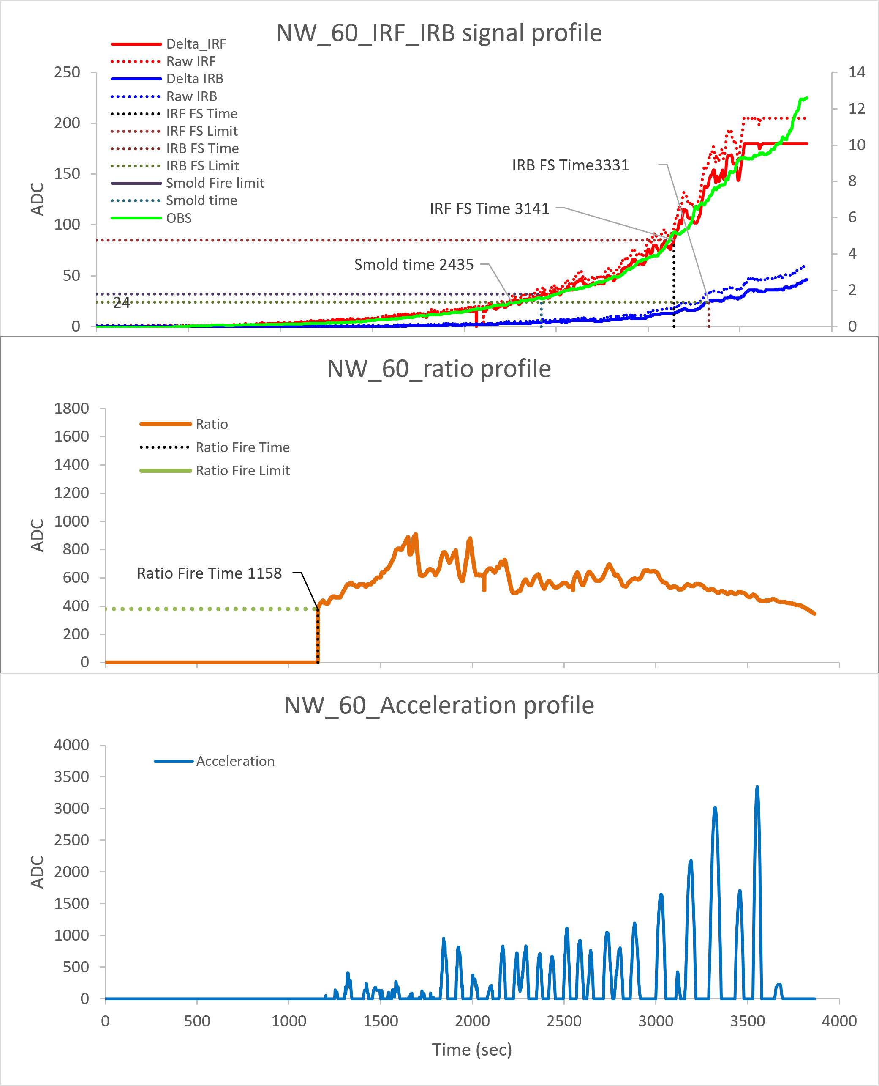
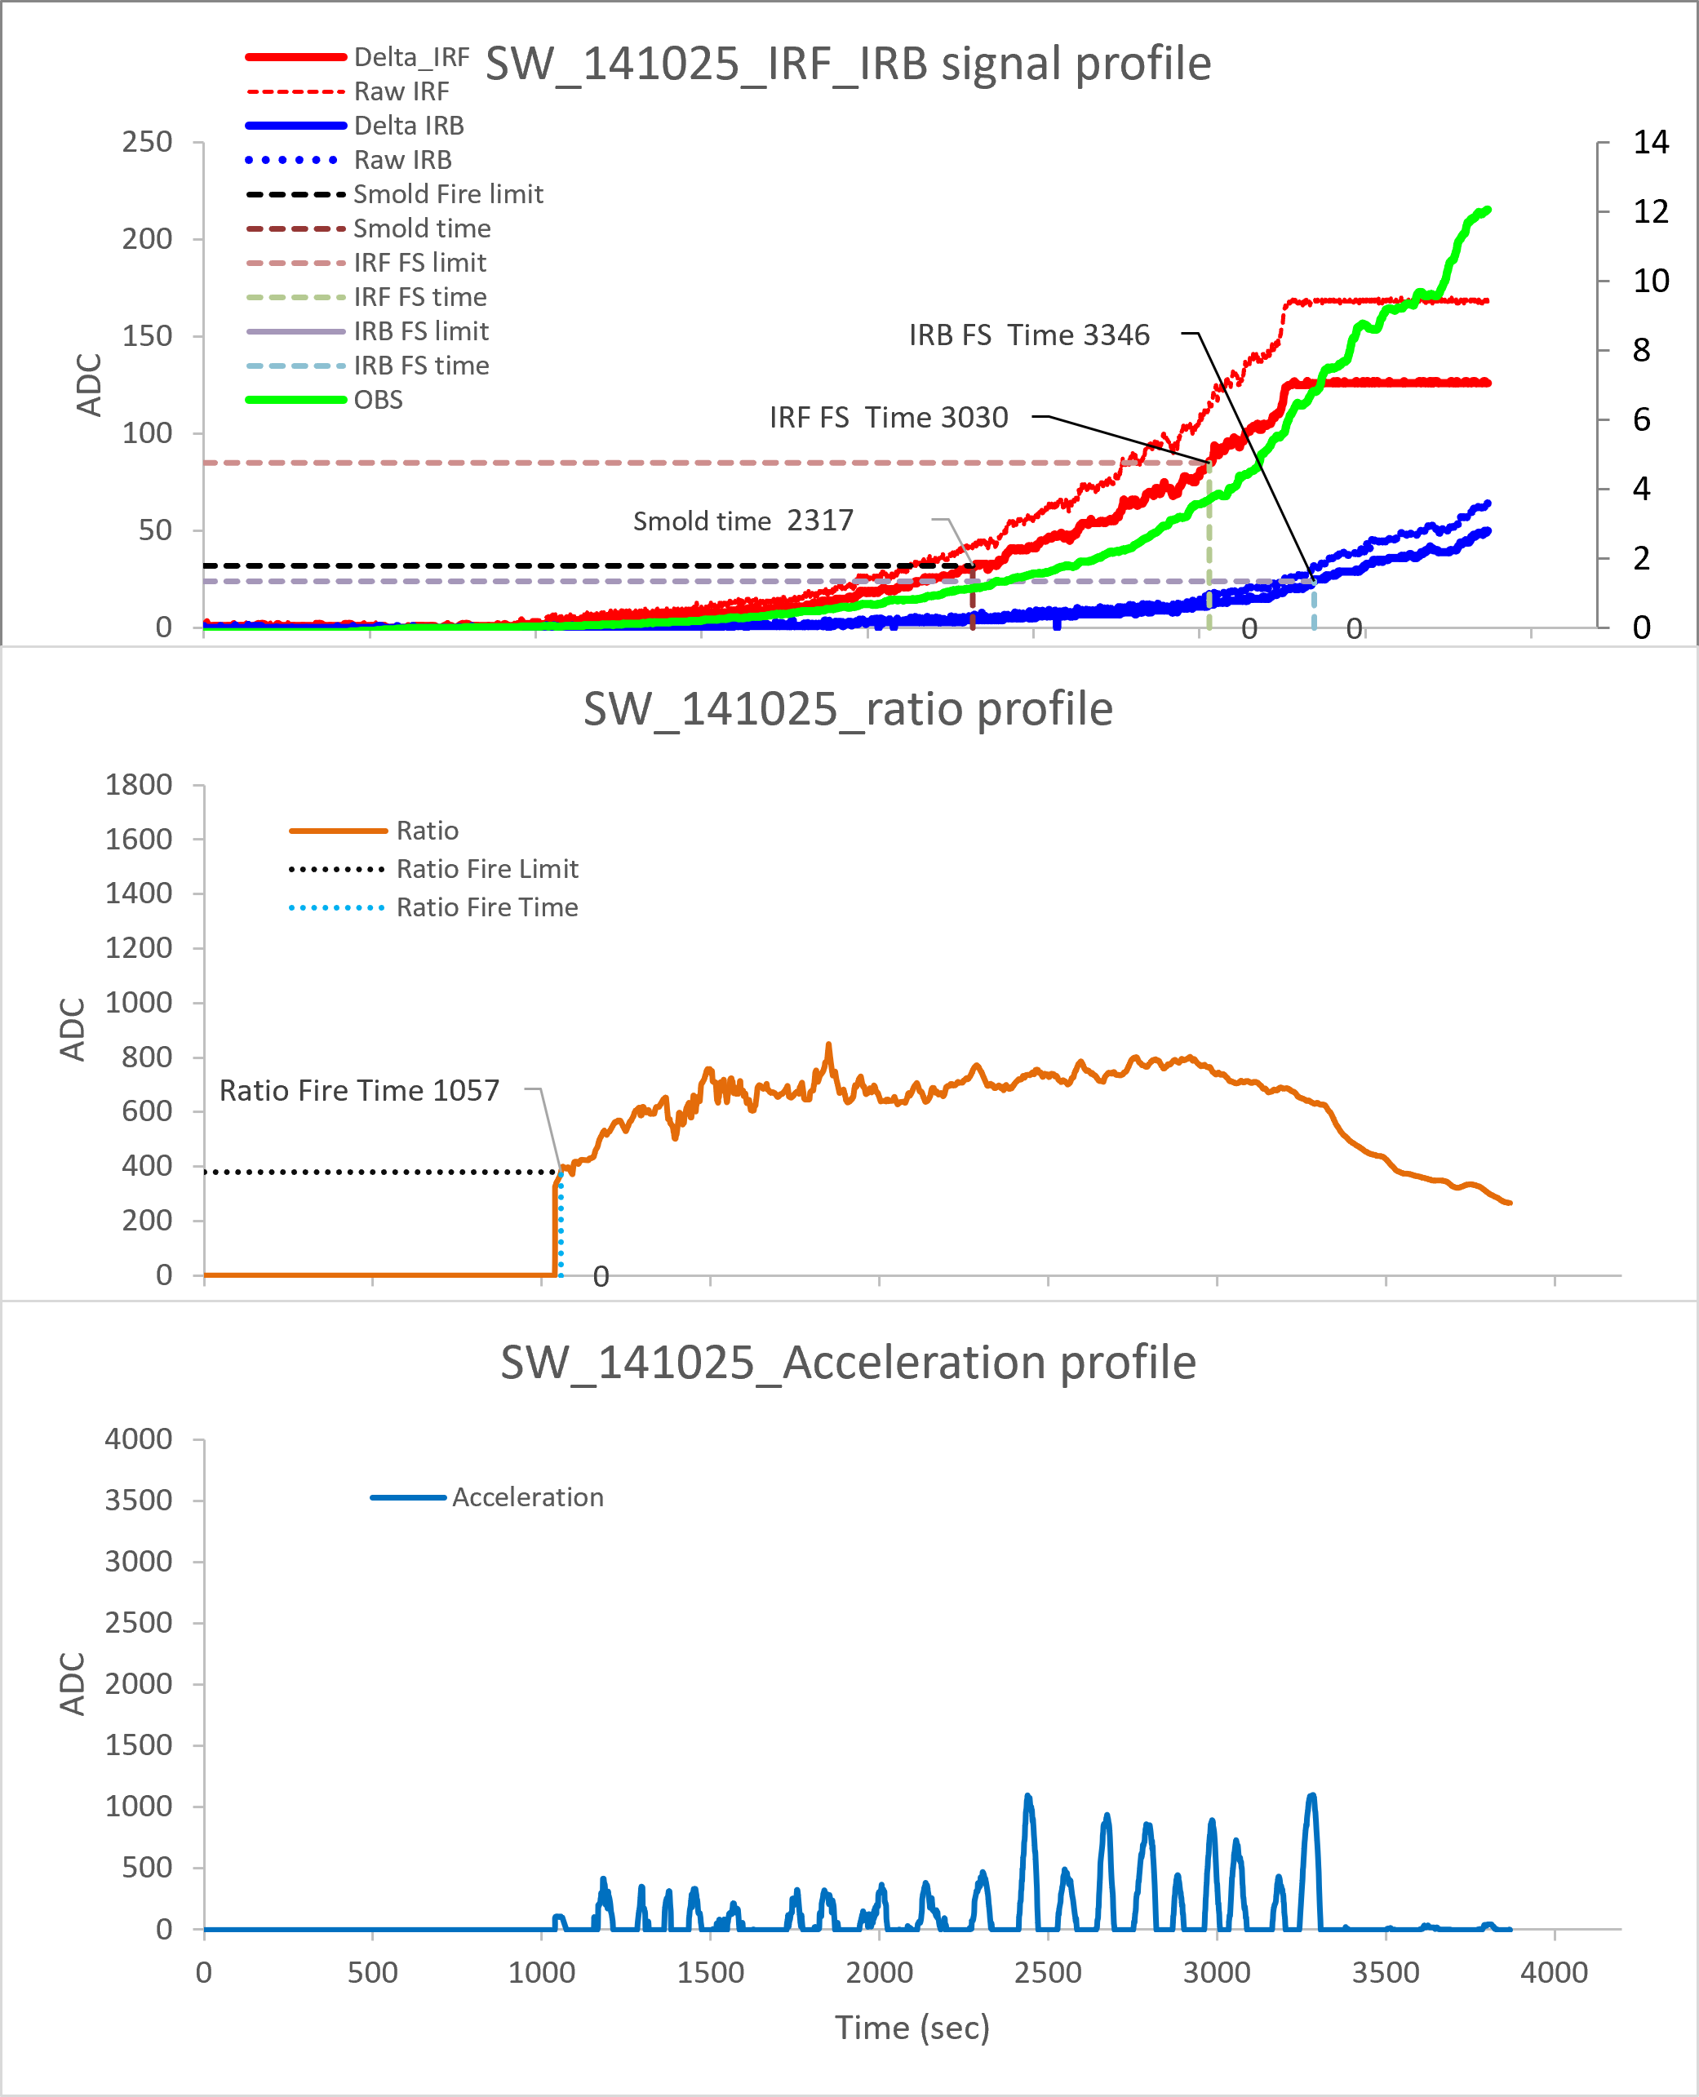
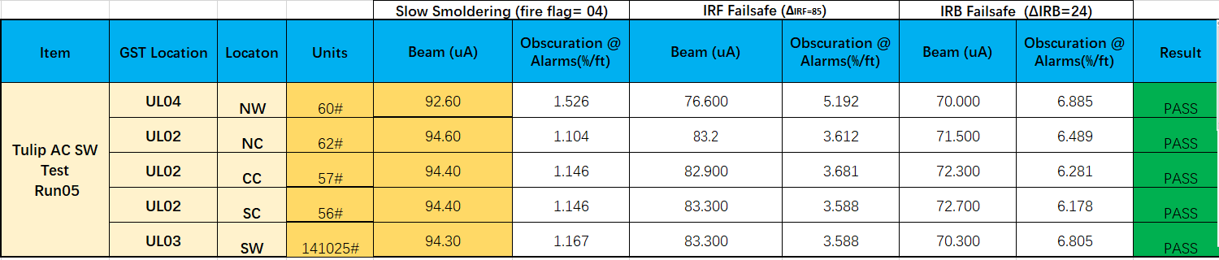
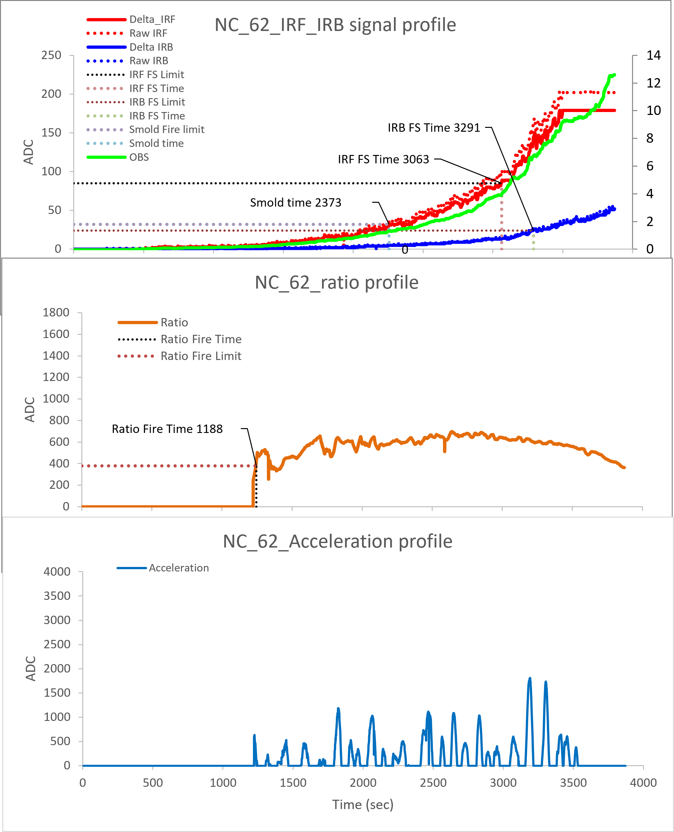
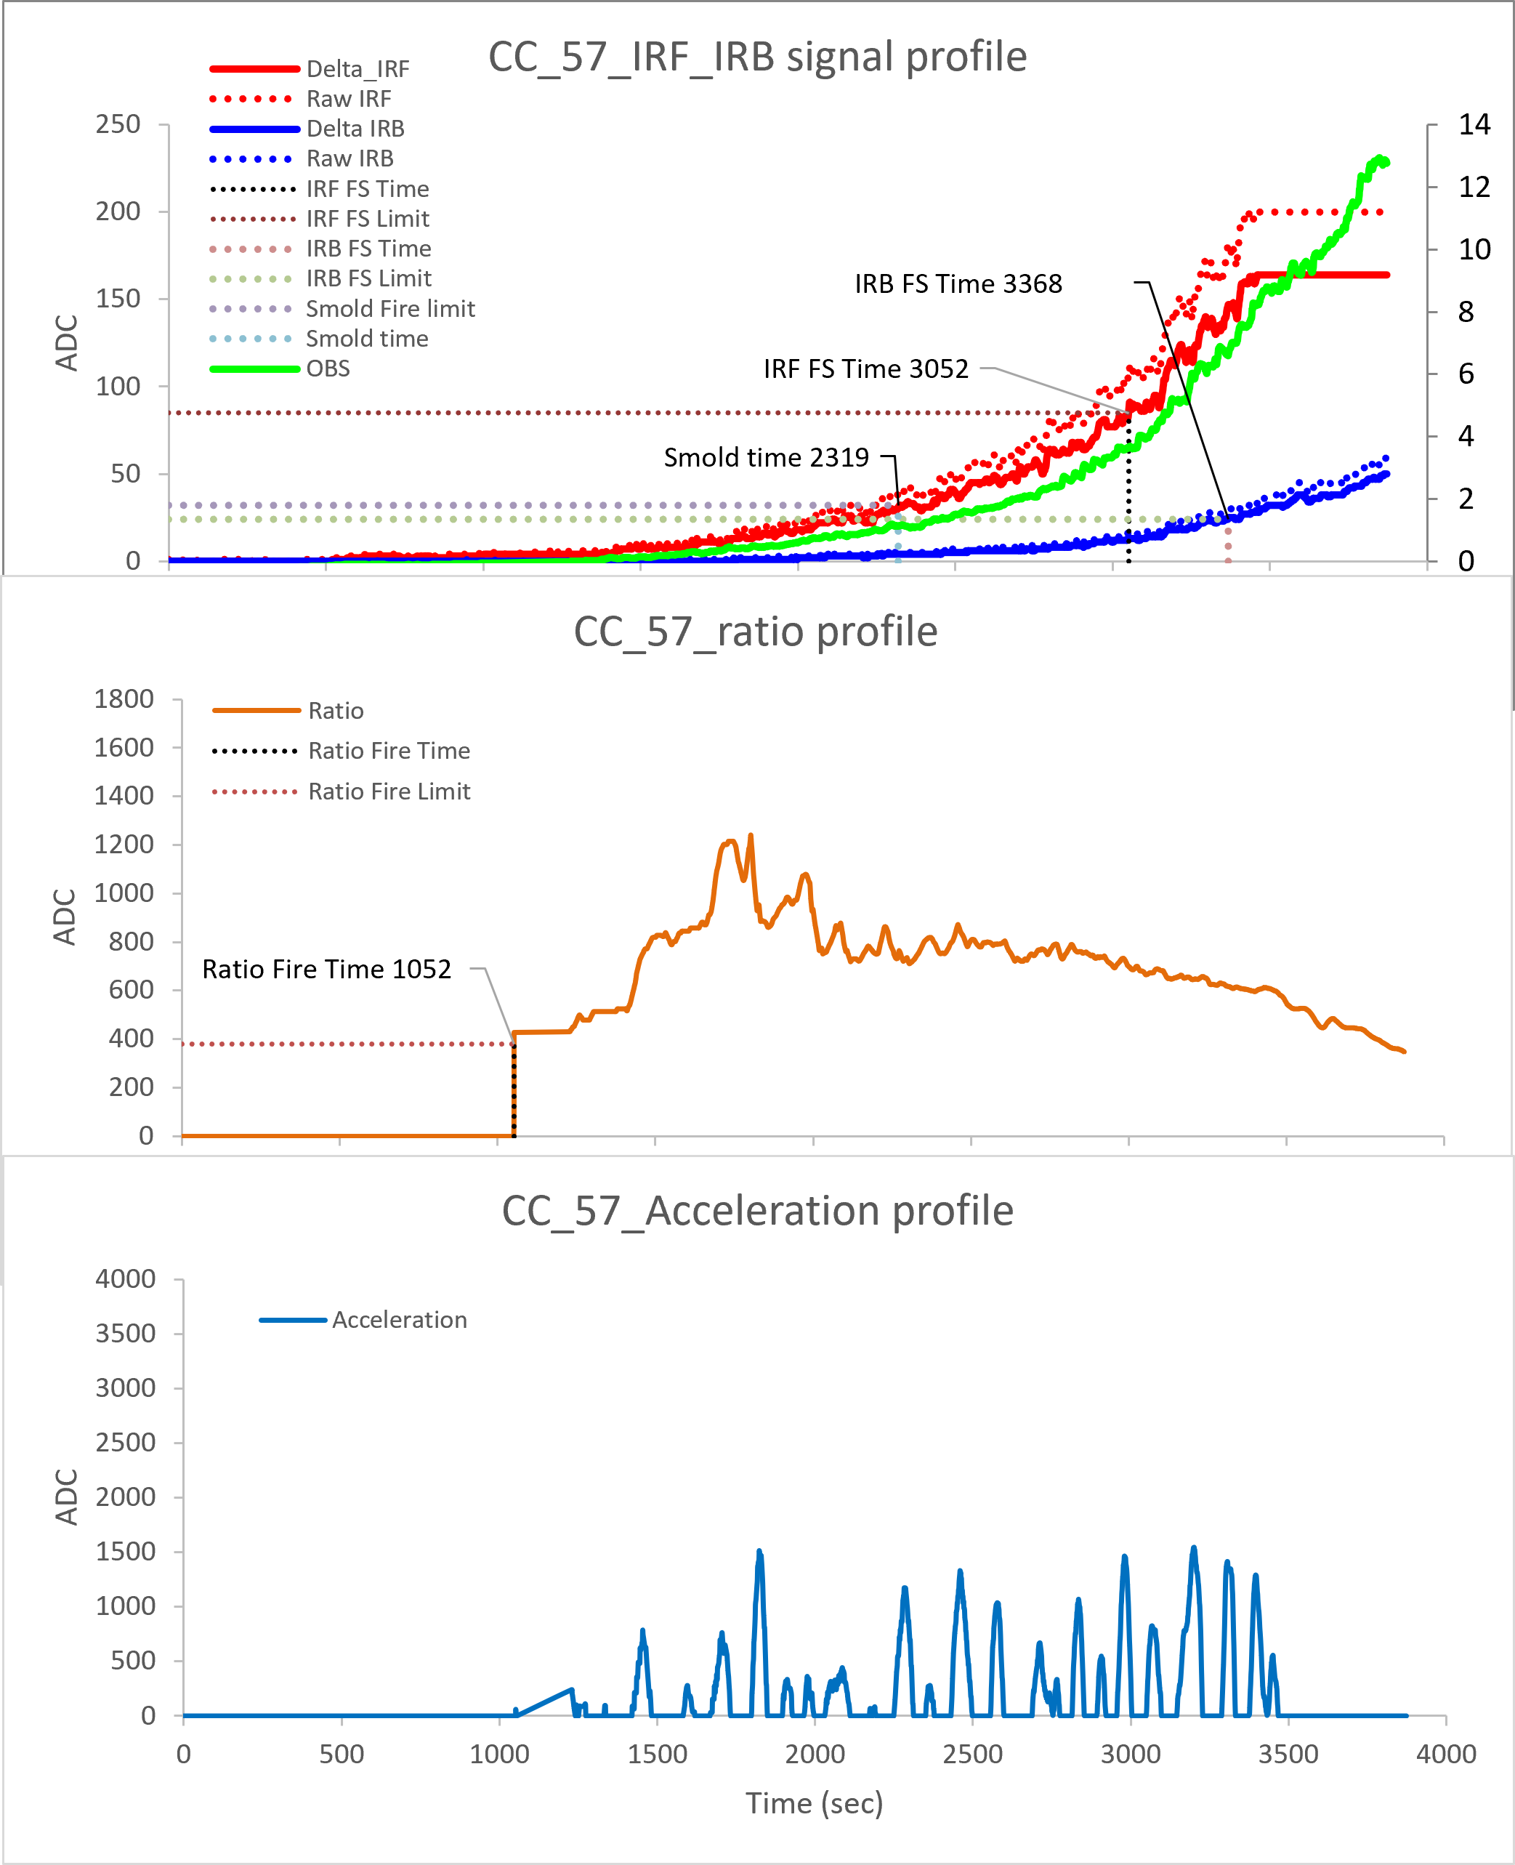
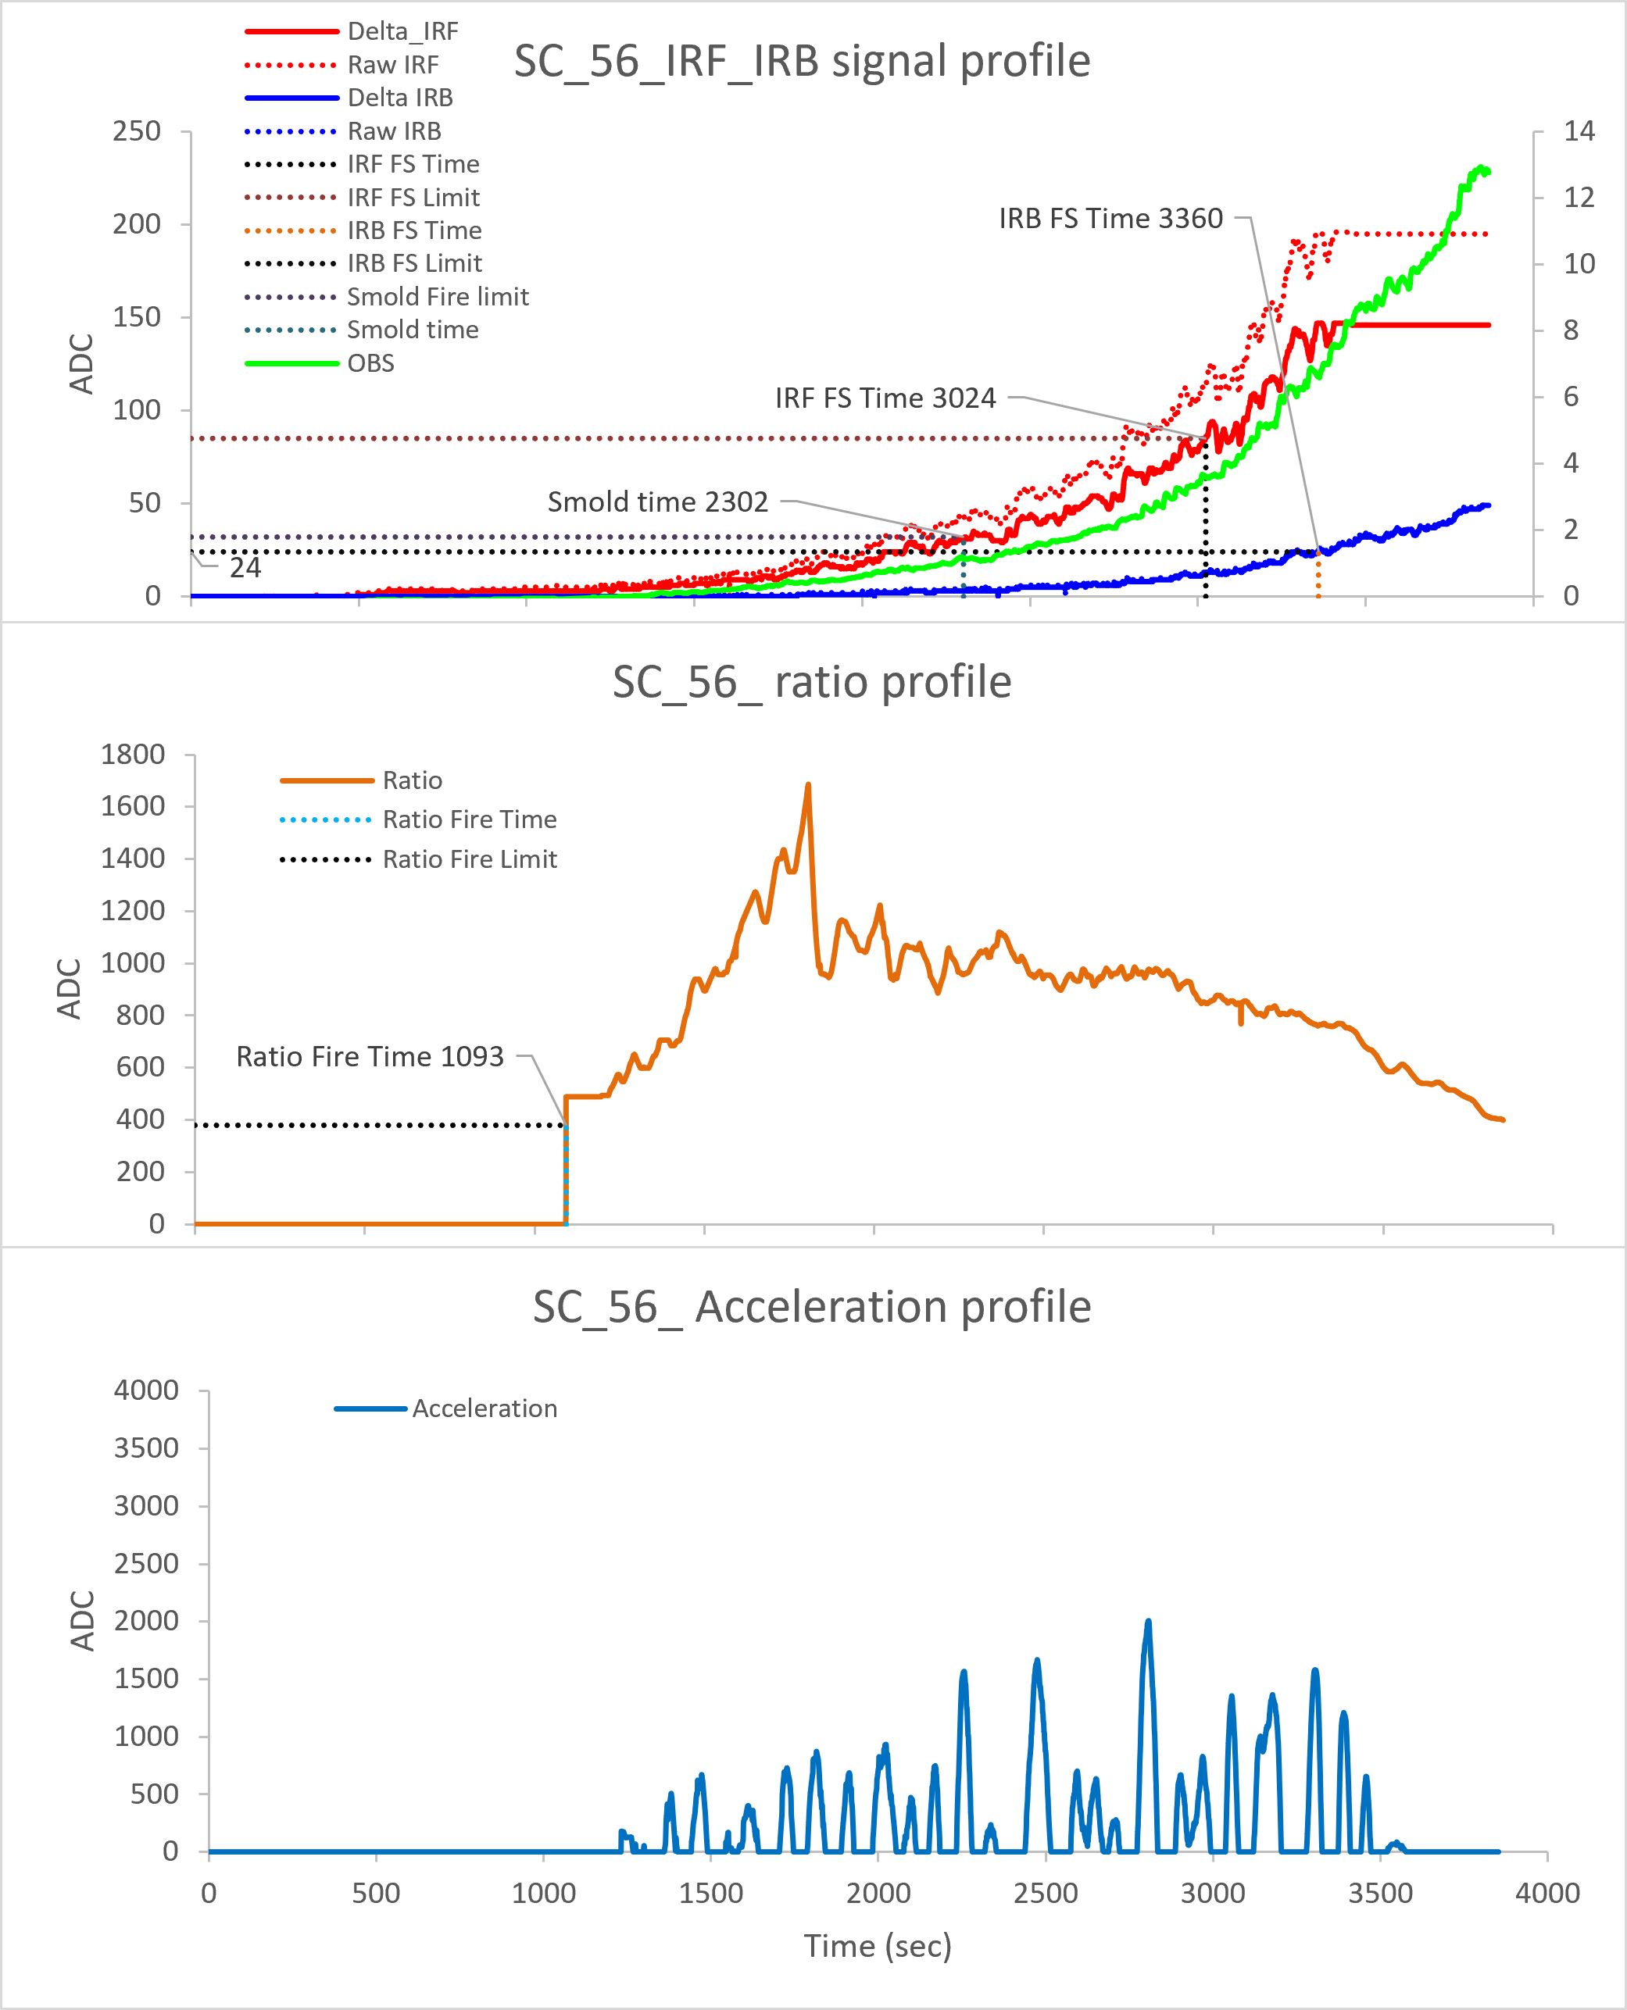
ES4-2 AC
North Wall :60#
South Wall :141025#-IRIS
North Ceiling :62#
Center Ceiling :57#
South Ceiling :56#
Ver 01.00.04
IRIS
RUN 05
Slow smoldering fire triggered at 1.1~1.5%/ft
IRF failsafe fire triggered at 3.5~5.2%/ft
IRB failsafe fire triggered at 6.1~6.9%/ft
Ratio distribution locates in range of 800~1800

Slide 9
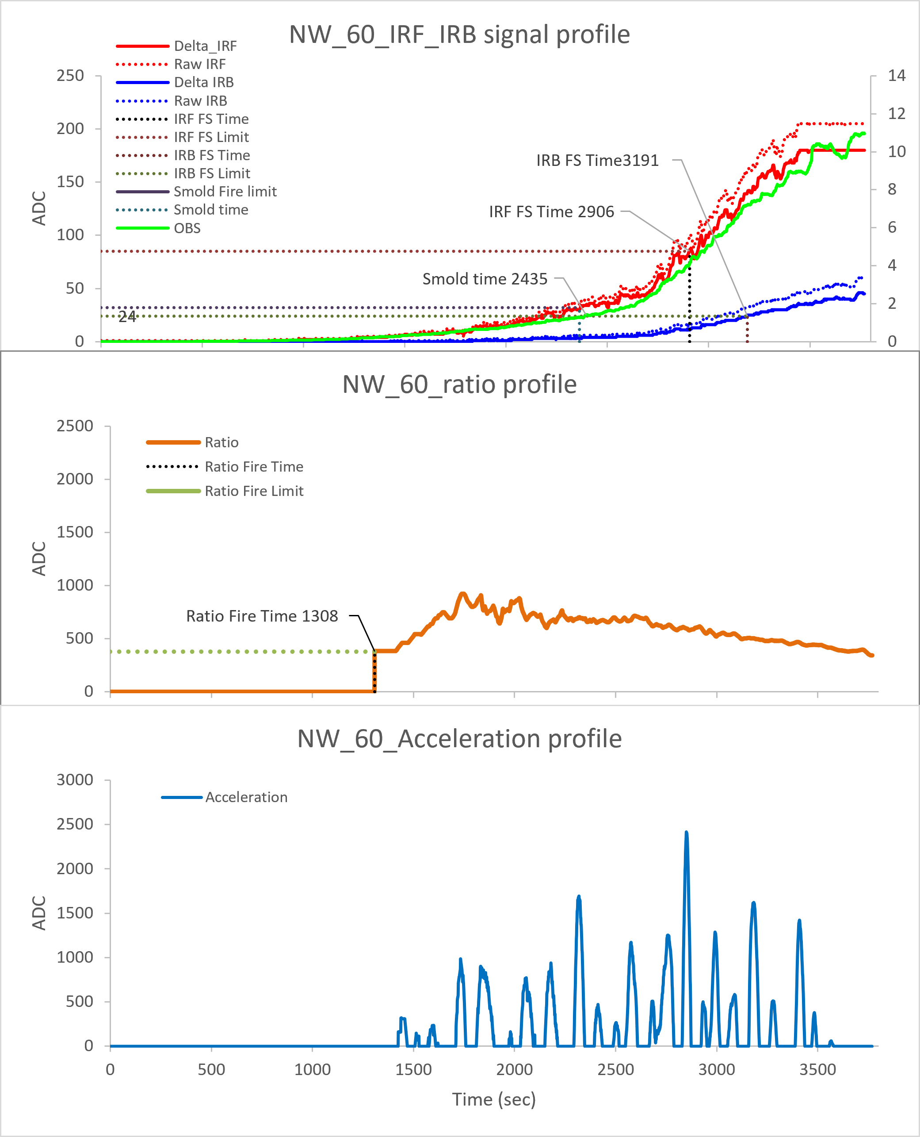
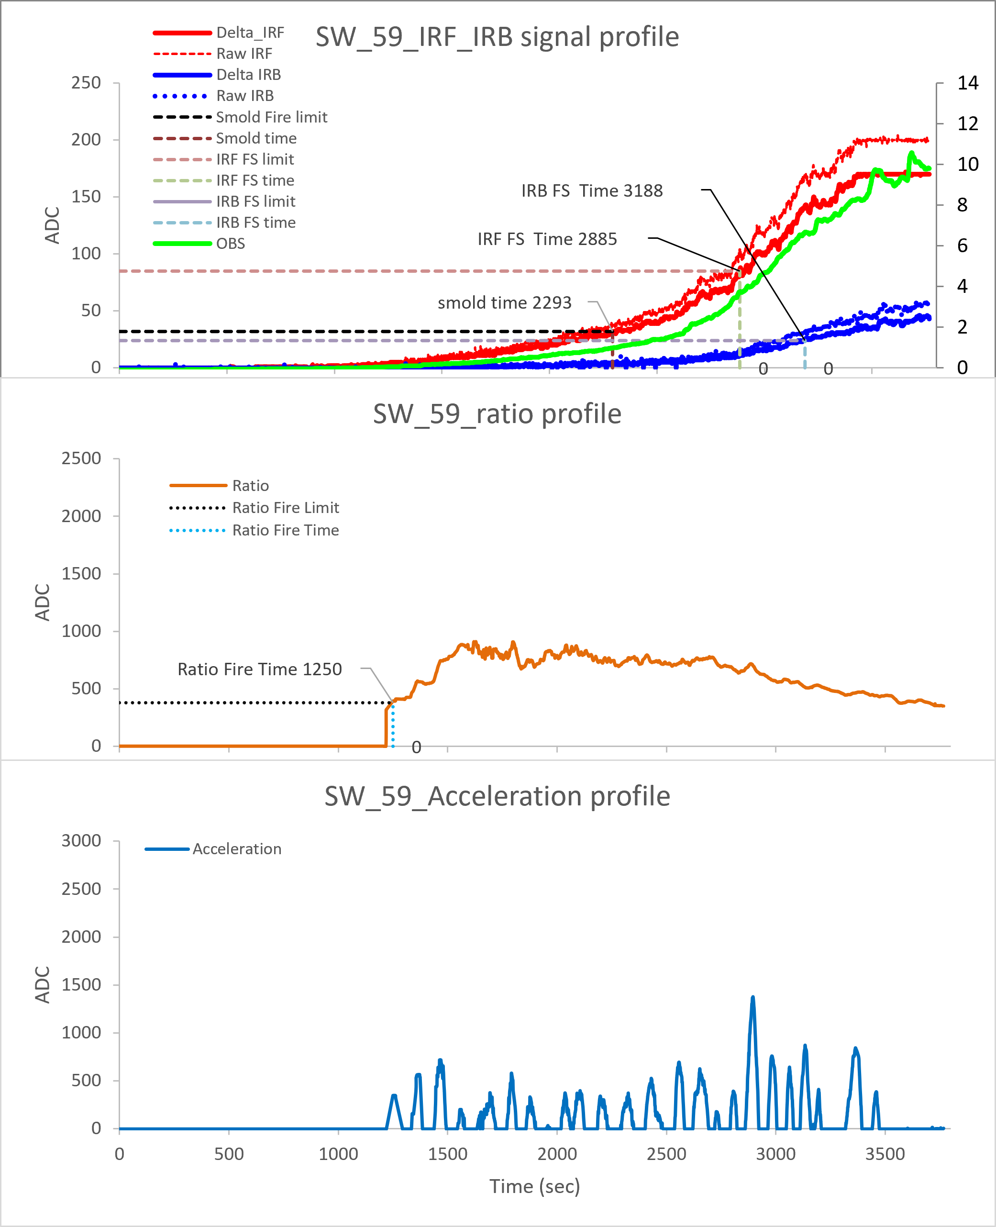
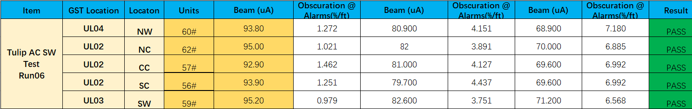
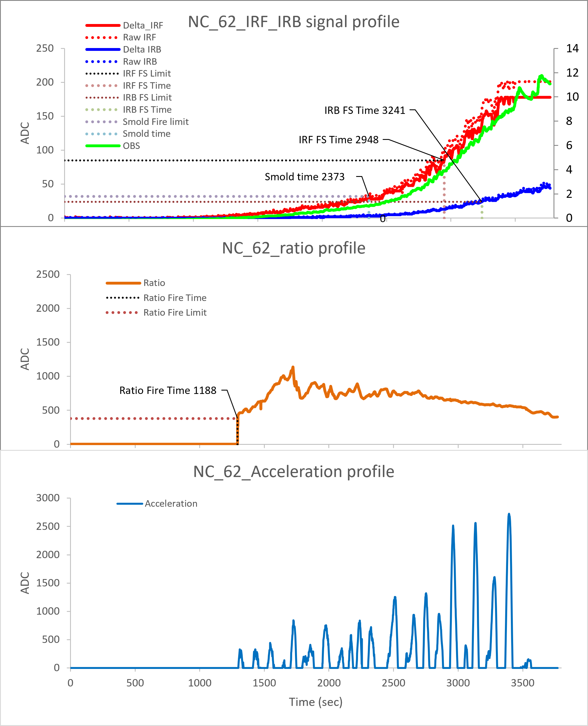
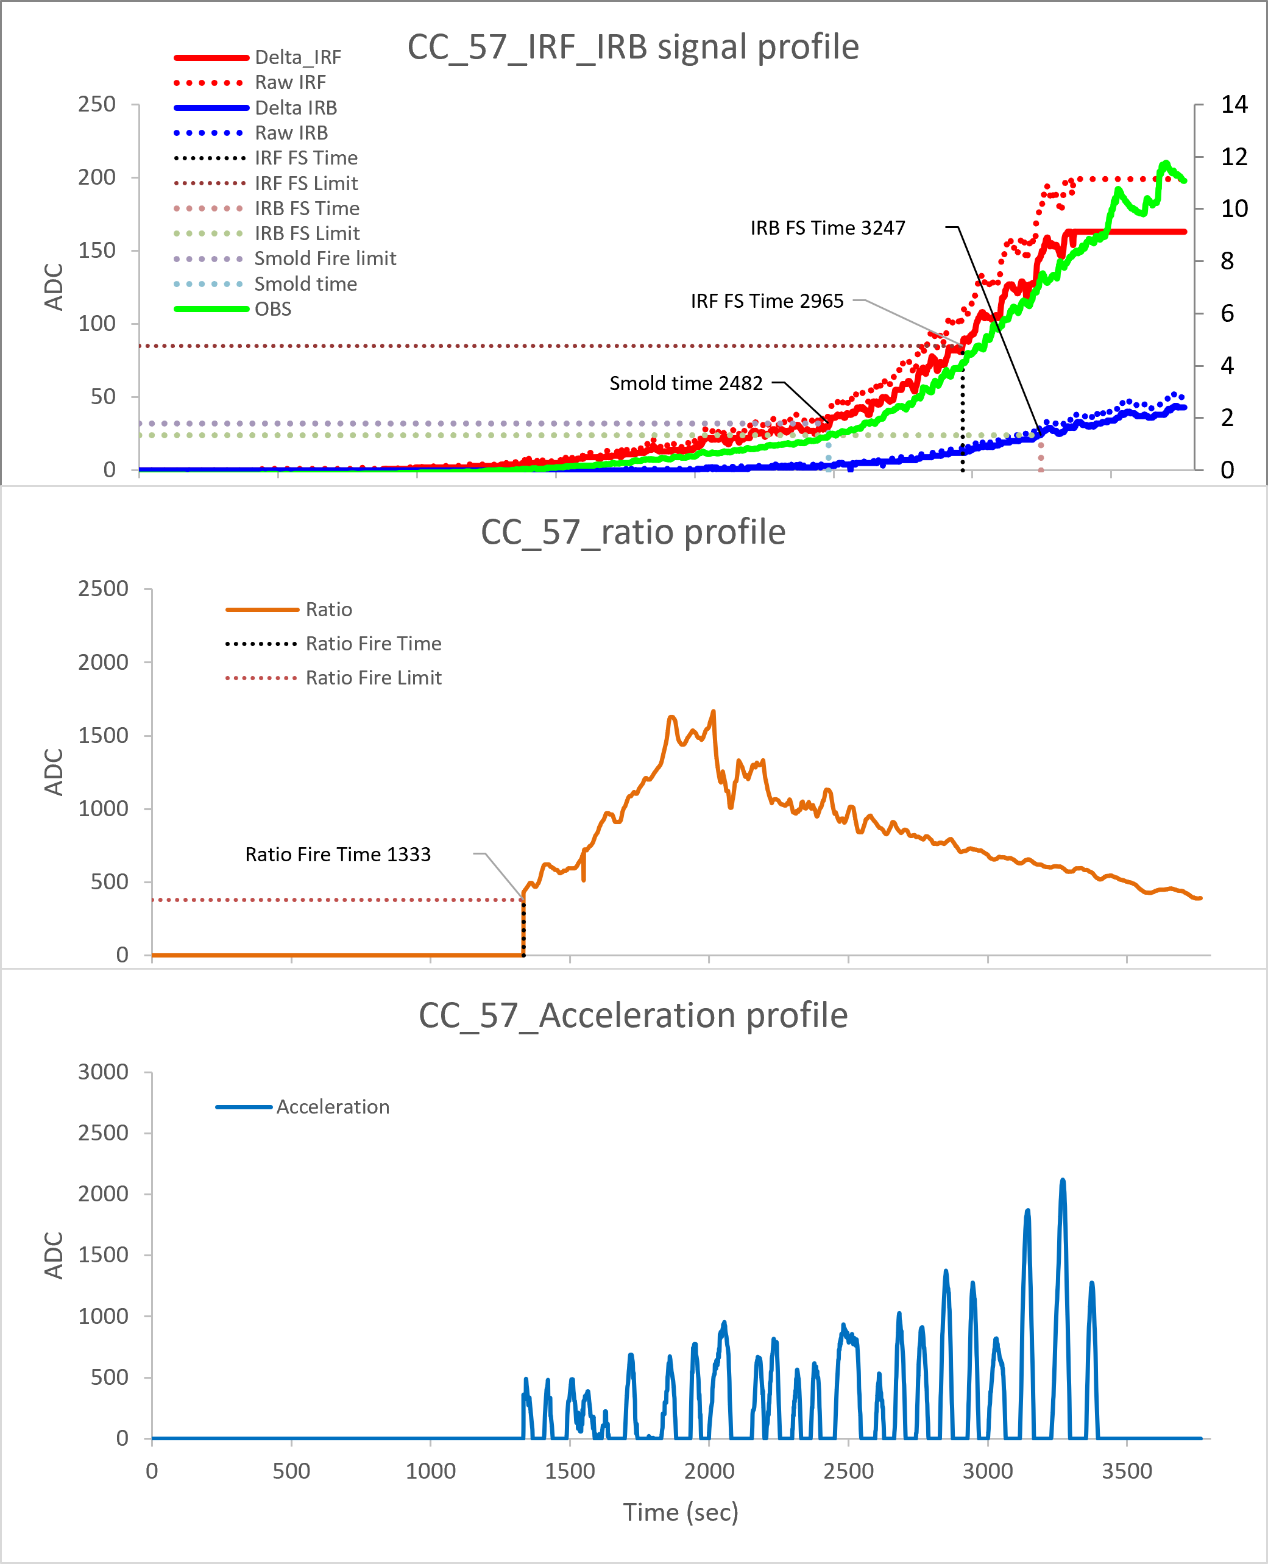
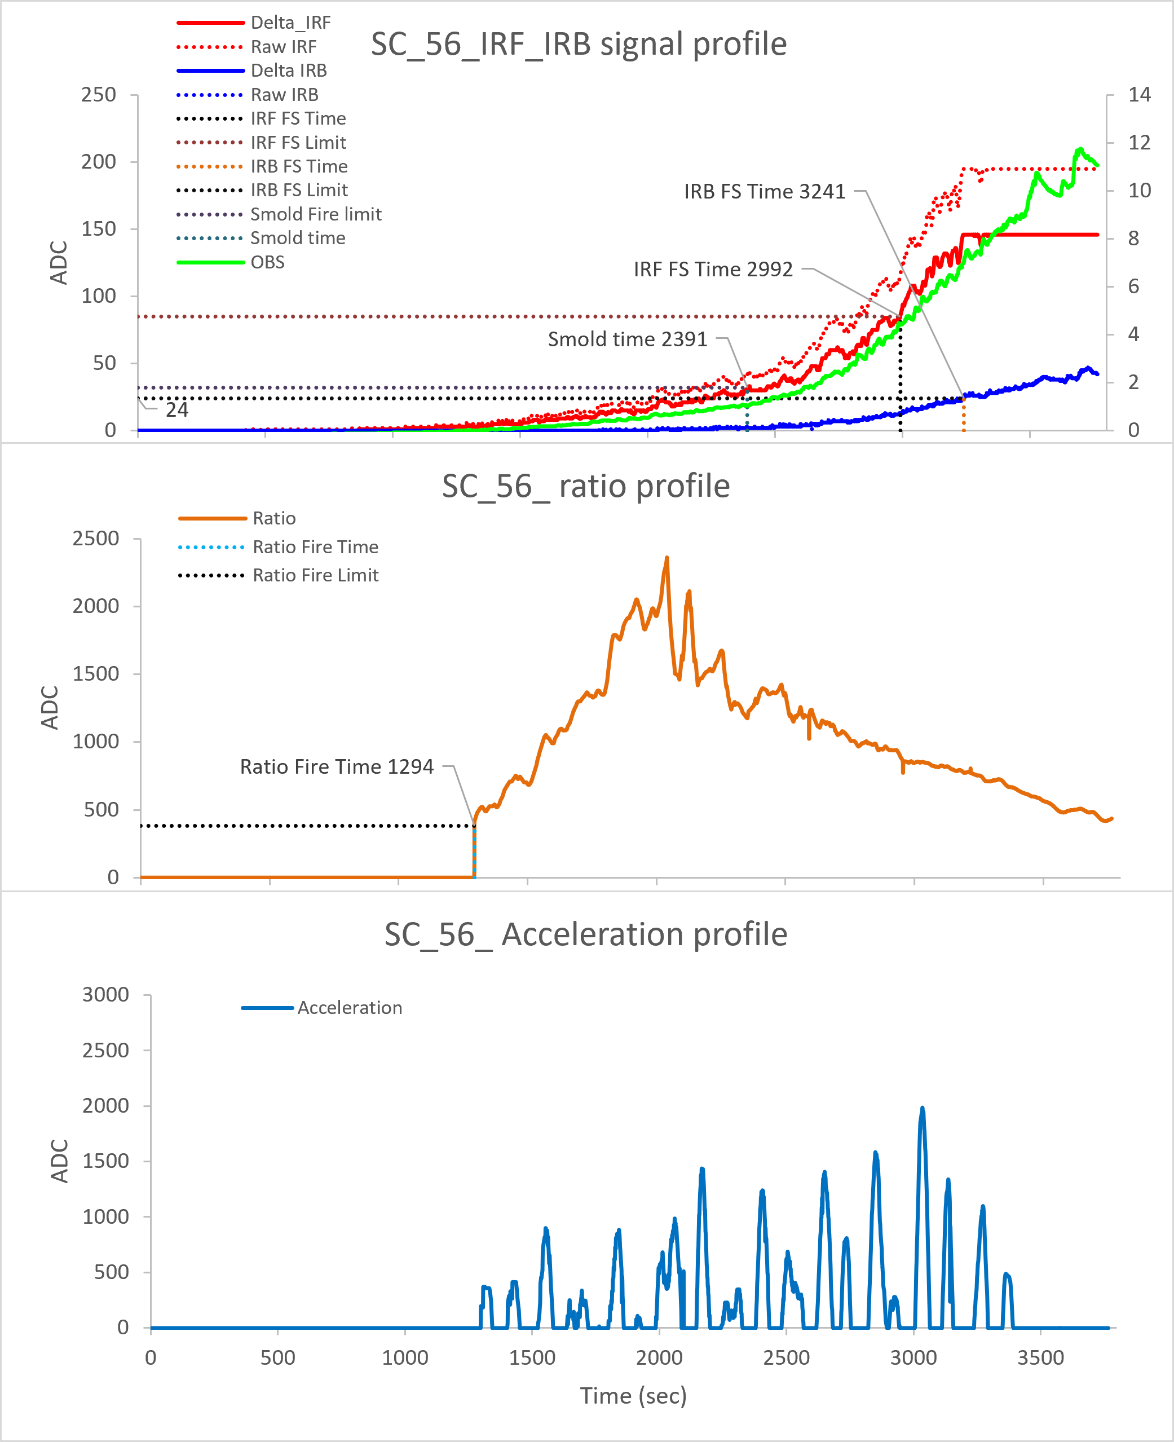
ES4-2 AC
North Wall :60#
South Wall :59#
North Ceiling :62#
Center Ceiling :57#
South Ceiling :56#
Ver 01.00.04
RUN 06
Slow smoldering fire triggered at 0.9~1.5%/ft
IRF failsafe fire triggered at 3.7~4.4%/ft
IRB failsafe fire triggered at 6.5~7.1%/ft
Ratio distribution locates in range of 1000~2500

Slide 10
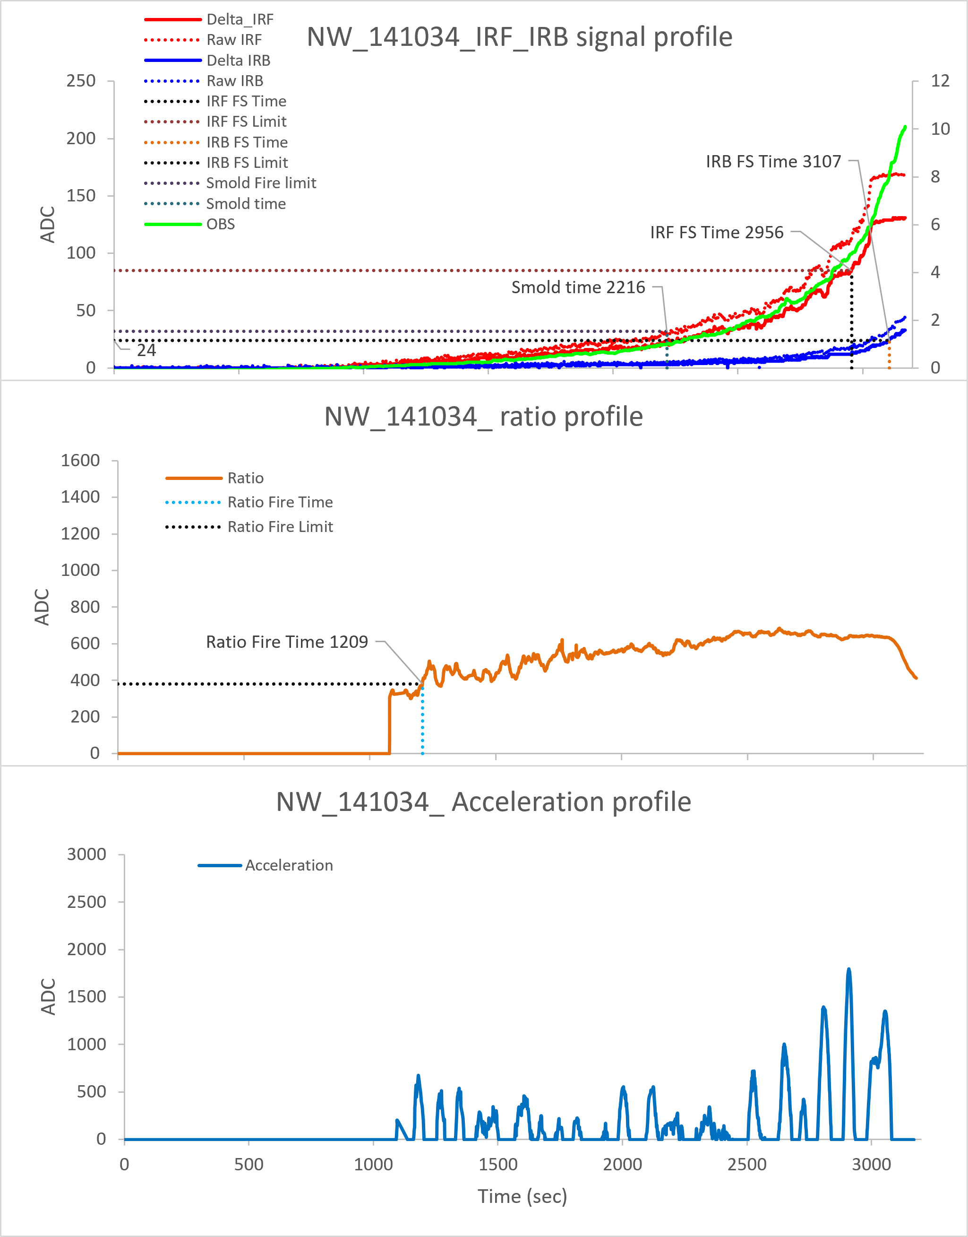
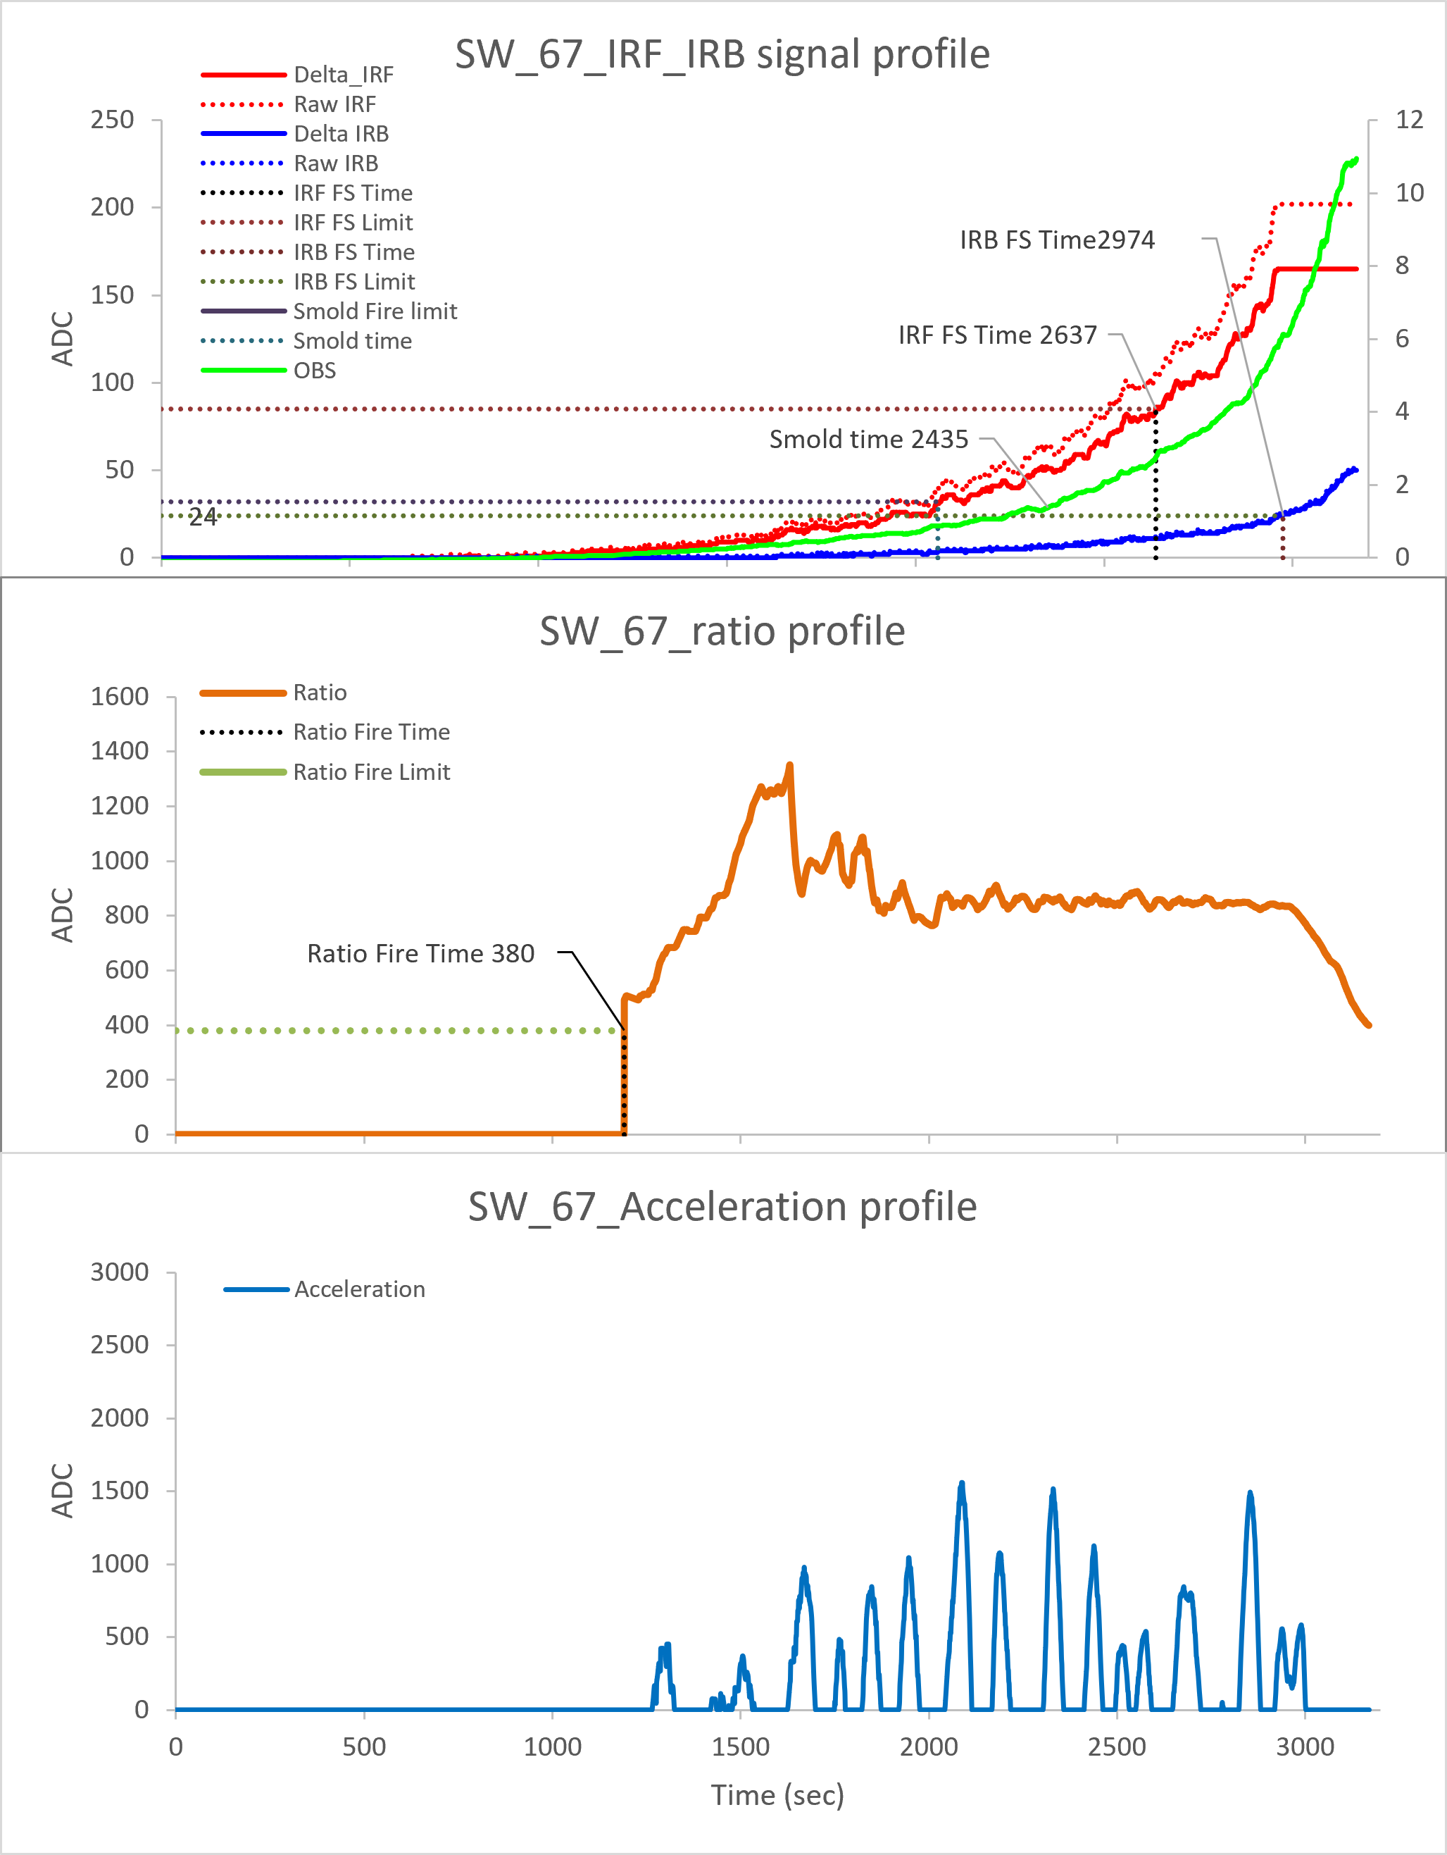
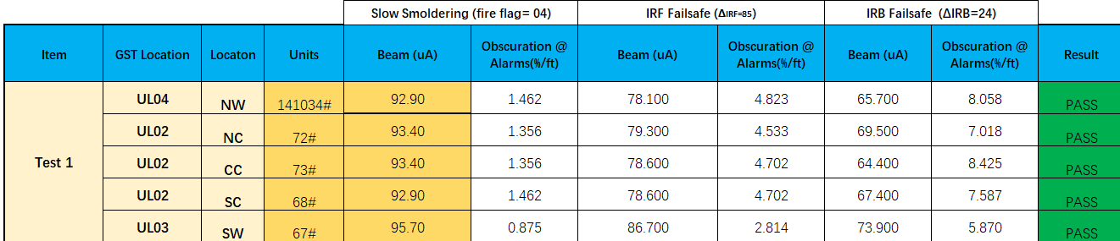
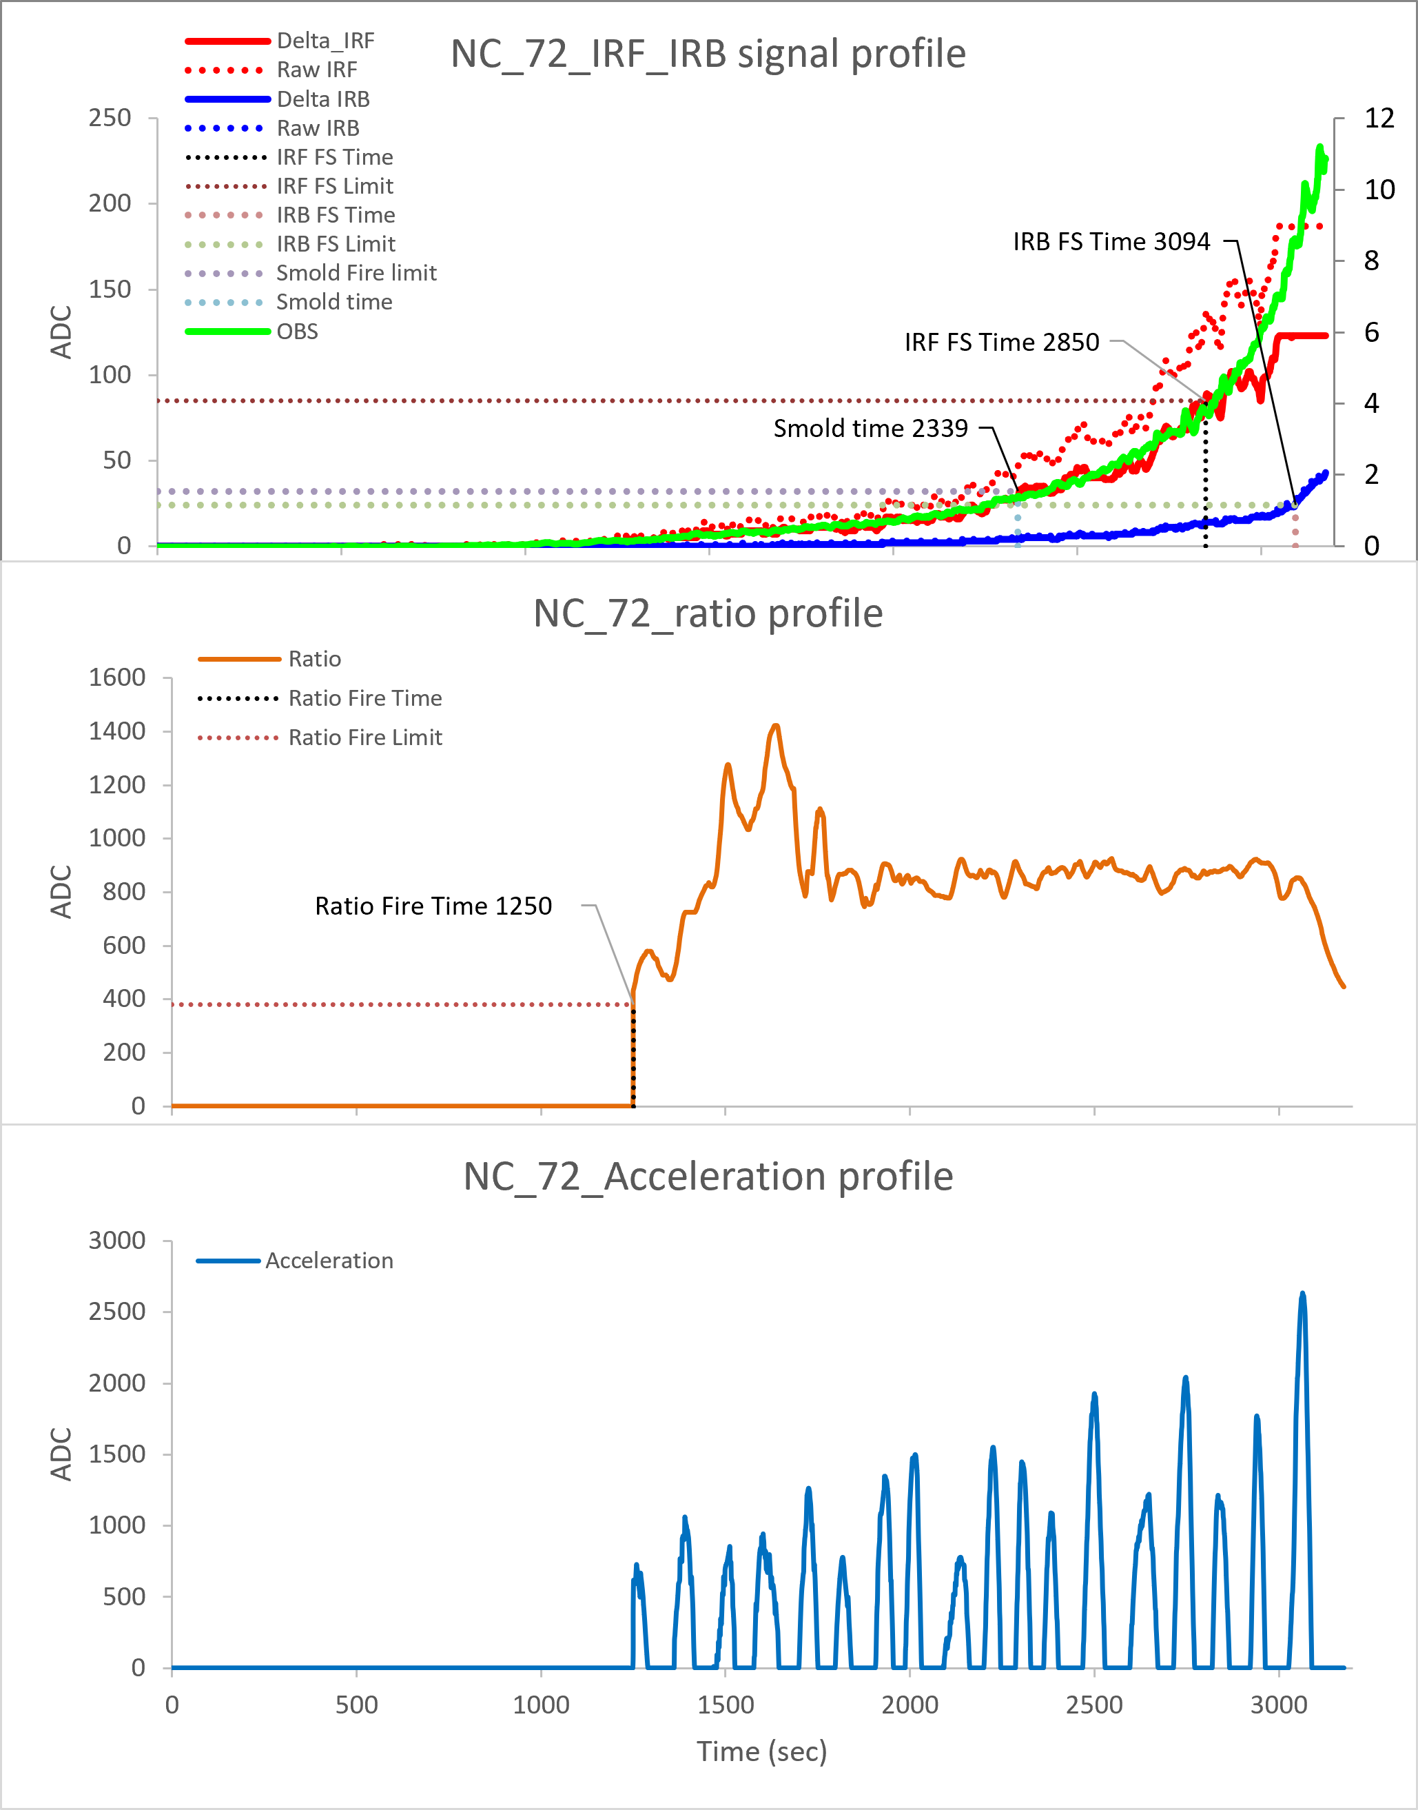
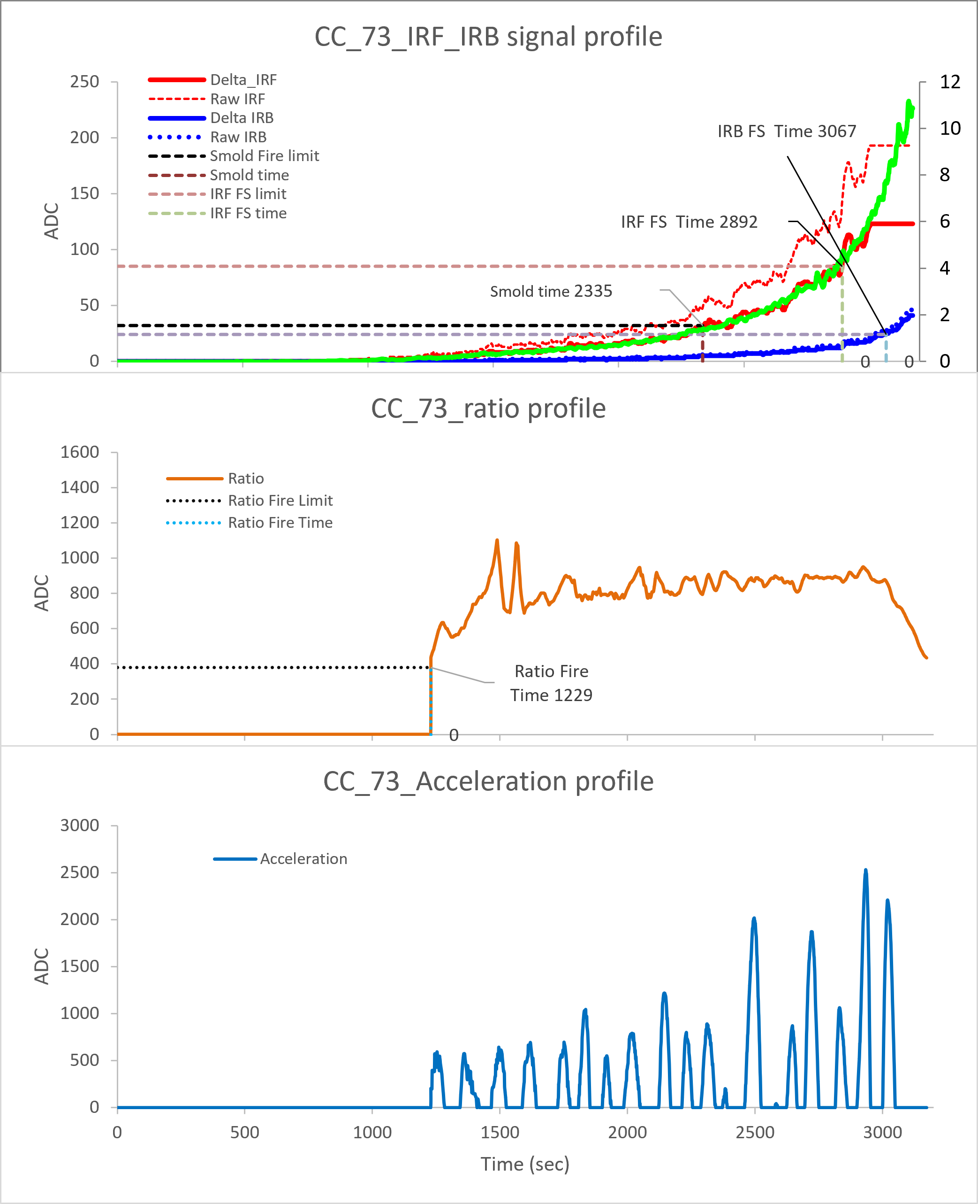
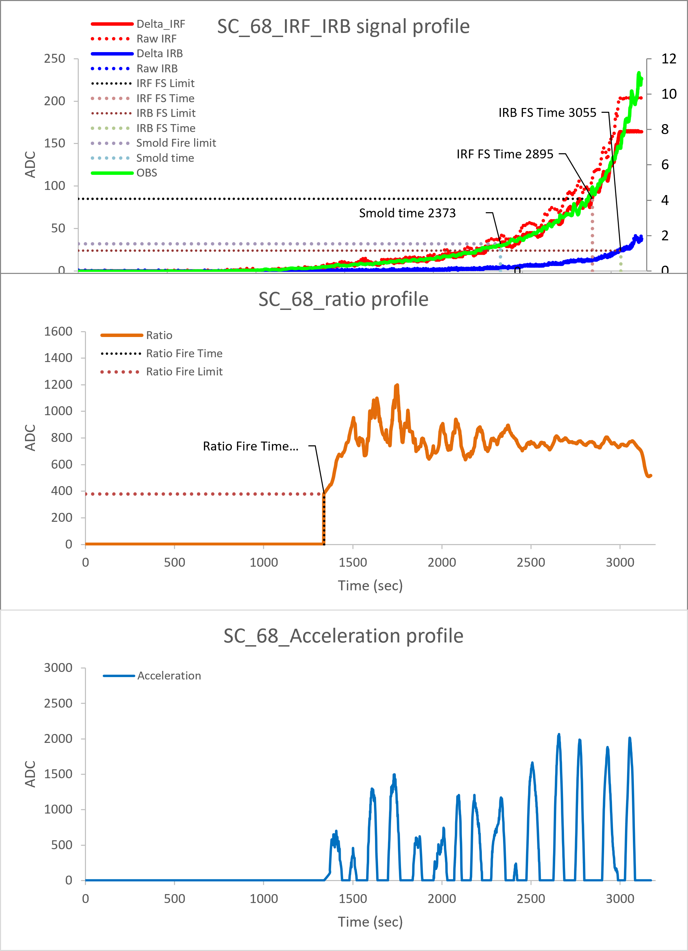
ES2-2 DC
North Wall :141034 #-IRIS
South Wall :67#
North Ceiling :72 #
Center Ceiling :73#
South Ceiling :68#
Ver 01.00.04
IRIS
RUN 01
Slow smoldering fire triggered at 0.8~1.5%/ft
IRF failsafe fire triggered at 2.8~4.9%/ft
IRB failsafe fire triggered at 5.8~8.5%/ft
Ratio distribution locates in range of 600~1400

Slide 11
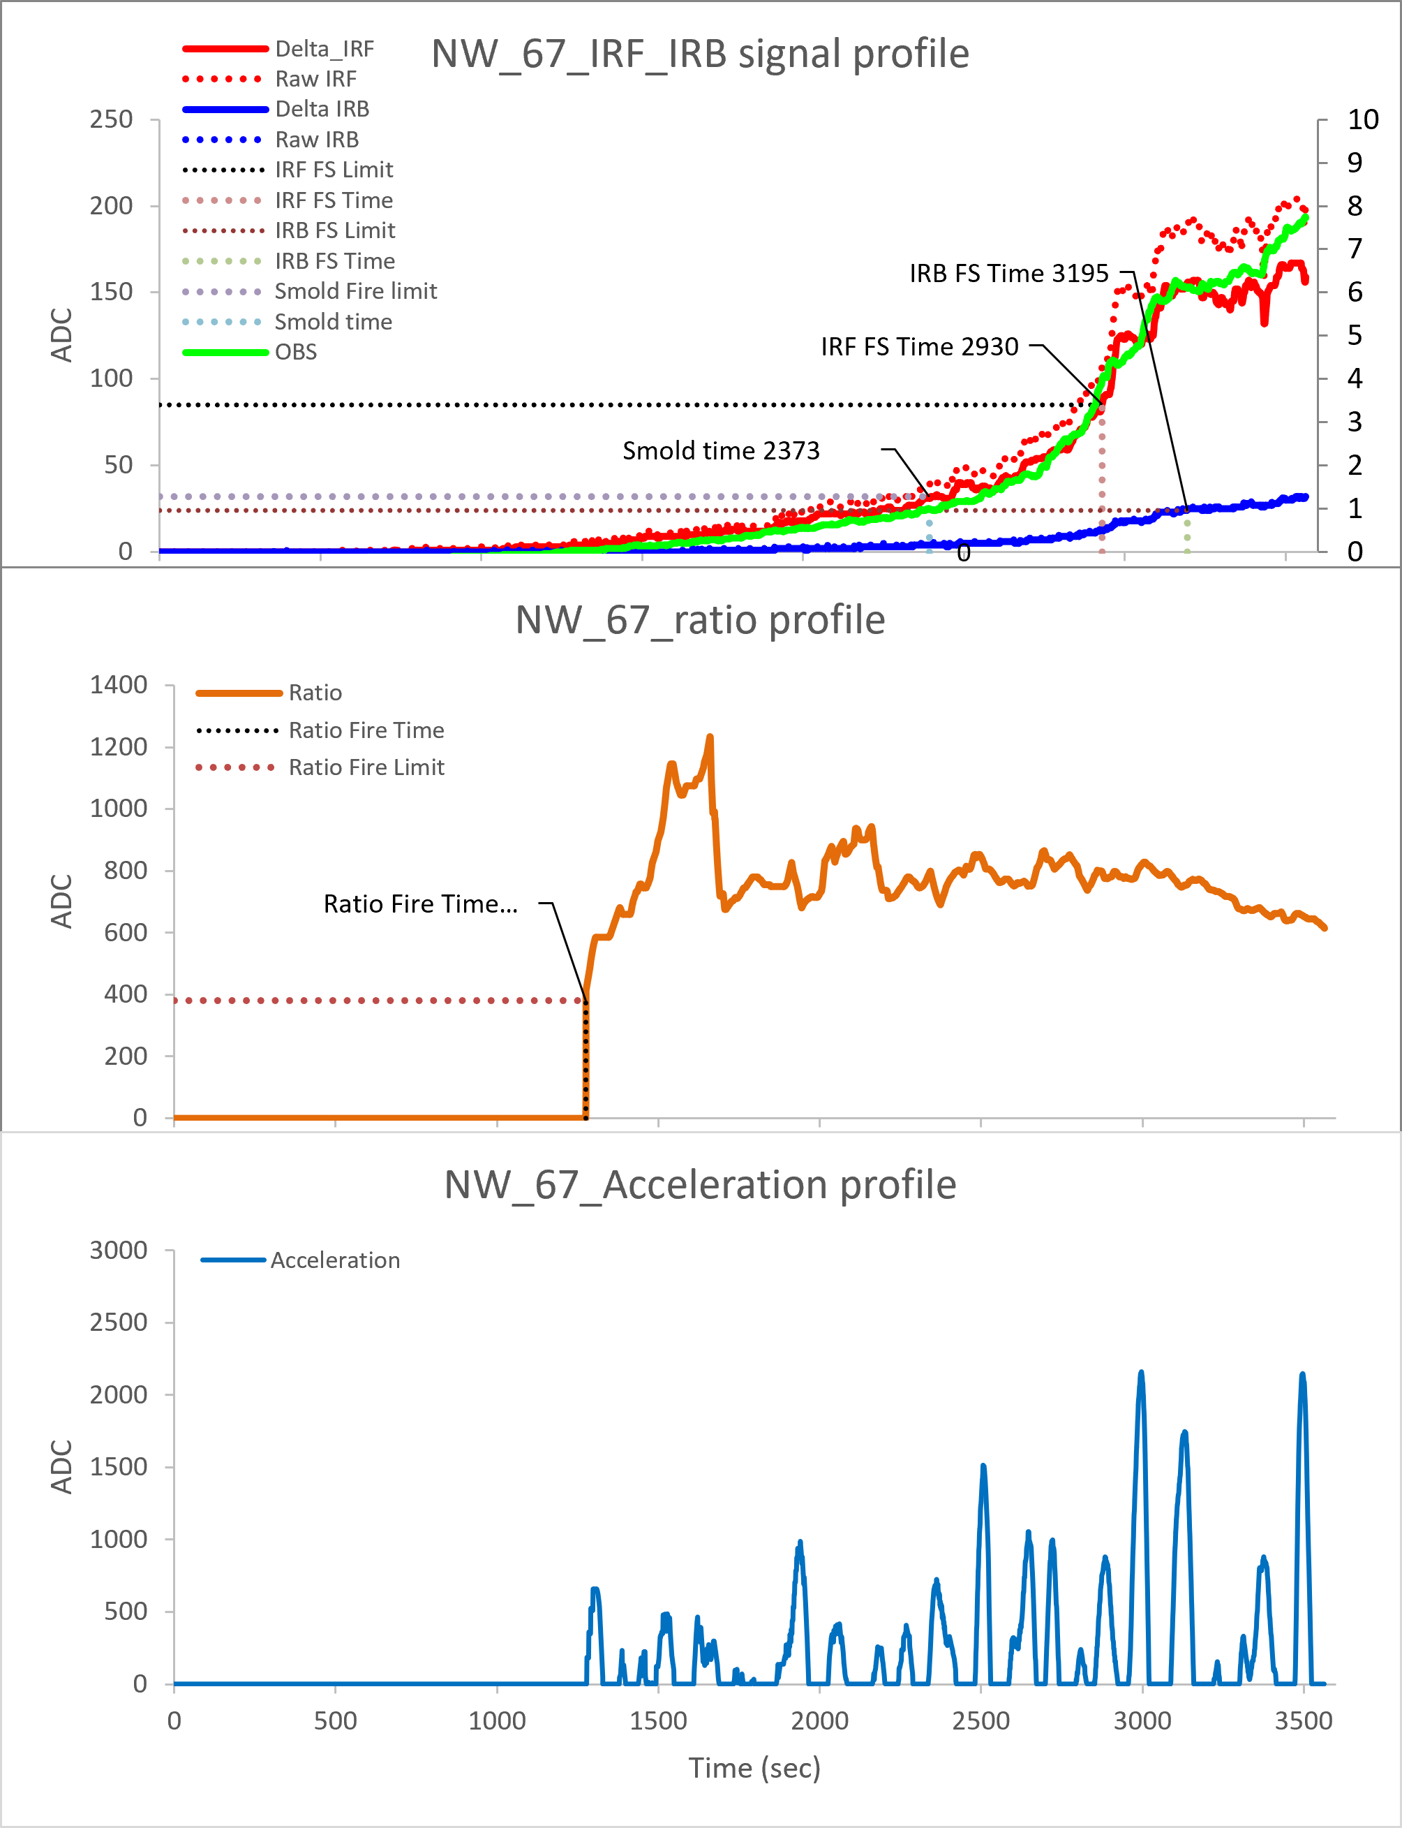
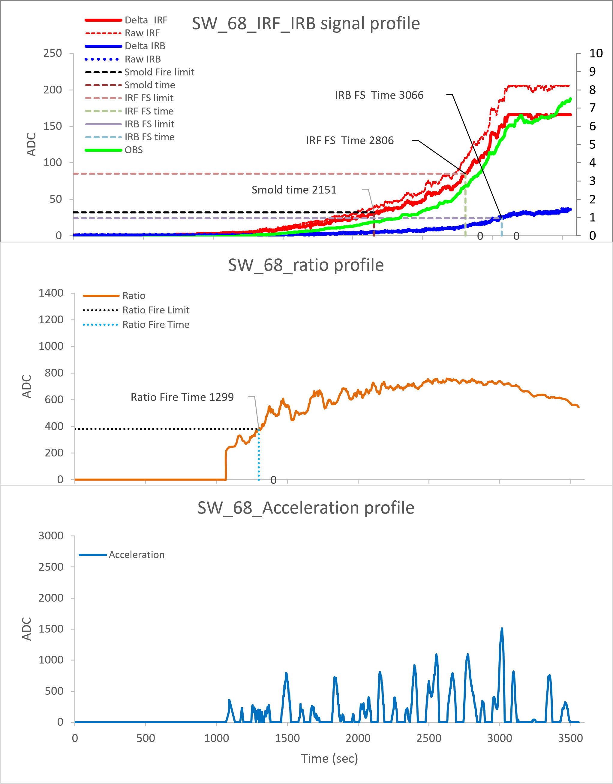
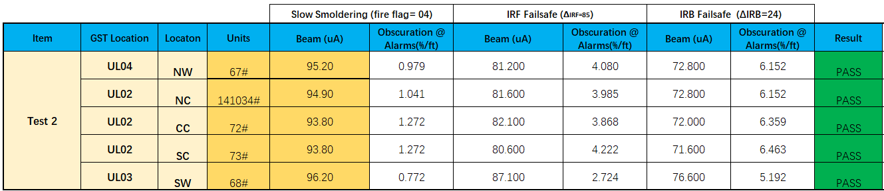
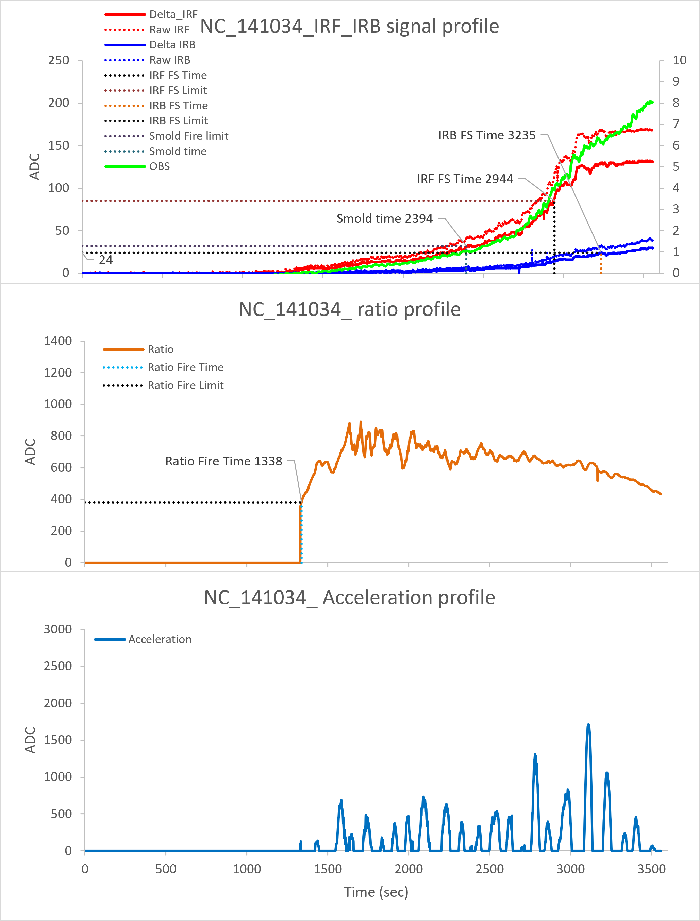
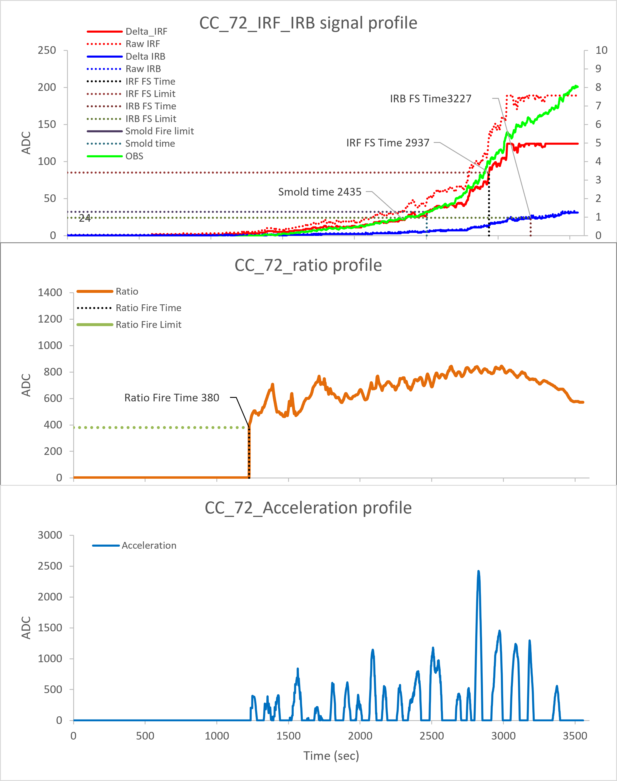
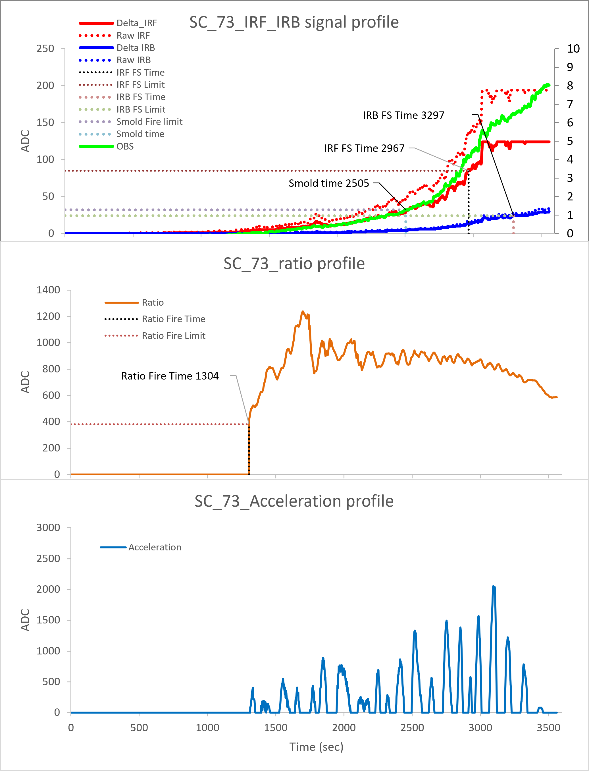
ES2-2 DC
North Wall :67#
South Wall :68#
North Ceiling :141034 #-IRIS
Center Ceiling :72#
South Ceiling :73#
Ver 01.00.04
RUN 02
IRIS
Slow smoldering fire triggered at 0.7~1.3%/ft
IRF failsafe fire triggered at 2.7~4.3%/ft
IRB failsafe fire triggered at 5.1~6.5%/ft
Ratio distribution locates in range of 650~1200

Slide 12






ES2-2 DC
North Wall :68#
South Wall :73#
North Ceiling :67#
Center Ceiling :141034#-IRIS
South Ceiling :72#
Ver 01.00.04
RUN 03
IRIS
Slow smoldering fire triggered at 1.2~1.7%/ft
IRF failsafe fire triggered at 3.6~5.8%/ft
IRB failsafe fire triggered at 6.9~7.6%/ft
Ratio distribution locates in range of 800~1400

Slide 13






ES2-2 DC
North Wall :73#
South Wall :72#
North Ceiling :68#
Center Ceiling :67#
South Ceiling :141034#-IRIS
Ver 01.00.04
RUN 04
IRIS
Slow smoldering fire triggered at 0.8~1.5%/ft
IRF failsafe fire triggered at 2.7~3.9%/ft
IRB failsafe fire triggered at 5.3~6.8%/ft
Ratio distribution locates in range of 1200~1800

Slide 14






ES2-2 DC
North Wall :72#
South Wall :141034#-IRIS
North Ceiling :73#
Center Ceiling :68#
South Ceiling :67#
Ver 01.00.04
IRIS
RUN 05
Slow smoldering fire triggered at 1.3~1.8%/ft
IRF failsafe fire triggered at 3.5~4.3%/ft
IRB failsafe fire triggered at 6.3~7.2%/ft
Ratio distribution locates in range of 600~2000

Slide 15






ES2-2 DC
North Wall :72#
South Wall :69#
North Ceiling :73#
Center Ceiling :68#
South Ceiling :67#
Ver 01.00.04
RUN 06
Slow smoldering fire triggered at 0.9~1.7%/ft
IRF failsafe fire triggered at 3.1~4.5%/ft
IRB failsafe fire triggered at 5.7~7.2%/ft
Ratio distribution locates in range of 1000~2000

Slide 16






ES2-2 DC NEW COVER
North Wall :141034 #-IRIS
South Wall :67#
North Ceiling :72 #
Center Ceiling :73#
South Ceiling :68#
Ver 01.00.04
IRIS
RUN 01
Slow smoldering fire triggered at 1.3~1.9%/ft
IRF failsafe fire triggered at 2.9~5.0%/ft
IRB failsafe fire triggered at 6.1~7.8%/ft
Ratio distribution locates in range of 800~2500

Slide 17







ES2-2 DC NEW COVER
North Wall :67#
South Wall :68#
North Ceiling :141034 #-IRIS
Center Ceiling :72#
South Ceiling :73#
Ver 01.00.04
RUN 02
IRIS
Slow smoldering fire triggered at 1.0~1.7%/ft
IRF failsafe fire triggered at 3.1~4.8%/ft
IRB failsafe fire triggered at 6.0~7.2%/ft
Ratio distribution locates in range of 600~1800

Slide 18







ES2-2 DC NEW COVER
North Wall :68#
South Wall :73#
North Ceiling :67#
Center Ceiling :141034#-IRIS
South Ceiling :72#
Ver 01.00.04
RUN 03
IRIS
Slow smoldering fire triggered at 0.9~1.7%/ft
IRF failsafe fire triggered at 2.4~4.8%/ft
IRB failsafe fire triggered at 5.8~7.5%/ft
Ratio distribution locates in range of 600~2100

Slide 19







ES2-2 DC NEW COVER
North Wall :73#
South Wall :72#
North Ceiling :68#
Center Ceiling :67#
South Ceiling :141034#-IRIS
Ver 01.00.04
RUN 04
IRIS
Slow smoldering fire triggered at 1.1~1.9%/ft
IRF failsafe fire triggered at 3.1~4.7%/ft
IRB failsafe fire triggered at 5.9~7.3%/ft
Ratio distribution locates in range of 600~2500

Slide 20






ES2-2 DC NEW COVER
North Wall :72#
South Wall :141034#-IRIS
North Ceiling :73#
Center Ceiling :68#
South Ceiling :67#
Ver 01.00.04
RUN 05
IRIS
Slow smoldering fire triggered at 0.9~1.5%/ft
IRF failsafe fire triggered at 2.4~5.0%/ft
IRB failsafe fire triggered at 3.6~7.4%/ft
Ratio distribution locates in range of 600~2000

Slide 21







ES2-2 DC NEW COVER
North Wall :72#
South Wall :69#
North Ceiling :73#
Center Ceiling :68#
South Ceiling :67#
Ver 01.00.04
RUN 06
Slow smoldering fire triggered at 1.2~2.4%/ft
IRF failsafe fire triggered at 3.5~6.0%/ft
IRB failsafe fire triggered at 6.3~8.1%/ft
Ratio distribution locates in range of 800~1800

Slide 22
THANK YOU
Optional contact information

